Slide 1
Quasicrystals from Higher Dimensional Lattices
Mehmet Koca
Department of Physics
College of Science
Sultan Qaboos University
Muscat-OMAN
kocam@squ.edu.om

Slide 2
Crystallography
Modern crystallography started in 1912 with the seminal work of von Laue who performed the first x-ray diffraction experiment.
The crystals von Laue studied were ordered and periodic, and all the hundreds of thousands crystals studied during the 70 years from 1912 till 1982 were found to be ordered and periodic.
Crystals are the 1D, 2D and 3D lattices invariant under the translation and the rotational symmetries of orders 2,3,4,6.
In 2D and 3D translational invariance is not compatible with rotations of orders such as 5, 7, 8, 10, 12, 30, 36.

Slide 3
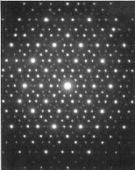
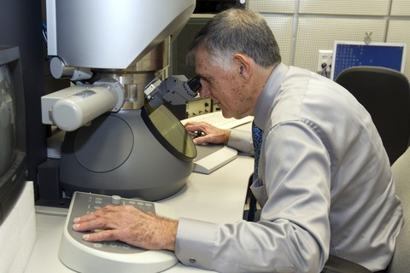
But in 1982 Daniel Shechtman has observed a crystal structure in Al-Mn alloy displaying 10 fold symmetry not invariant under translational symmetry.
Shechtman's is an interesting story, involving a fierce battle against established science, ridicule and mockery from colleagues and a boss who found the finding so controversial, he has been asked to leave the lab.
(Daniel Shechtman: Nobel Prize in Chemistry, 2011), Israel Institute of Technology (Technion)

Slide 4
A new definition for Crystal
“… By crystal we mean any solid having an essentially discrete diffraction diagram, and by aperiodic crystal we mean any crystal in which three dimensional lattice periodicity can be considered to be absent.”

Slide 6
Are QCs rare? QCs are not rare there are hundreds of them

Slide 7
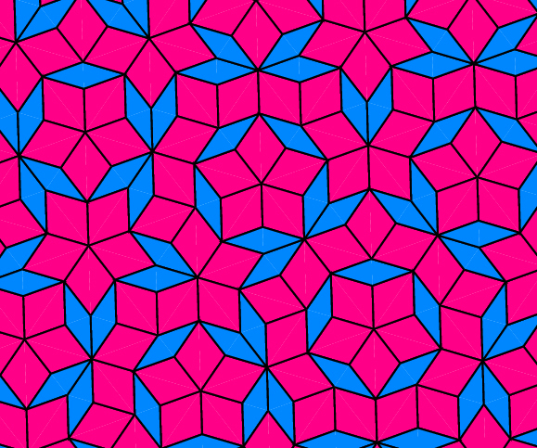
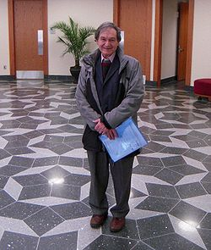
Mathematical Modelling
Penrose Tiling of the plane with 5-fold symmetry

Slide 9
The projected point set of the root lattice displays a generalized Penrose tiling with a point dihedral symmetry D₅ of order 10 which can be used for the description of the decagonal quasicrystals.
The projection of the Voronoi cell of the root lattice of A₄ describes a framework of nested decagrams growing with the power of the golden ratio recently discovered in the Islamic arts.
Note that the root and weight lattices of A₃ correspond to the face centered cubic (fcc) and body centered cubic (bcc) lattices respectively

Slide 10
A₃ Lattices

Slide 11


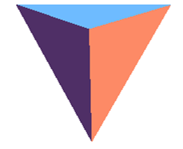



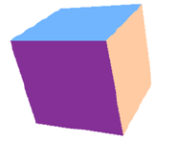

Orbits of W(A3)
Tetrahedron: (1,0,0)_{A3}
Cuboctahedron : (1,0,1)_{A3}
Octahedron : (0,1,0)_{A3}
Rhombic Dodecahedron
Wigner-Seitz Cell
Cube : (1,0,0)_{A3} + (0,0,1)_{A3}
Truncated Octahedron :
(1,1,1)_{A3}
Wigner-Seitz Cell for BCC

Slide 12
Construction of the affine Coxeter group A4 in terms of quaternions

Slide 13
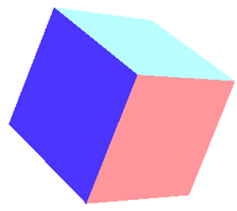

Slide 14
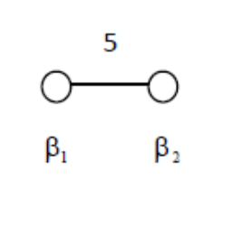
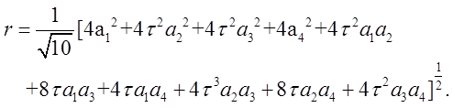
Orthogonal projection of the lattices onto the Coxeter plane and the decagonal quasicrystallography

Slide 16
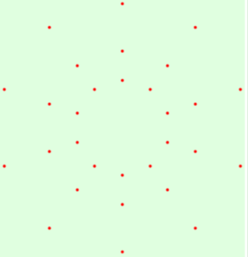
The root system of A4 projected onto the Coxeter plane
(a) root system (b) the polytope
The orthogonal projection of the Voronoi cell of the root lattice onto the Coxeter plane
(a) points (b) dual of the polytope (1,0,0,1)

Slide 17
Decagram point distributions

Slide 18
Orthogonal projection of the polytope (1,1,1,1)_{A4}

Slide 19
Orthogonal projection of the polytope (0,1,1,0)_{A4}

Slide 20
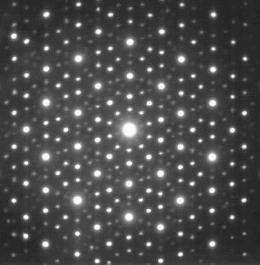
Electron diffraction pattern of an icosahedral Ho-Mg-Zn quasicrystal and A4 prediction

Slide 21
Icosahedral symmetry

Slide 22
A general technique for every Coxeter-Weyl Group

Slide 24


Some Examples

Slide 25
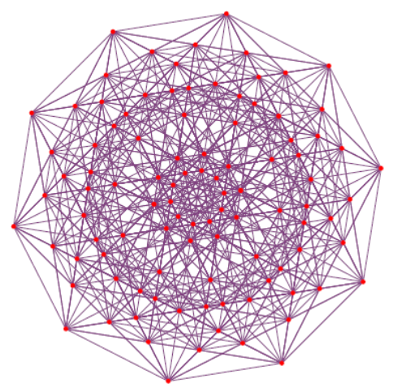
Some Examples

Slide 26
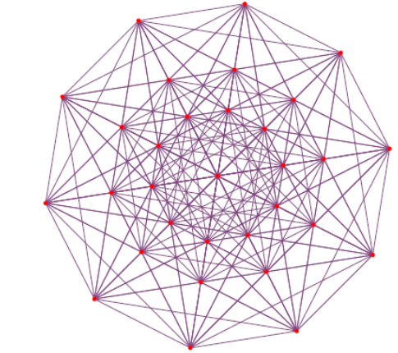
Some Examples

Slide 27
Some Examples

Slide 28
Some Examples

Slide 29
Projection into 3D space of H₃

Slide 34
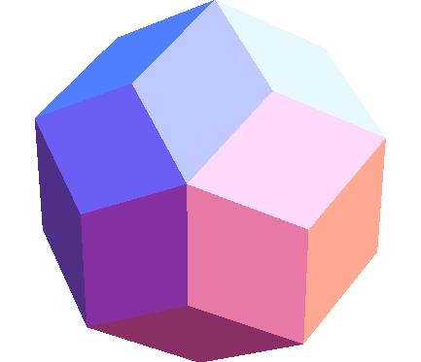

Slide 35
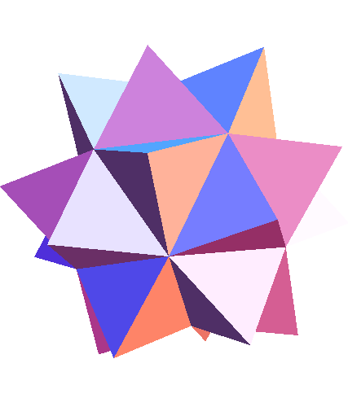

Slide 36
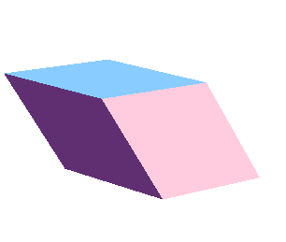

Tiling three dimensional space with two rhombohedra
Acute rhombohedron
Obtuse rhombohedron

Slide 37
Conclusion
The projection technique developed can be applied to any Coxeter group.
Projected points have the dihedral symmetry Dh of order 2h.
Quasicrystals possessing a dihedral symmetry of order 2h can be described by the appropriate Coxeter group.

