Slide 1
Rank 3-4 Coxeter Groups, Quaternions and Quasicrystals
Mehmet Koca
Department of Physics
College of Science
Sultan Qaboos University
Muscat-OMAN
kocam@squ.edu.om

Slide 2
References
Polyhedra obtained from Coxeter groups and quaternions. Koca M., Al-Ajmi M., Koc R. 11, November 2007, Journal of Mathematical Physics, Vol. 48.
Catalan solids derived from 3D-root systems and quaternions. Koca M., Koca N.O, Koc R. 4, s.l. : Journal of Mathematical Physics, 2010, Vol. 51.
Chiral Polyhedra Derived from Coxeter Diagrams and Quaternions, Mehmet Koca, Nazife Ozdes Koca and Muna Al-Shueili, ", arXiv:1006.3149 [pdf], SQU Journal for Science, 16 (2011) 63-82, 2011.

Slide 3
Outline
1. Rank-3 Coxeter Groups with Quaternions and Polyhedra
1.1. Rank-3 Coxeter Groups with Quaternions
1.2. Quaternionic construction of vertices of Platonic and Archimedean polyhedra with tetrahedral, octahedral and icosahedral symmetries
1.3. Catalan solids as duals of the Archimedean solids
1.4. Novel construction of chiral polyhedra and their duals.

Slide 4
Outline
2. Rank-4 Coxeter Groups with Quaternions and 4D polytopes

Slide 5
Outline
3. Quasicrystallography from higher dimensional lattices
3.1. Quasicrystals and aperiodic tiling of the plane
3.2. Maximal dihedral subgroups of the Coxeter groups
3.3. Projection of the lattices generated by the affine Coxeter groups onto the Coxeter plane
3.4. Affine A4 and decagonal quasicrystals
3.5. Affine D6 and Icosahedral quasicrystals
3.6. Conclusion

Slide 6
1.1. Rank-3 Coxeter Groups with Quaternions
O(4) transformations with quaternions

Slide 7
Reflections
Quaternions can be used to represent reflections and rotations in Coxeter Groups.
The reflection can be represented as:
ʌ
-α
α

Slide 8
Finite Subgroups of Quaternions

Slide 9
Finite Subgroups of Quaternions

Slide 10
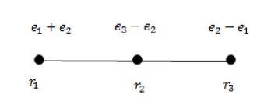


Coxeter Diagrams A3, B3 and H3 with quaternionic roots

Slide 11
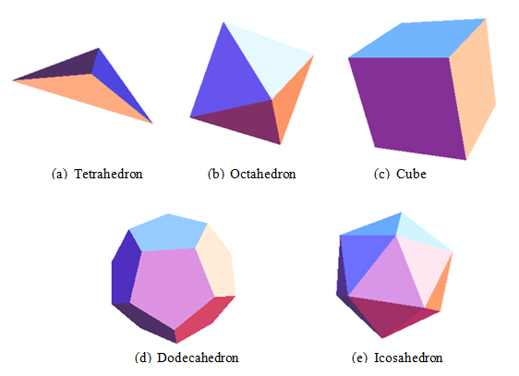
Platonic solids (regular polyhedra)
  Platonic solids are the five convex regular polyhedra. They consist of regular polygons (triangle, square or pentagon) meeting in identical vertices. They have identical faces of regular polygons and the same number of faces meeting at each corner
  In geometry, polyhedra are formed in pairs called duals, where the vertices of one correspond to the faces of the other. The dual of each platonic solid is another platonic solid:
  Tetrahedron is self dual
  Cube and Octahedron form a dual pair
  Dodecahedron and Icosahedron form
  a dual pair

Slide 12
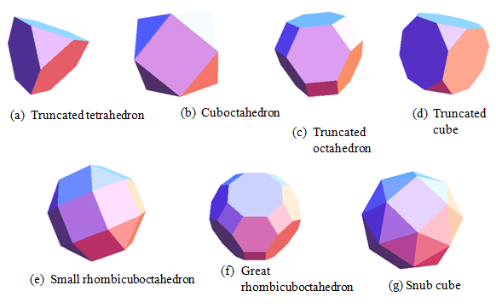
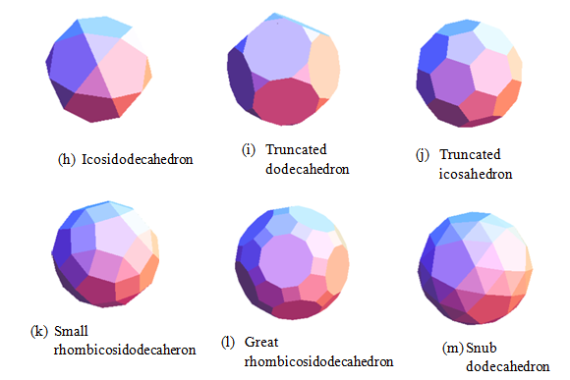
Archimedean Solids (semi-regular polyhedra)
  Two or more types of regular polygons meet in identical vertices.
  There are 13 Archimedean solids.
  7 of the Archimedean solids can be obtained by truncation of the platonic solids.
  4 of the Archimedean solids are obtained by expansion of platonic solids and previous Archimedean solids.
The remaining 2 chiral solids are snub cube and snub dodecahedron

Slide 13
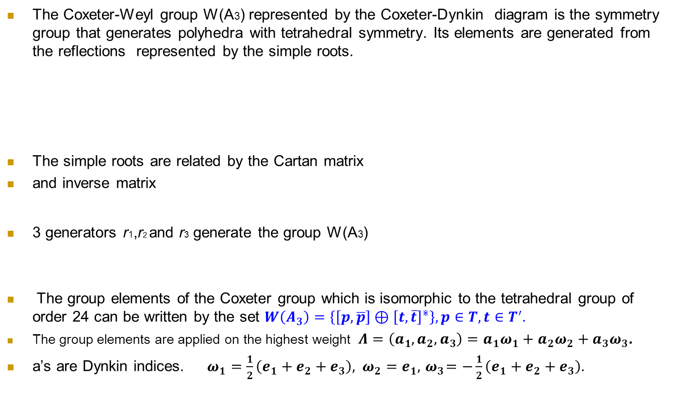


Construction of polyhedra with Tetrahedral Symmetry
,
,

Slide 14
A method used to construct the polyhedra
We construct polyhedra using a method based on applying the group elements of Coxeter-Weyl groups W(A3), W(B3) and W(H3) on a vector representing one vertex of the polyhedron in the dual space denoted as
This vector is called “highest weight” . It can be expressed as a linear combination of imaginary quaternionic units.
Certain choices of the parameters of the highest weight vector lead to the Platonic, Archimedean solids as well as the semi-regular polyhedra.
The set of vertices obtained by the action of Coxeter-Weyl group elements on the highest weight defines a polyhedron and is called the “orbit”.
Denote by W(G)(a₁a₂a₃)=(a₁a₂a₃)_{G} , the orbit of W(G)

Slide 15
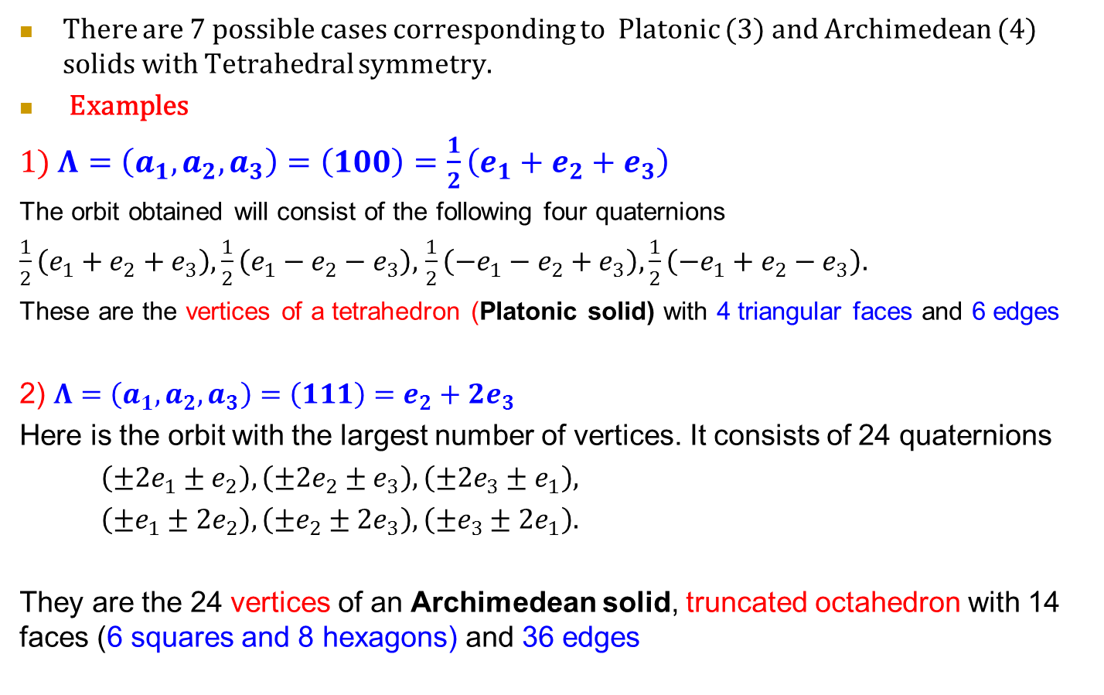
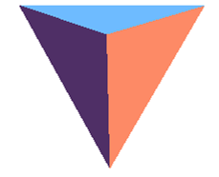

Construction of polyhedra with Tetrahedral Symmetry

Slide 16
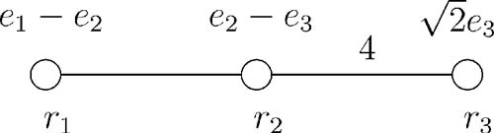
Construction of polyhedra with Octahedral Symmetry

Slide 17
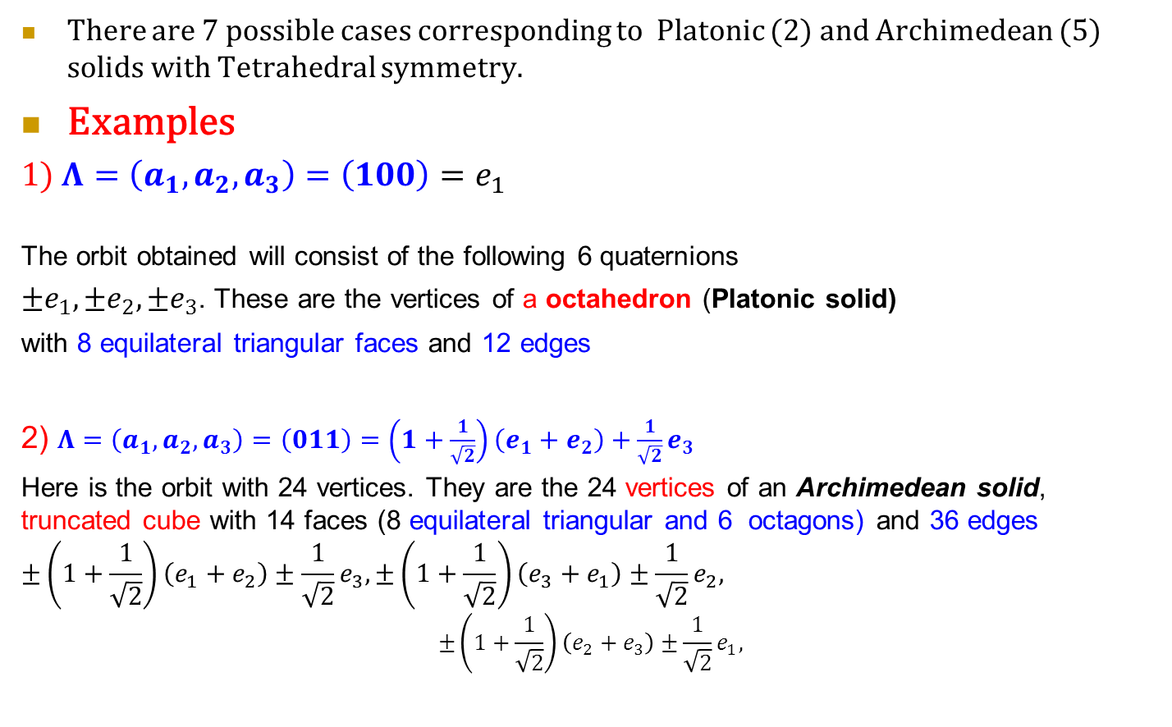
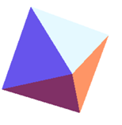
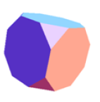
Construction of polyhedra with Octahedral Symmetry

Slide 18
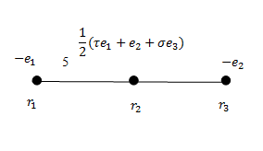
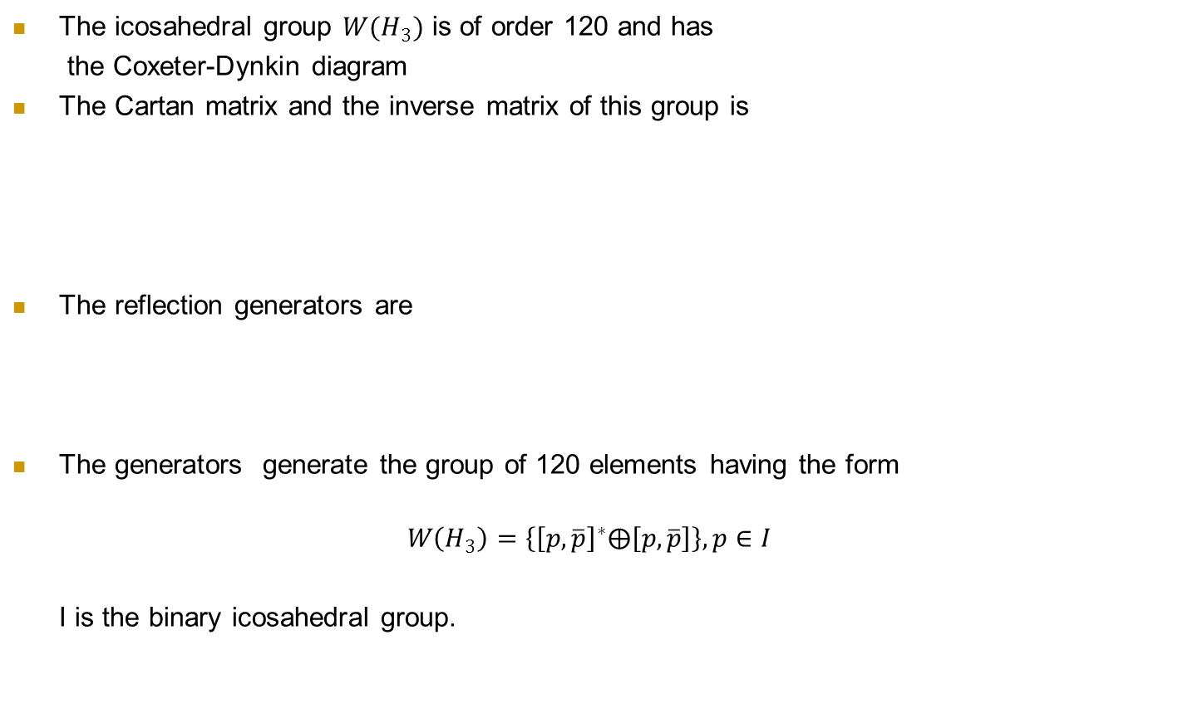
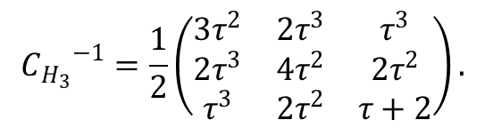
Construction of polyhedra with Icosahedral symmetry
$${C_{H_{3}}}^{−1}=\frac{1}{2}\left(\begin{matrix}3τ^{2} & 2τ^{3} & τ^{3} \\ 2τ^{3} & 4τ^{2} & 2τ^{2} \\ τ^{3} & 2τ^{2} & τ+2\end{matrix}\right).$$
$r_{1}={\left[e_{1}, −e_{1}\right]}^{∗},$$r_{2}={\left[\frac{1}{2}\left(τe_{1}+e_{2}+σe_{3}\right),− \frac{1}{2}(τe_{1}+e_{2}+σe_{3})\right]}^{∗}{, r}_{3}={\left[e_{2},{−e}_{2}\right]}^{∗}$.

Slide 19
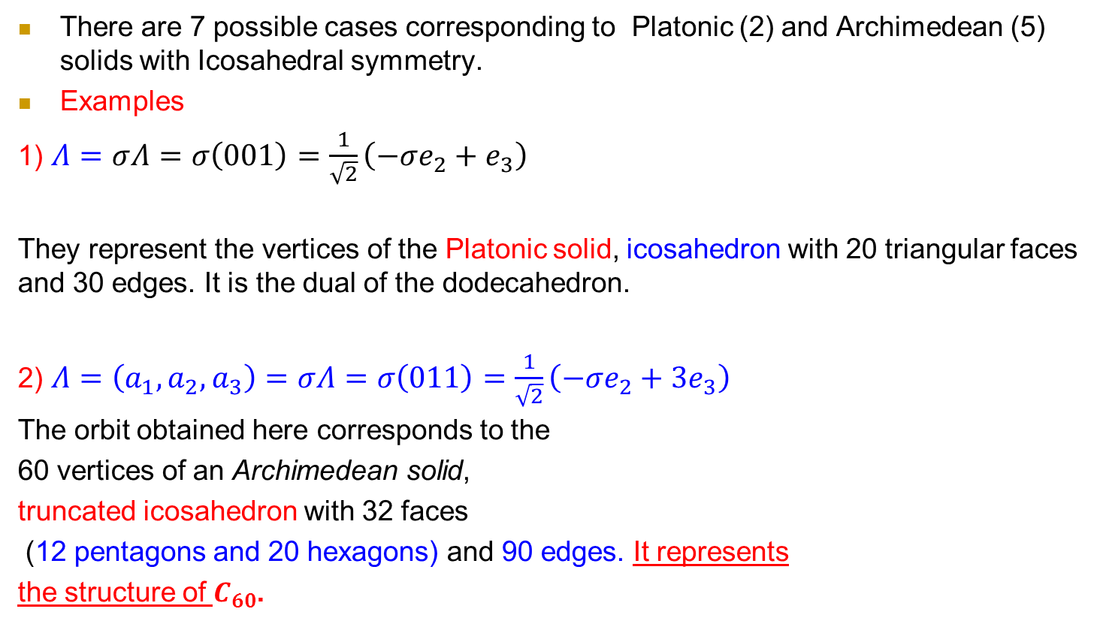
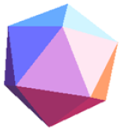

Construction of polyhedra with Icosahedral Symmetry

Slide 20
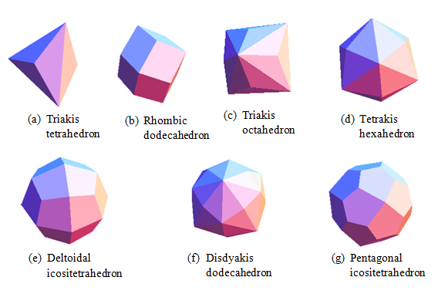
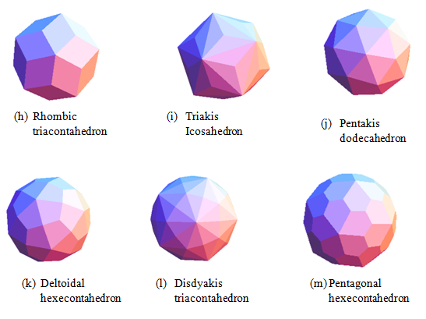
Catalan Solids (Duals of Archimedean Solids)
Face transitive (faces are transformed to each other by the Coxeter-Weyl group) .
Faces are non regular polygons: scalene triangles, isosceles triangles, rhombuses, kites or irregular pentagons. Two Catalan solids are Chiral.

Slide 21
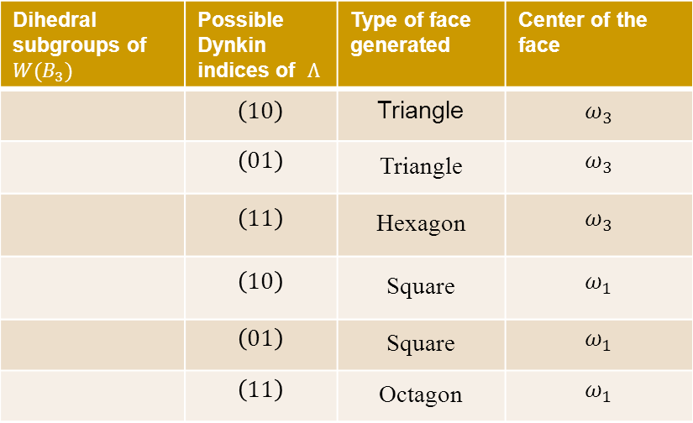


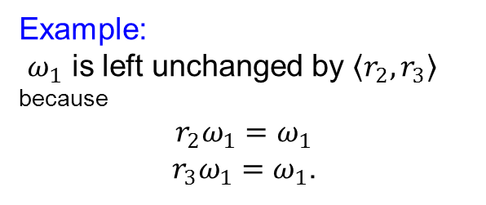
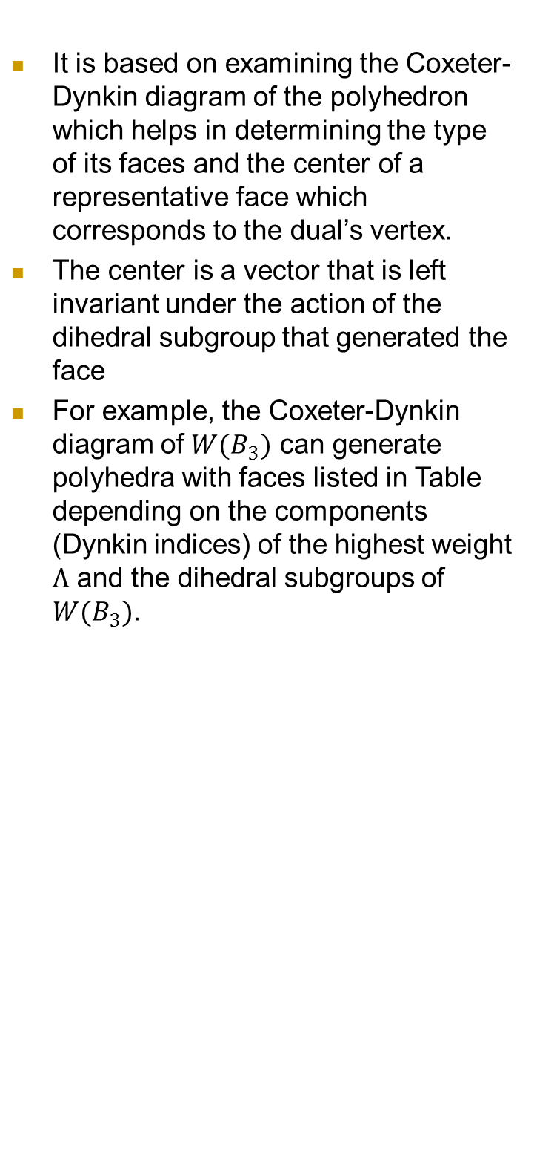
The method to generate the dual polyhedra
It is based on examining the Coxeter-Dynkin diagram of the polyhedron which helps in determining the type of its faces and the center of a representative face which corresponds to the dual’s vertex.
The center is a vector that is left invariant under the action of the dihedral subgroup that generated the face
For example, the Coxeter-Dynkin diagram of $W(B_{3})$ can generate polyhedra with faces listed in Table depending on the components (Dynkin indices) of the highest weight $Λ$ and the dihedral subgroups of $W(B_{3})$.
Example:
$ω_{1}$ is left unchanged by $〈r_{2},r_{3}〉$because
$$r_{2}ω_{1}=ω_{1 }$$
$r_{3}ω_{1}=ω_{1}$.

Slide 22
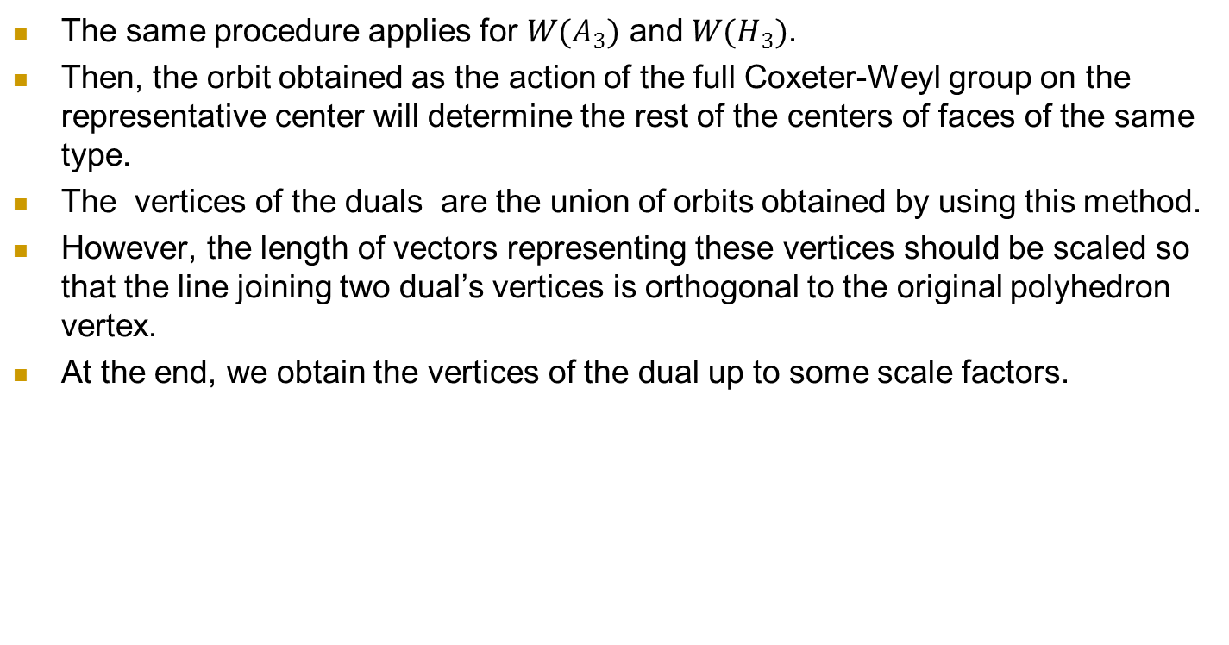
The method to generate the dual polyhedra

Slide 23
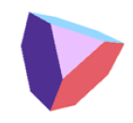


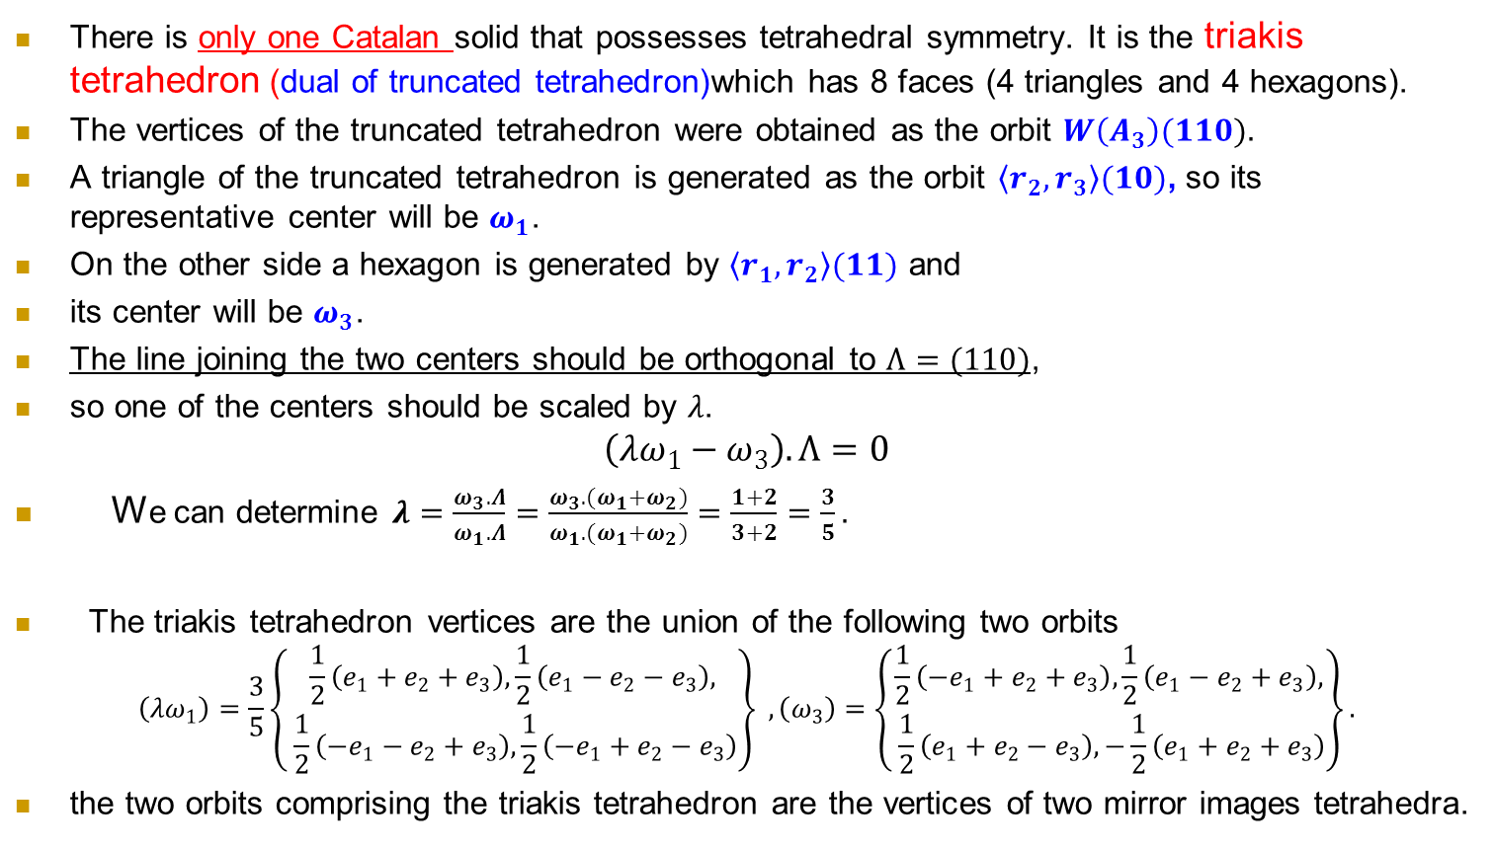
  Catalan Solid Possessing Tetrahedral Symmetry
There is only one Catalan solid that possesses tetrahedral symmetry. It is the triakis tetrahedron (dual of truncated tetrahedron)which has 8 faces (4 triangles and 4 hexagons).
The vertices of the truncated tetrahedron were obtained as the orbit $W\left(A_{3}\right)(110).$
A triangle of the truncated tetrahedron is generated as the orbit $〈r_{2},r_{3}〉(10)$, so its representative center will be $ω_{1}$.
On the other side a hexagon is generated by $〈r_{1},r_{2}〉(11)$and
its center will be $ω_{3}$.
The line joining the two centers should be orthogonal to $Λ=(110)$,
so one of the centers should be scaled by $λ$.
$$\left(λω_{1}−ω_{3}\right).Λ=0$$
We can determine $λ=\frac{ω_{3}.Λ}{ω_{1}.Λ}=\frac{ω_{3}.(ω_{1}+ω_{2})}{ω_{1}.(ω_{1}+ω_{2})}=\frac{1+2}{3+2}=\frac{3}{5}.$
The triakis tetrahedron vertices are the union of the following two orbits
$$\left(λω_{1}\right)=\frac{3}{5}\left\{\begin{aligned}\frac{1}{2}\left(e_{1}+e_{2}+e_{3}\right), \frac{1}{2}\left(e_{1}−e_{2}−e_{3}\right), \\ \frac{1}{2}\left({−e}_{1}−e_{2}+e_{3}\right),\frac{1}{2}\left(−e_{1}+e_{2}−e_{3}\right)\end{aligned}\right\} , \left(ω_{3}\right)=\left\{\begin{aligned}\frac{1}{2}\left(−e_{1}+e_{2}+e_{3}\right), \frac{1}{2}\left(e_{1}−e_{2}+e_{3}\right), \\ \frac{1}{2}\left(e_{1}+e_{2}−e_{3}\right),−\frac{1}{2}\left(e_{1}+e_{2}+e_{3}\right)\end{aligned}\right\}.$$
the two orbits comprising the triakis tetrahedron are the vertices of two mirror images tetrahedra.

Slide 24
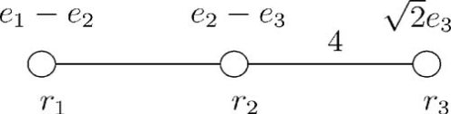



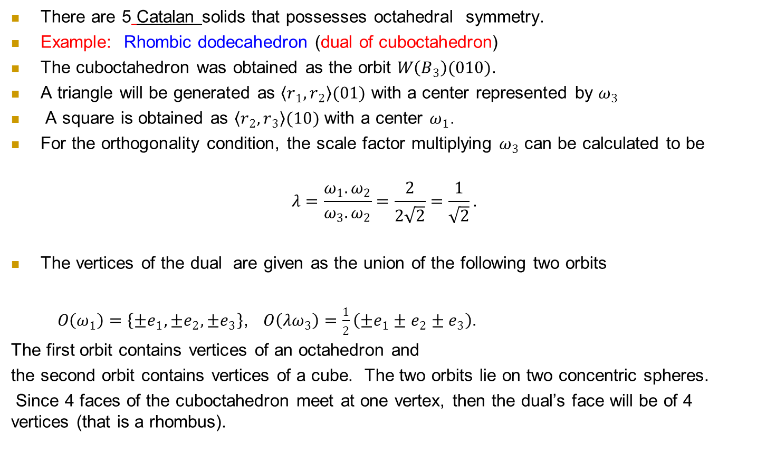
  Catalan Solid Possessing Octahedral Symmetry
There are 5Catalan solids that possesses octahedral symmetry.
Example:Rhombic dodecahedron (dual of cuboctahedron)
The cuboctahedron was obtained as the orbit $W\left(B_{3}\right)(010)$.
A triangle will be generated as $〈r_{1},r_{2}〉(01)$ with a center represented by $ω_{3}$
Asquare is obtained as $〈r_{2},r_{3}〉(10)$ with a center $ω_{1}$.
For the orthogonality condition, the scale factor multiplying $ω_{3}$ can be calculated to be
$$λ=\frac{ω_{1}.ω_{2}}{ω_{3}.ω_{2}}=\frac{2}{2\sqrt{2}}=\frac{1}{\sqrt{2}}\text{.}$$
The vertices of the dual are given as the union of the following two orbits
$O\left(ω_{1}\right)=\left\{±e_{1}, ±e_{2}, ±e_{3}\right\}$, $O\left(λω_{3}\right)=\frac{1}{2}\left(±e_{1}±e_{2}±e_{3}\right).$
The first orbit contains vertices of an octahedron and
the second orbit contains vertices of a cube. The two orbits lie on two concentric spheres.
Since 4 faces of the cuboctahedron meet at one vertex, then the dual’s face will be of 4 vertices (that is a rhombus).

Slide 25
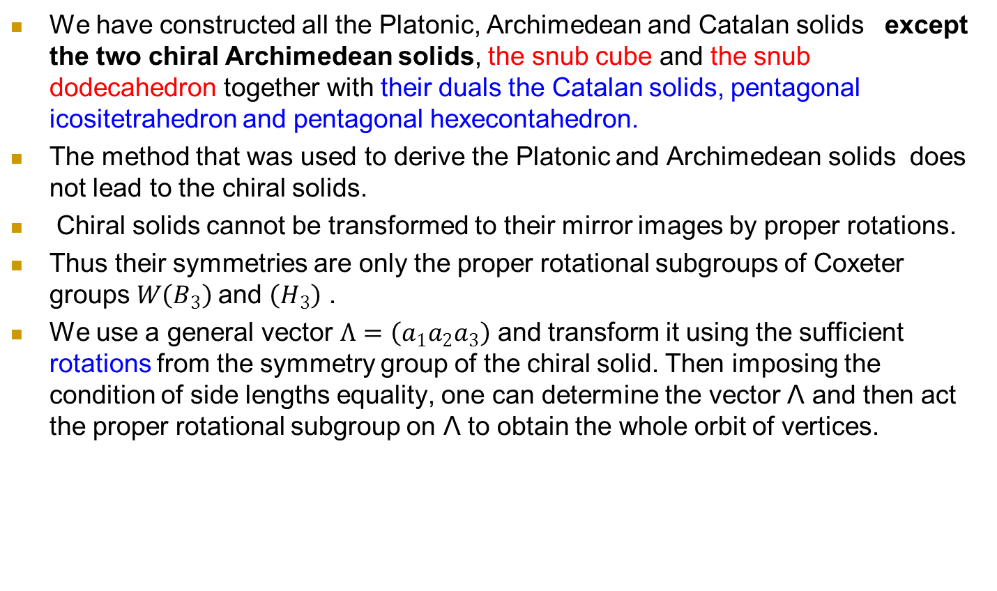
  Chiral Archimedean and Catalan solids

Slide 26
Chirality
Objects or molecules which cannot be superimposed with their mirror image are called chiral. Human hands are one of the example of chirality. Achiral (not chiral) objects are objects that are identical to their mirror image.
In three dimensional Euclidean space the chirality is defined as follows:
The object which can not be transformed to its mirror image by proper rotations and translations is called a chiral object.
Chirality is a very interesting topic in
i) molecular chemistry
A number of molecules display one type of chirality; they are either left-oriented or right-oriented molecules.
ii) In fundamental physics chirality plays very important role. For example:
  A massless Dirac particle has to be either in the left handed state or in the right handed state.
  The weak interactions which is described by the standard model of high energy physics is invariant under one type of chiral transformations

Slide 27
Snub Cube

Slide 28
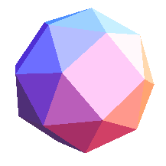
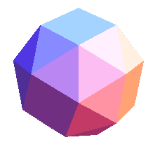
Snub Cube
The first vertex and its mirror image can be derived from the vector and can be written in terms of quaternionic units as deleting the overall scale factor the orbits can easily be determined as
The snub cubes represented by these sets of vertices are shown

Slide 29
Dual solid of the snub cube
We can determine the centers of the faces in figure below:
The faces 1 and 3 are represented by the vectors and up to some scale factors. is invariant under the rotation represented by r₁r₂ . In other words the triangle 3 is rotated to itself by a rotation around the vector .
The vectors representing the centers of the faces 2, 4 and 5 can be determined by averaging the vertices representing these faces and they lie in the same orbit under the proper octahedral group.
The vector representing the center of the face 2 is
The scale factors multiplying the vectors can be determined as and when represents the normal of the plane containing these five points .

Slide 30
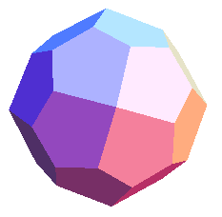
Dual solid of the snub cube
Then 38 vertices of the dual solid of the snub cube, the pentagonal icositetrahedron, are given in three orbits

Slide 31
Snub Dodecahedron
The proper rotational subgroup W(H₃)/C₂ is the simple finite subgroup of order 60.
They can be generated by the generators
Let be a general vector in the dual basis.
The following sets of vertices form a pentagon and an equilateral triangle with the respective square of edge lengths:
We have another vertex :
Let all edge lengths be the same.
The following equation is satisfied
The equation has the real solution

Slide 32
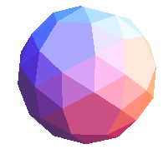
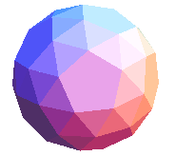
Snub Dodecahedron
The first orbit and its mirror image can be obtained from the vectors expressed in terms of quaternionic units as
The snub dodecahedrons represented by the orbits of these vectors are shown:

Slide 33
Dual solid of the snub dodecahedron
The vertices of the dual solid of the snub dodecahedron represented by can be given as the union of three orbits of the group W(H₃)/C₂.
The first orbit consists of 20 vertices of a dodecahedron.
The second orbit consists of 12 vertices of an icosahedron where
The third orbit involves the vertices including the centers of the faces 2, 4 and 5 where the vector is given by

Slide 34
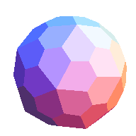
Dual solid of the snub dodecahedron
Applying the group on the vector one generates an orbit of size 60.
The 92 vertices consisting of these three orbits constitute dual solid of the snub dodecahedron, pentagonal hexecontahedron. It is one of the face transitive Catalan solid which has 92 vertices, 180 edges and 60 faces.

Slide 35
Summary
In this work a systematic construction of all Platonic, Archimedean and Catalan solids and chiral polyhedra, the snub cube, snub dodecahedron and their duals have been presented.
The Coxeter diagrams A₃, B₃ and H₃ were used to represent the symmetries of the polyhedra.
A number of programs were developed to generate Coxeter group elements in terms of quaternions, quaternionic vertices of polyhedra and to plot the polyhedra.

