Slide 1
Testing for Equality of means of two populations

Slide 2
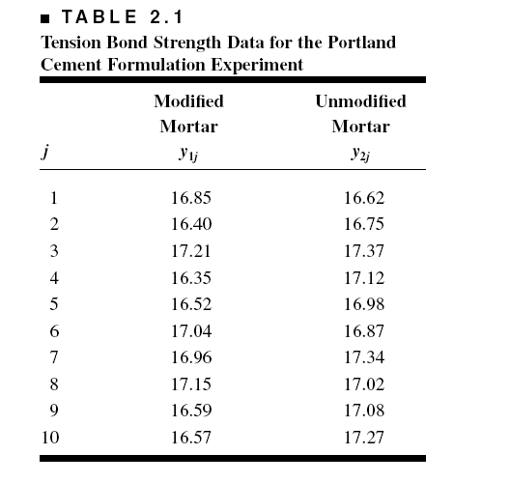
Portland Cement Formulation

Slide 3
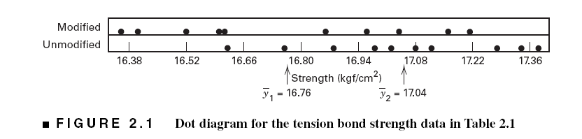
Graphical View of the Data
Dot Diagram

Slide 4
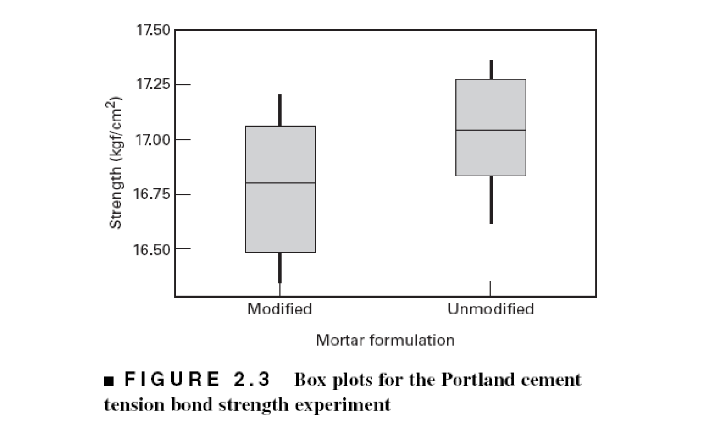
Box Plots, Figure 2.3, Section 2.2

Slide 5
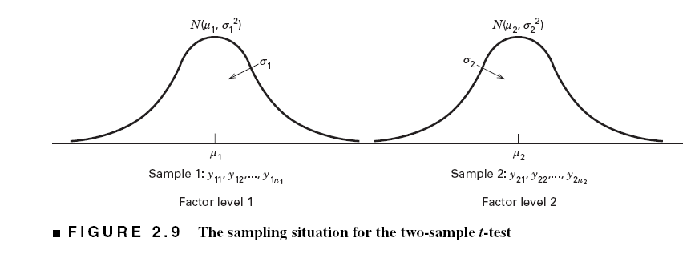
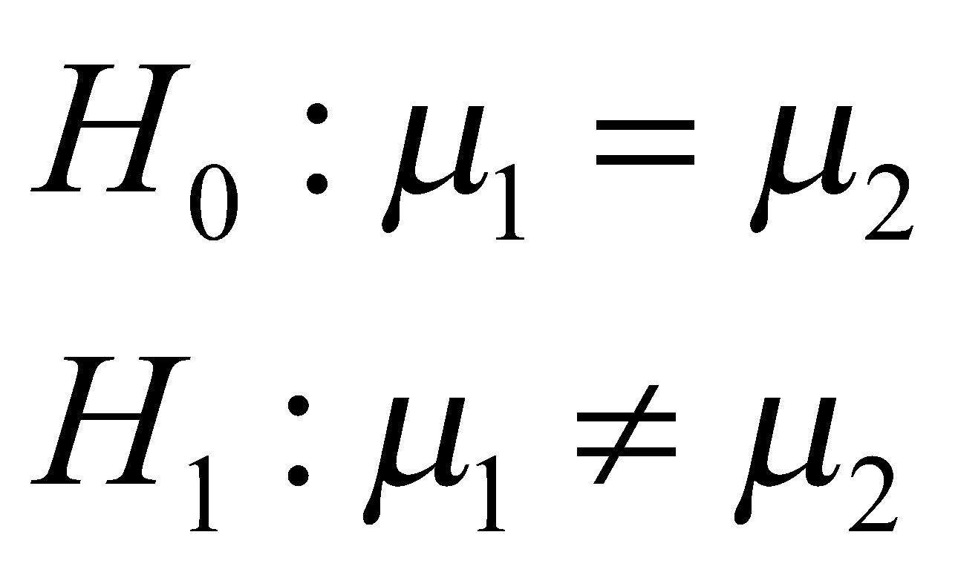
The Hypothesis Testing Framework
Sampling from a normal distribution
Statistical hypotheses:

Slide 6
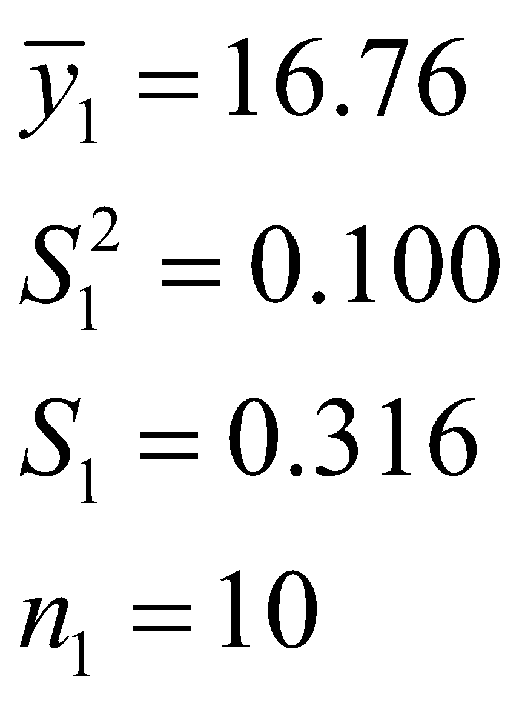
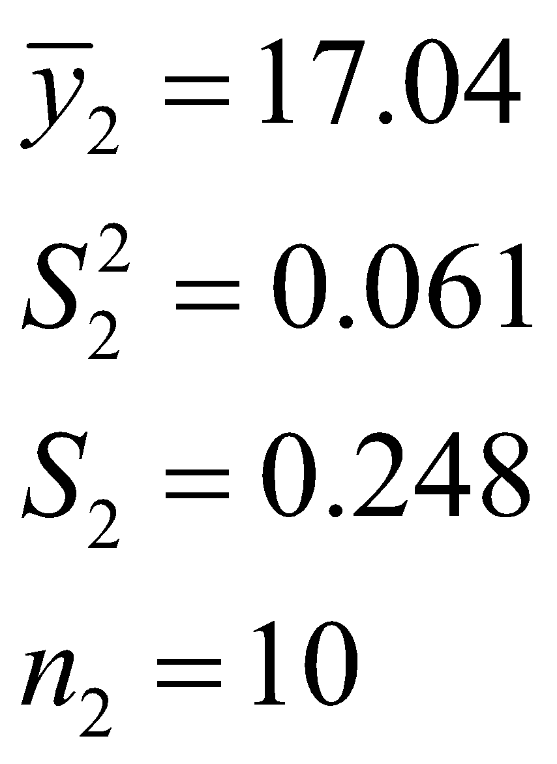
Summary Statistics
Modified Mortar
“New recipe”
Unmodified Mortar
“Original recipe”

Slide 7
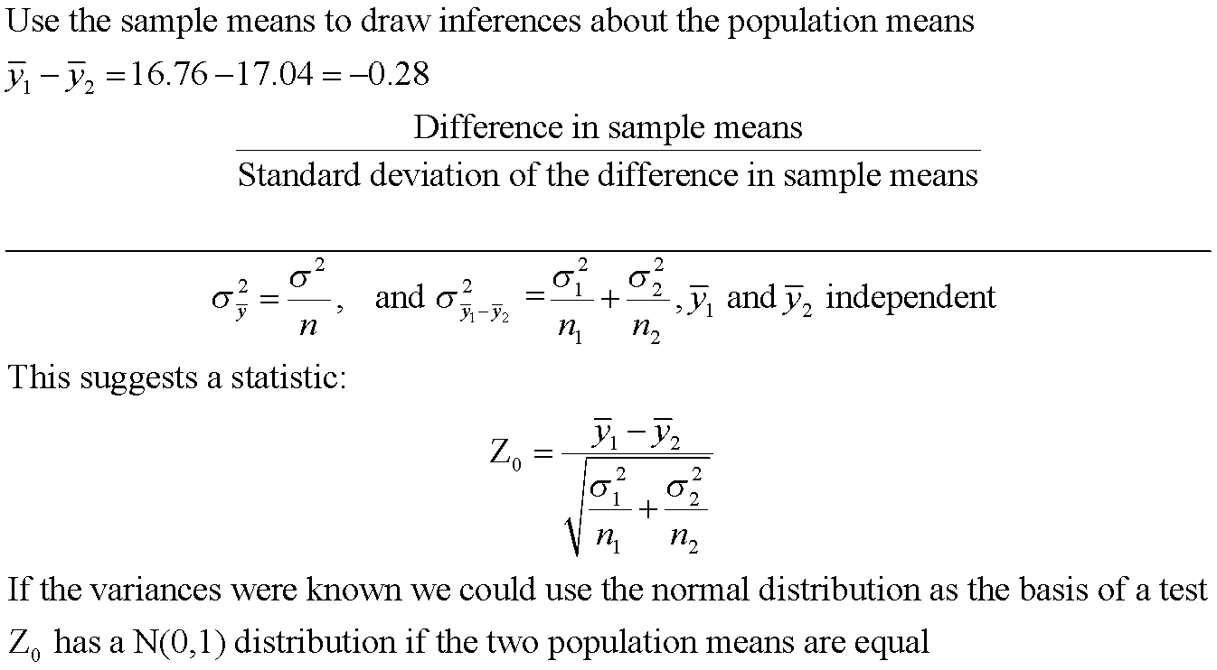
How the Two-Sample t-Test Works:

Slide 8
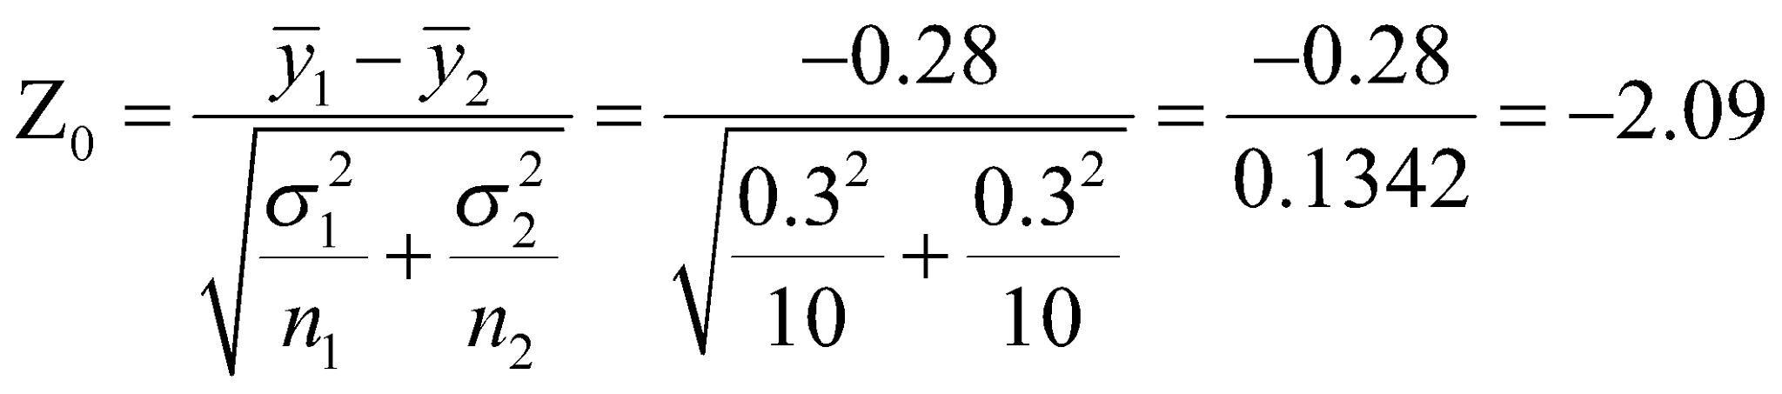

If we knew the two variances how would we use Z₀ to test H₀?
Suppose that σ₁ = σ₂ = 0.30. Then we can calculate
How “unusual” is the value Z₀ = -2.09 if the two population means are equal?
It turns out that 95% of the area under the standard normal curve (probability) falls between the values Z_{0.025} = 1.96 and - Z_{0.025} = -1.96.
So the value Z₀ = -2.09 is pretty unusual in that it would happen less that 5% of the time if the population means were equal

Slide 9
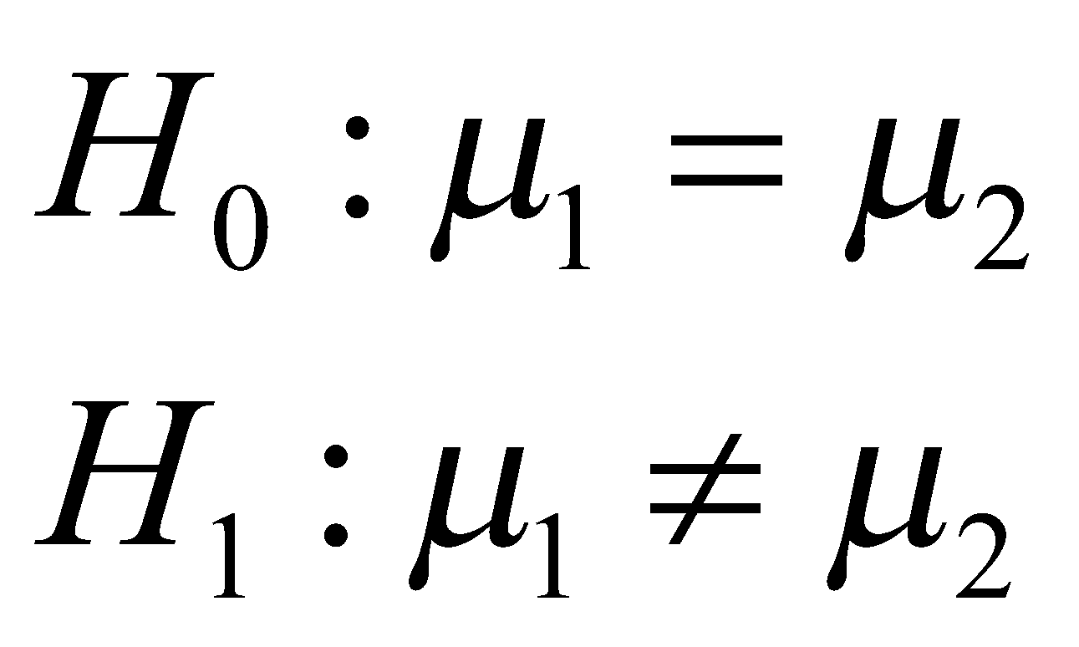
So if the variances were known we would conclude that we should reject the null hypothesis at the 5% level of significance
and conclude that the alternative hypothesis is true.
This is called a fixed significance level test, because we compare the value of the test statistic to a critical value (1.96) that we selected in advance before running the experiment.
The standard normal distribution is the reference distribution for the test.
Another way to do this that is very popular is to use the P-value approach. The P-value can be thought of as the observed significance level.
For the Z-test it is easy to find the P-value.

Slide 10
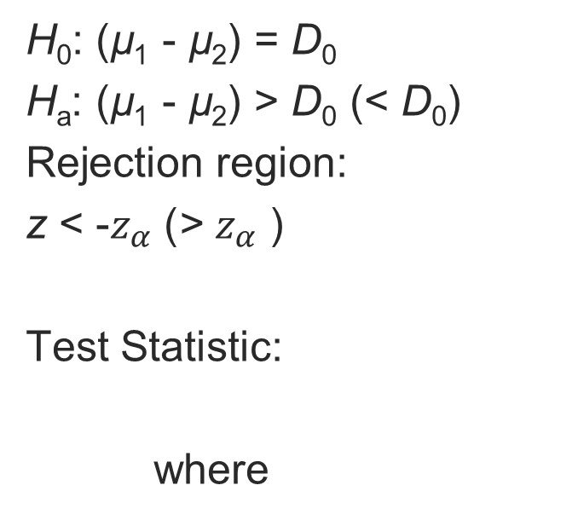
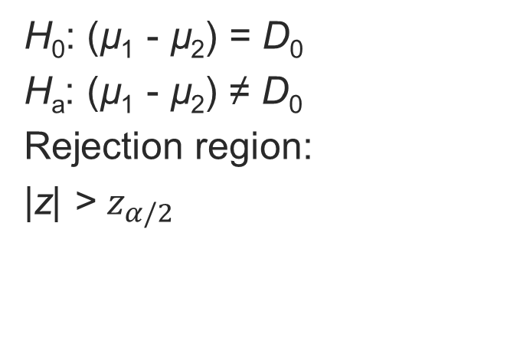
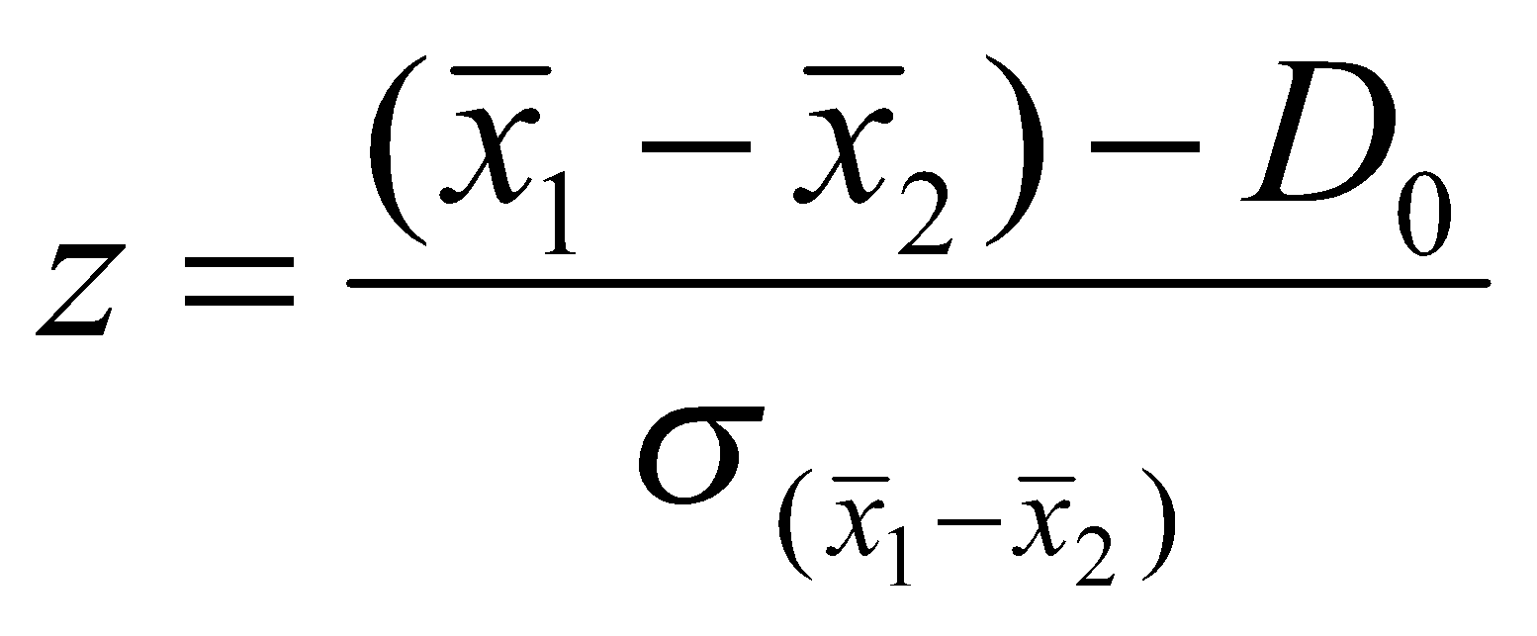
Comparing Two Population Means: Independent Sampling
One-Tailed Test
Two-Tailed Test

Slide 11
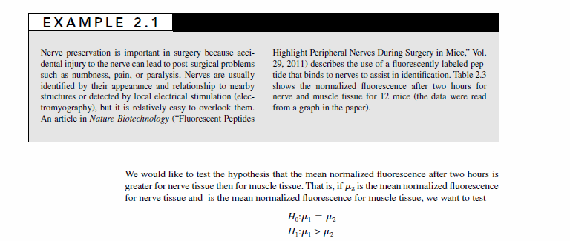
What if the Two Variances are Different?

Slide 12
Comparing Two Population Means: Independent Sampling
Conditions Required for Valid Large-Sample Inferences about (µ₁ - µ₂)
1. The two samples are randomly and independently selected from the target populations.
2. The sample sizes are both ≥ 30.

Slide 13
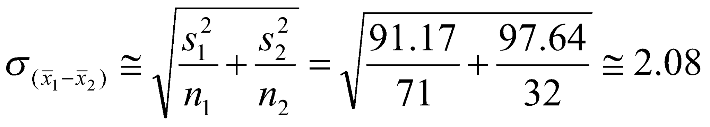
Comparing Two Population Means: Independent Sampling
We want to test the hypothesis that there is no significant difference in retention at privates and publics.
Private Colleges
Public Universities
n: 71
Mean: 79.37
Standard Deviation: 9.45
Variance: 91.17
n: 32
Mean: 84
Standard Deviation: 9.88
Variance: 99.44

Slide 14
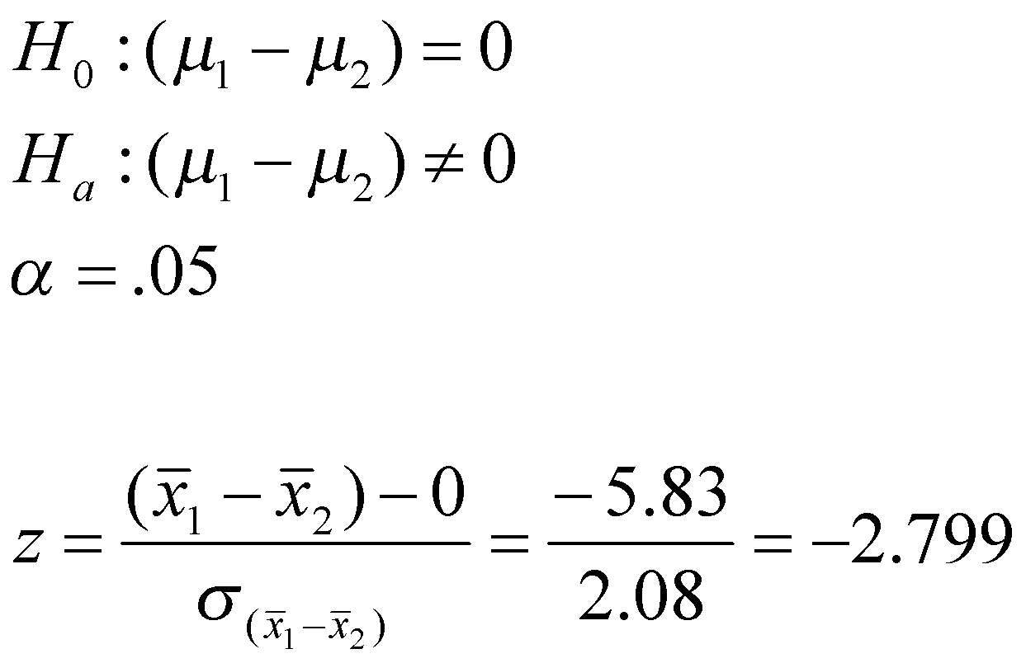
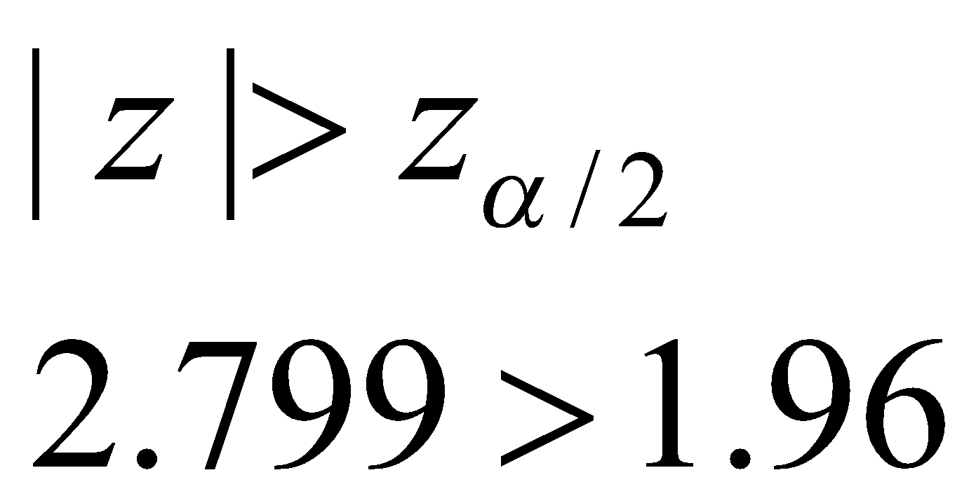
Comparing Two Population Means: Independent Sampling
Test statistic:
Reject the null hypothesis:

Slide 15
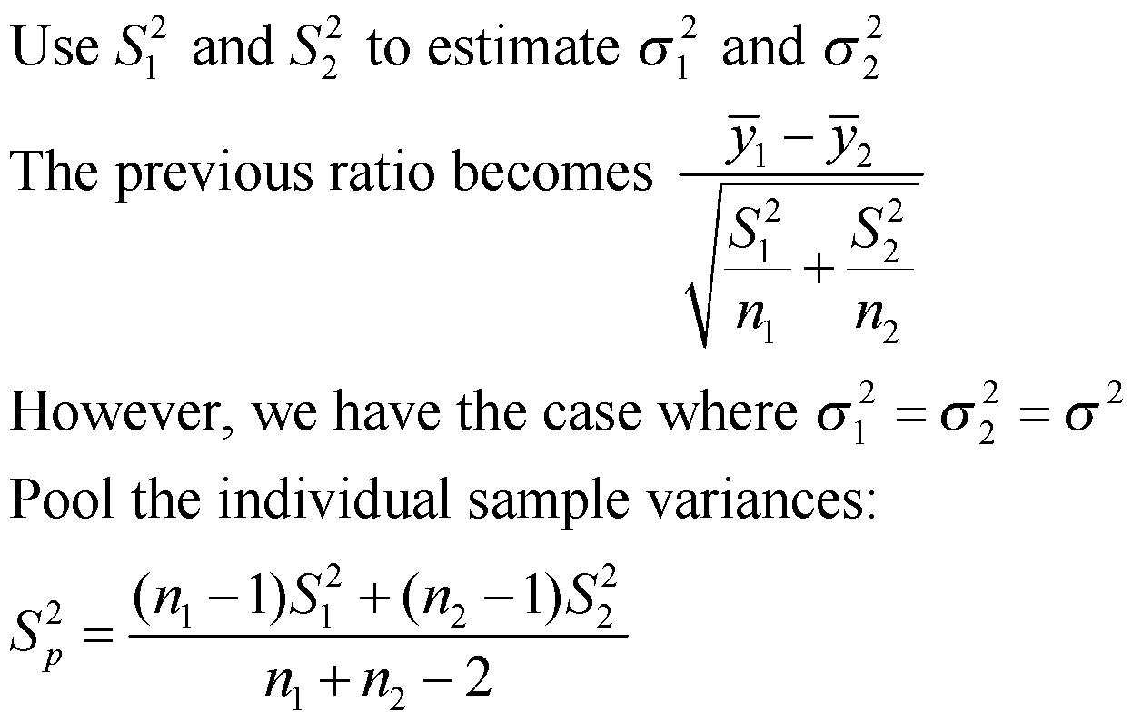
How the Two-Sample t-Test Works:

Slide 16
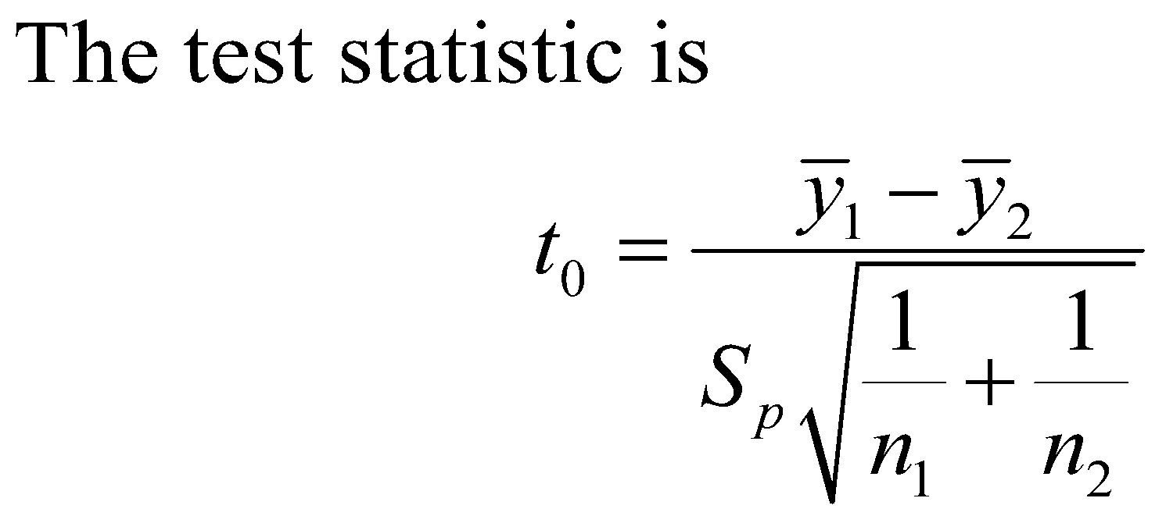
How the Two-Sample t-Test Works:
Values of t₀ that are near zero are consistent with the null hypothesis
Values of t₀ that are very different from zero are consistent with the alternative hypothesis
t₀ is a “distance” measure-how far apart the averages are expressed in standard deviation units
Notice the interpretation of t₀ as a signal-to-noise ratio

Slide 17
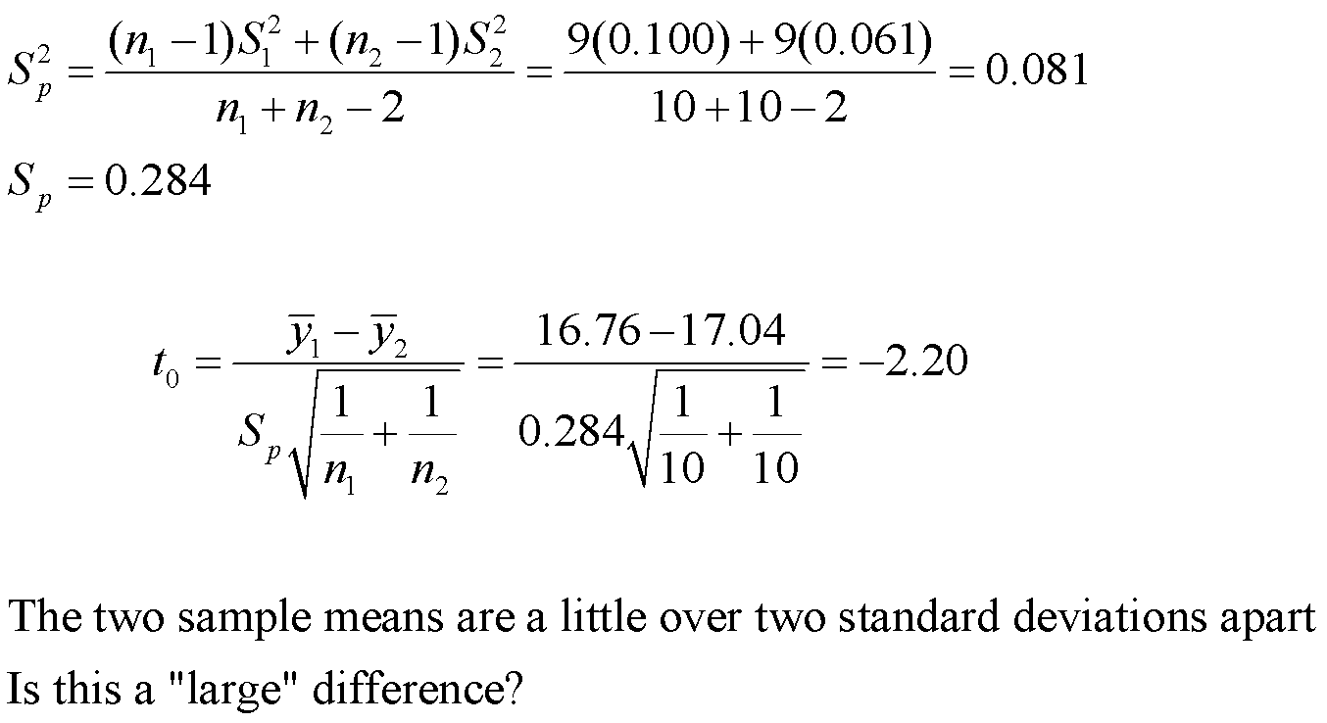
The Two-Sample (Pooled) t-Test

Slide 18
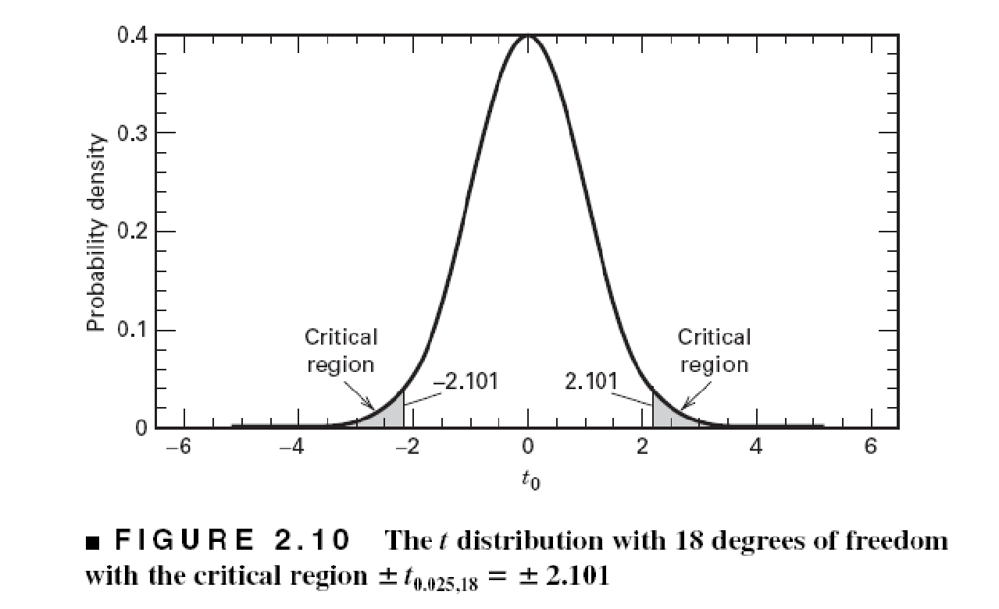
The Two-Sample (Pooled) t-Test
A value of t₀ between –2.101 and 2.101 is consistent with equality of means
It is possible for the means to be equal and t₀ to exceed either 2.101 or –2.101, but it would be a “rare event” … leads to the conclusion that the means are different
Could also use the P-value approach
t₀ = -2.20

Slide 19
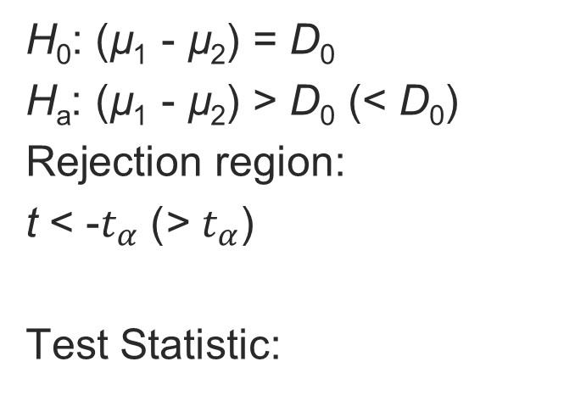

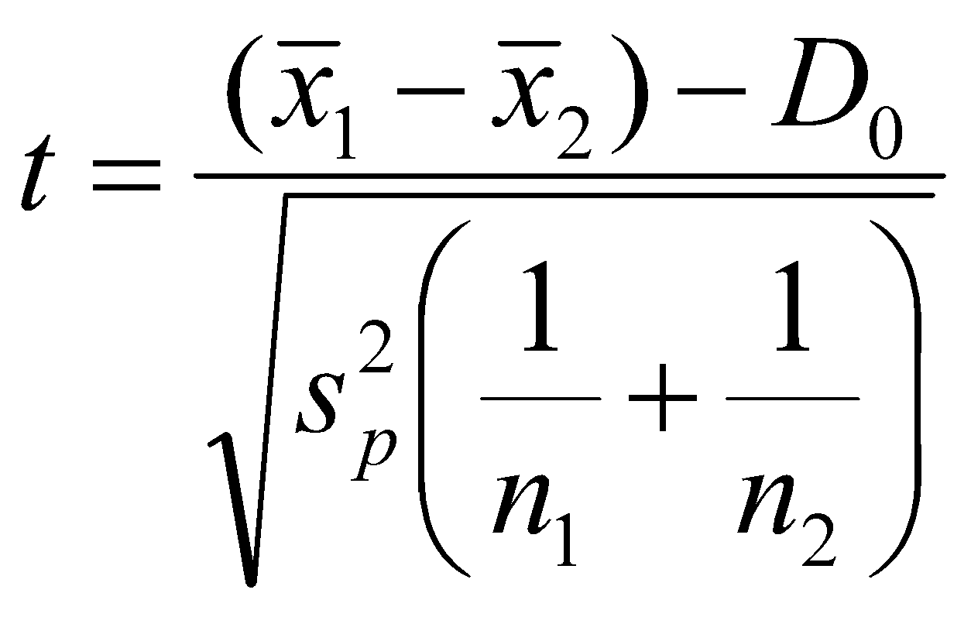
Comparing Two Population Means: Independent Sampling
One-Tailed Test
Two-Tailed Test

Slide 20
Comparing Two Population Means: Independent Sampling
Conditions Required for Valid Small-Sample Inferences about (µ₁ - µ₂)
1. The two samples are randomly and independently selected from the target populations.
2. Both sampled populations have distributions that are approximately normal.
3. The population variances are equal.

Slide 21
Comparing Two Population Means: Independent Sampling
Does class time affect performance?
  The test performance of students in two sections of international trade, meeting at different times, were compared.
8:00 a.m. Class
Mean: 78
Standard Deviation: 14
Variance: 196
n: 21
9:30 a.m. Class
Mean: 82
Standard Deviation: 17
Variance: 289
n: 21
With α = .05, test H₀ : µ₁ = µ₂

Slide 22
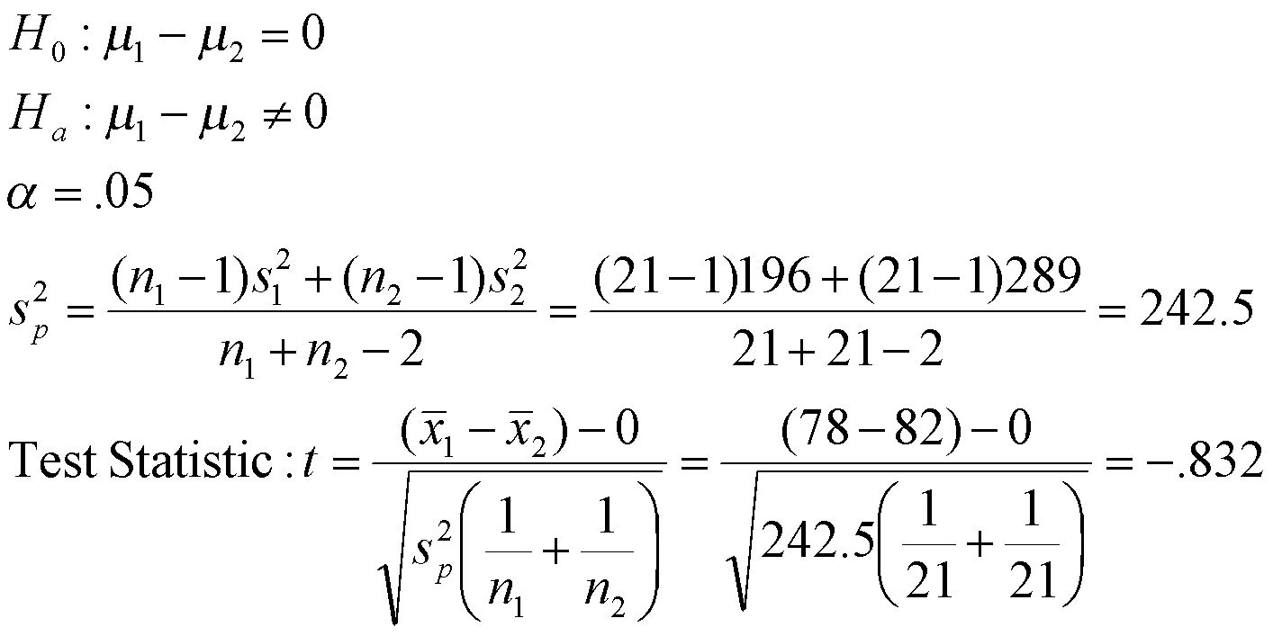
Comparing Two Population Means: Independent Sampling
8:00 a.m. Class
Mean: 78
Variance: 196
n: 21
9:30 a.m. Class
Mean: 82
Variance: 289
n: 21

Slide 23
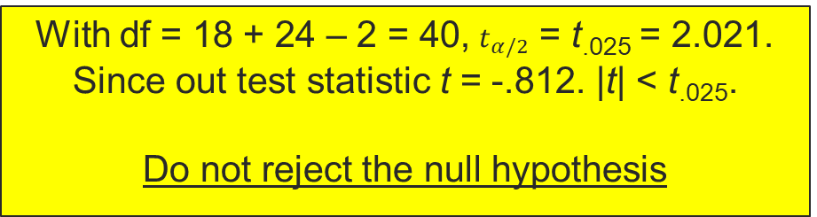
Comparing Two Population Means: Independent Sampling
8:00 a.m. Class
Mean: 78
Variance: 196
n: 21
9:30 a.m. Class
Mean: 82
Variance: 289
n: 21

Slide 24
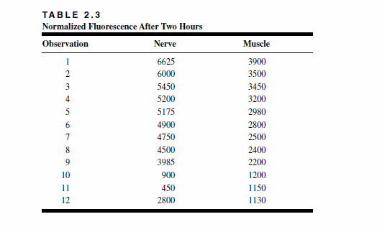
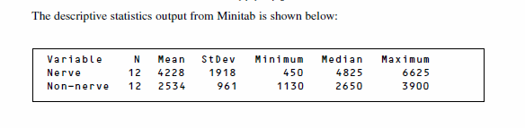
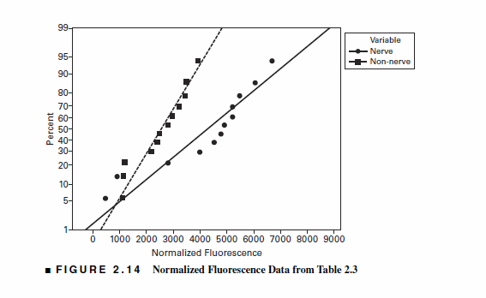

Slide 25
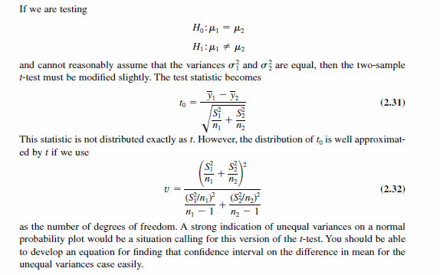


Slide 26
