Slide 1
Synchronization in Epilepsy and Schizophrenia
Kaushik Majumdar
Indian Statistical Institute
8th Mile, Mysore Road
Bangalore 560059
https://sites.google.com/site/isicng/
Workshop on “Cognition, Emotion and Computing,” Infosys Limited, Bangalore, 30 April 2013

Slide 2
Cognition
Cognition is a combination of perception and action.
http://angel0701.hubpages.com/hub/how-much-alike-are-monkeys-and-humans

Slide 3
Cognition and Computing
Cortical oscillations
Grandmother neuron
Binding problem
Time-frequency analysis
Spike detection and sorting
Synchronization
Correlation
Coherence

Slide 4
Cortical Oscillation in Memory Formation
Phase synchrony at around 40 Hz between rhinal cortex and hippocampus is implicated in declarative memory formation.
Fell et al. Nature Neurosci., 4: 1259-1264, 2001.
http://www.bristol.ac.uk/synaptic/pathways/

Slide 5
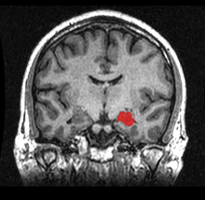
Grandmother Neuron
Quiroga et al. Nature, 435: 1102 – 1107, 2005
http://en.wikipedia.org/wiki/Hippocampus

Slide 6
Broadmann’s Areas
linguisticsandbeyond.wordpress.com

Slide 7
Binding Problem
Engel et al. Nat. Rev. Neurosci., 2: 704-716, 2001

Slide 8
Superposition of Signals

Slide 9
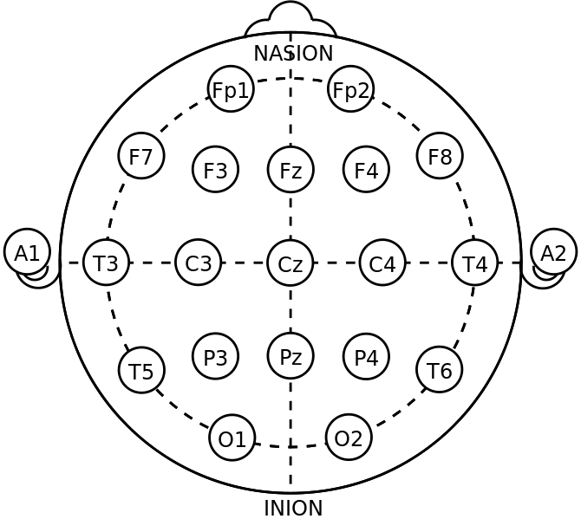
Excessive Synchronization
3 Hz synchronous pattern of absence seizure.
http://en.wikipedia.org/wiki/File:21_electrodes_of_International_10-20_system_for_EEG.svg
http://brain.fuw.edu.pl/~suffa/Modeling_SW.html

Slide 10
Facts About Epilepsy
1% of the world population have epilepsy.
Over 50% can successfully be treated by anti-epileptic drugs, albeit in many cases with severe side effects.
25% do not respond to drugs.
8-10% are treatable only by surgical intervention.
Surgery may have side effects.

Slide 11
Epilepsy Surgical Evaluation
Structural MRI
Intracranial EEG
http://teddybrain.wordpress.com/2013/02/02/clinical-presentation-electroencephalography-eeg-and-mri-of-mesial-temporal-lobe-epilepsy-mtle/
http://www.downstate.edu/epilepsy/intracranial.html

Slide 12
Synchronization in Focal Channels During Seizure
Majumdar et al. Brain Topography, available online at http://link.springer.com/article/10.1007/s10548-013-0284-z.

Slide 13
Amplitude Correlation Across Focal Channels During Seizure
Majumdar et al. Brain Topography, available online at http://link.springer.com/article/10.1007/s10548-013-0284-z.

Slide 14
Seizure Termination Through Excessive Synchronization
Hypothesis
Synchronous firing
CO₂ formation
Reduced excitation & enhanced inhibition
Extracellular acidity
Seizure termination

Slide 15
Hallucination in Schizophrenia
Hallucination in schizophrenia is most often auditory. Patients with schizophrenia hear voices which no one else can hear.
Auditory hallucination experiment.

Slide 16
Synchronization Snapshots
310 ms after stimuli onset
Normal control
Schizophrenia patient
Prasad et al. unpublished work, 2012.

Slide 17
Ensemble Synchronization on Whole Hemisphere
Normal control
Schizophrenia patient
Prasad et al. unpublished work, 2012.

Slide 18
Synchronization vs. Response Latency
Prasad et al. unpublished work, 2012.

Slide 19
Separation Results
Prasad et al. unpublished work, 2012.

Slide 20
THANK YOU

