Slide 1
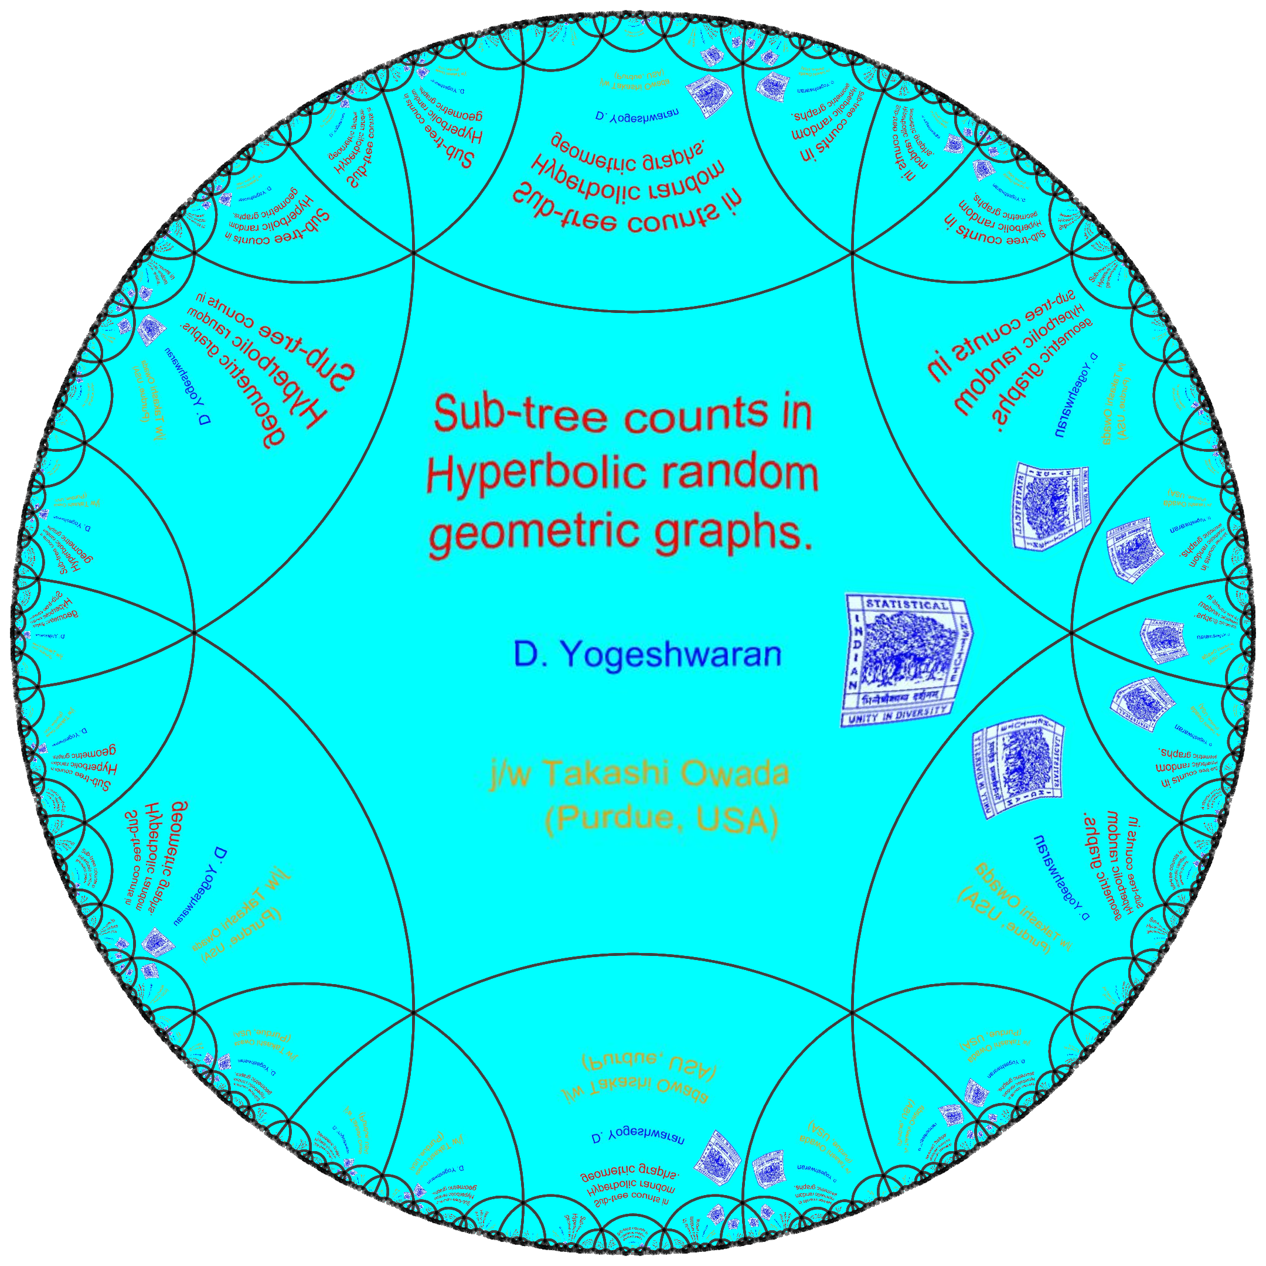
arXiv : 1802.06105

Slide 2
Random geometric graphs
Mn - Increasing compact metric (finite)measure spaces
Throw `n’ points at random in Mn
Connect any two points within a distance ‘rn’.
Study asymptotics as n increases.
Well-studied cases :
Compact Euclidean d-dimensional subsets. Penrose (2003).
`Nice’ compact manifolds. Penrose-Yukich (2013), Bobrowski-Mukherjee (2016)
What more interesting spaces ?

Slide 3
Our work in five lines !
Mn - Sequence of increasing balls in d- Poincare ball, a canonical model of hyperbolic space.
Throw Poisson (n) points (not necessarily uniform).
Connect any two points with distance less than the radius of the ball.
Count number of copies of a fixed tree.
Study Expectation, Variance and CLT.
Oft-studied cases :
Compact Euclidean d-dimensional subsets. Penrose (2003).
`Nice’ compact manifolds. Penrose-Yukich (2013), Bobrowski-Mukherjee (2016)

Slide 4
There is really no good way to introduce
Hyperbolic geometry
in a few, self-contained, slides !

Slide 5
Poincare Ball
d-dimensional unit ball with metric given by
How to understand the metric ?
Path length :
Metric :
“It takes more time to travel near the boundary than the centre.”

Slide 6
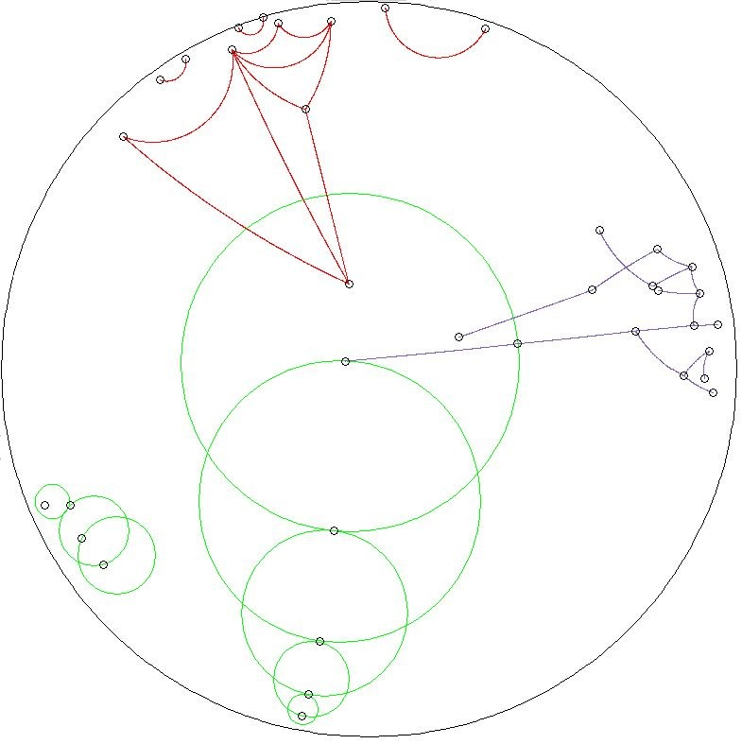
Geodesic
line segments.
Unit
length
Geodesics.
Unit
Radii
Circles.

Slide 7
Hyperbolic Polar co-ordinates
Hyperbolic radii
Volume of hyperbolic ball.
Uniform radial density.
Uniform angular density.

Slide 8
Hyperbolic random geometric graphs
The graph
Vertex set :
Edge set :

Slide 9
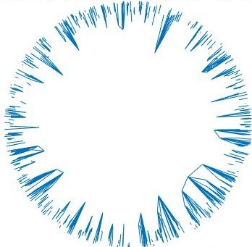
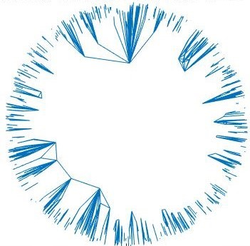
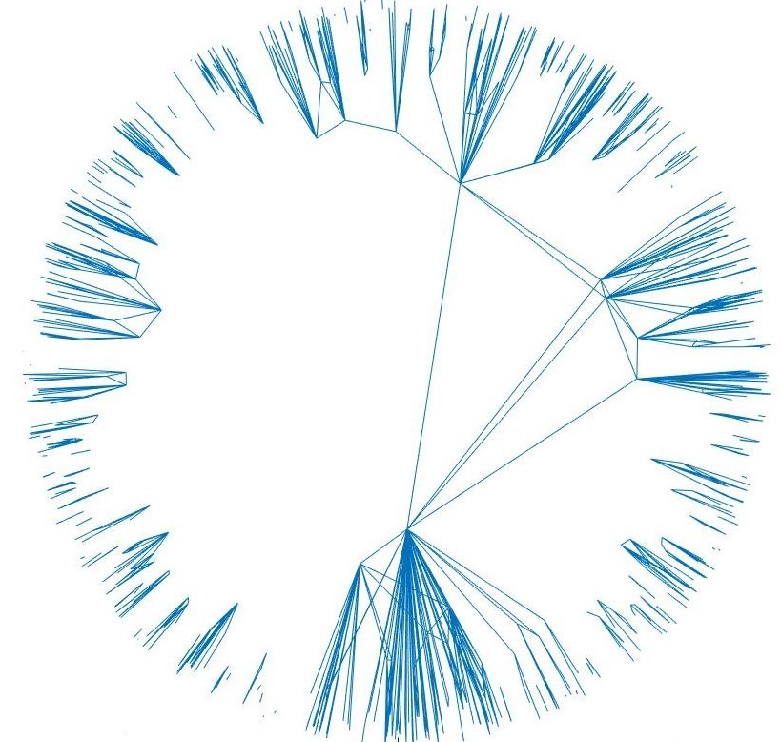
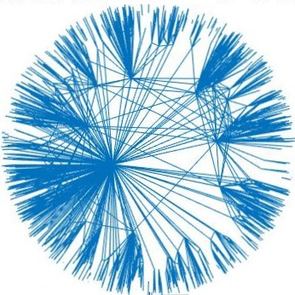
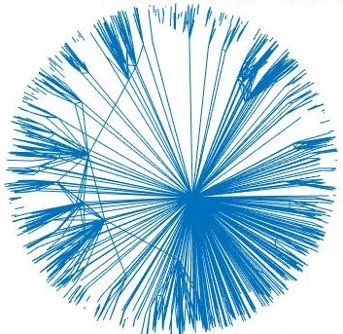

Slide 10
Features of Hyperbolic random geometric graphs
Introduced by Krioukov et al. (2010) - KPKVB Model in d = 2.
Observations :
Some literature
N. Fountalakis
E. Candellero
T. Muller
M. Bode
M. Kiwi
D. Mietsche et al..
Connectivity,
Percolation,
Typical distances
Diameter.
Sparsity
Small-worldness
Clustering
Power-law degree distribution
Phase transition at
Tree-like structures
?

Slide 11
What do we do ?
Sub-tree counts
Only special case here :
Candellero-Fountoulakis (2016) :
(For special case and d = 2.)
More precise asymptotic for the case k = 2 (edges), 3 (degree 2 vertices)
and Binomial model in d =2.

Slide 12
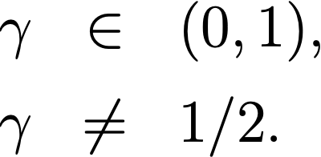
Expectation Asymptotics
Only special case here :
Theorem 1 :
More hyperbolic, boundary effects dominate !

Slide 13
Variance asymptotics
Theorem 2 :
Power-law behaviour.

Slide 14
Central Limit Theorem
Theorem 3 :
via Malliavin-Stein bound of
Last-Peccati-Schulte (2016).

Slide 15
Some remarks
Earlier Works :
Mostly expectation and first-order results.
Many consider the Binomial model - a type of random connection model.
Our set-up :
d > 1. More general Rn for expectation and
variance asymptotics.
For CLT, we need
Our results suggest higher-dimensional analogues of other results.

Slide 16
Summary of the subject
 | Bode Fountoulakis Muller 2016. | Bode Fountoulakis Muller 2015. | Friedrich Krohmer 2015 | Owada D. Y. 2018
 | Connect-ivity | Percolation | k-Clique counts | sub-tree counts
 | YES | YES | ???
 | NO | YES
 | NO | NO
 | NO | NO

Slide 17
Special Case
.
.
.
No giant component and
cliques of any finite order grow linearly
but tree counts grow super-linearly.
LOTS OF HUBS WITH VERY FEW CLIQUES

Slide 19
Proof Ideas
Measure approximation :
Density well-approximated near boundary !
Hyperbolic law of cosines.
Derive approximations of the metric using the above formula.

Slide 21
Why tree assumption?

Slide 22
What more ?
Tree counts for small curvature i.e.,
Second-order results ?
Exact clique counts / subgraph counts ?
And much more ????

Slide 23
Some other random hyperbolic things
Percolation on hyperbolic lattices and tessellations - I. Benjamini, O. Schramm, T. Hutchroft, R. Lyons, J. Tykesson et al..
Random hyperbolic surfaces - R. Brooks, E. Makover, B. Petri, C. Thaele, M. Mirzakhani et al..
Random geodesics on hyperbolic surfaces - S. P. Lalley.
And some more in next talk….

Slide 24
