Slide 1


Nodal intersections of random toral eigenfunctions with a test curve
Zeev Rudnick, Tel-Aviv
Maurizia Rossi, Luxembourg
Igor Wigman, KCL
Indian Institute of Science
April 27, 2017

Slide 2
1. Motivation & Background

Slide 3
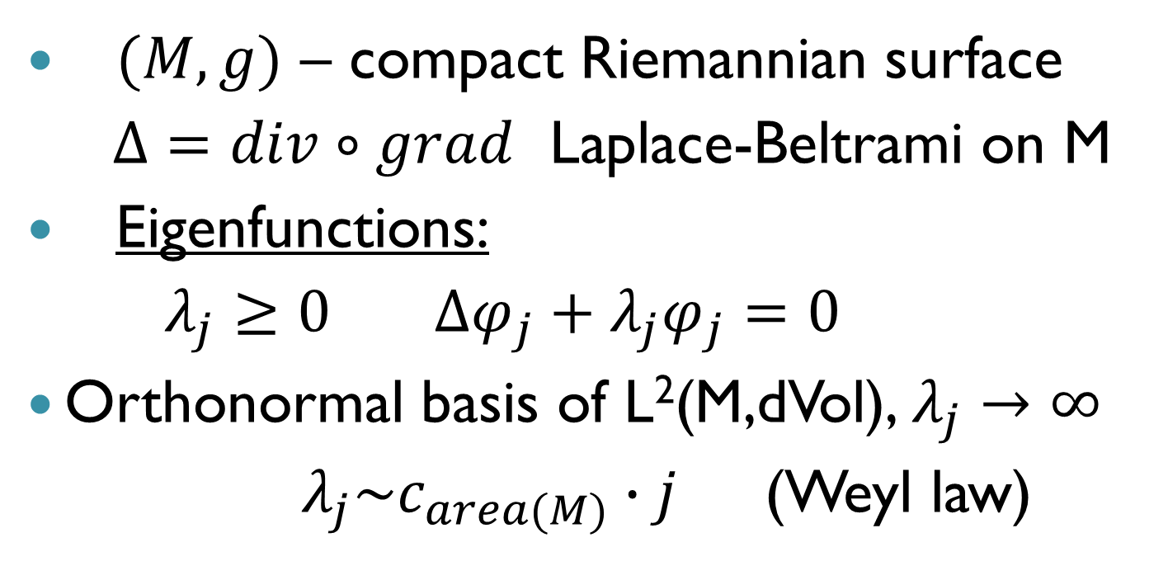
General Setup
$(M,g)$ – compact Riemannian surface
$Δ=div∘grad$ Laplace-Beltrami on M
Eigenfunctions:
$λ_{j}≥0$ $Δφ_{j}+λ_{j}φ_{j}=0$
Orthonormal basis of L²(M,dVol), $λ_{j}→∞$
$λ_{j}\sim c_{area(M)}∙j$ (Weyl law)

Slide 4
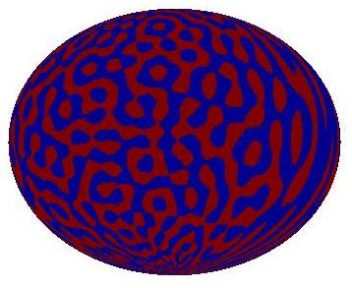
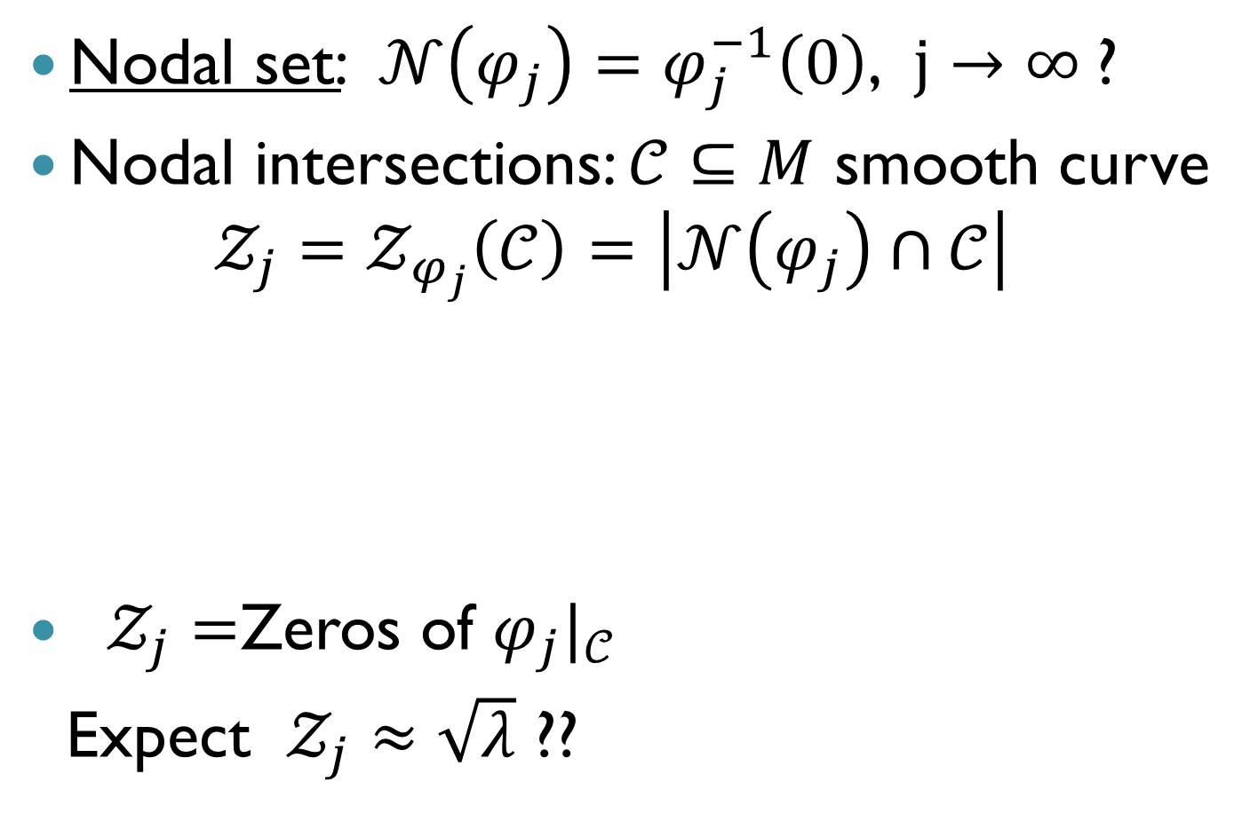

Nodal intersections
Nodal set: $𝒩\left(φ_{j}\right)=φ_{j}^{−1}\left(0\right)$, $j→∞$?
Nodal intersections: $𝒞⊆M$ smooth curve
$$𝒵_{j}=𝒵_{φ_{j}}\left(𝒞\right)=\left|𝒩\left(φ_{j}\right)∩𝒞\right|$$
$𝒵_{j}=$Zeros of ${φ_{j}|}_{𝒞}$
Expect $𝒵_{j}≈\sqrt{λ}$ ??
$$𝒵_{j}=7$$

Slide 5
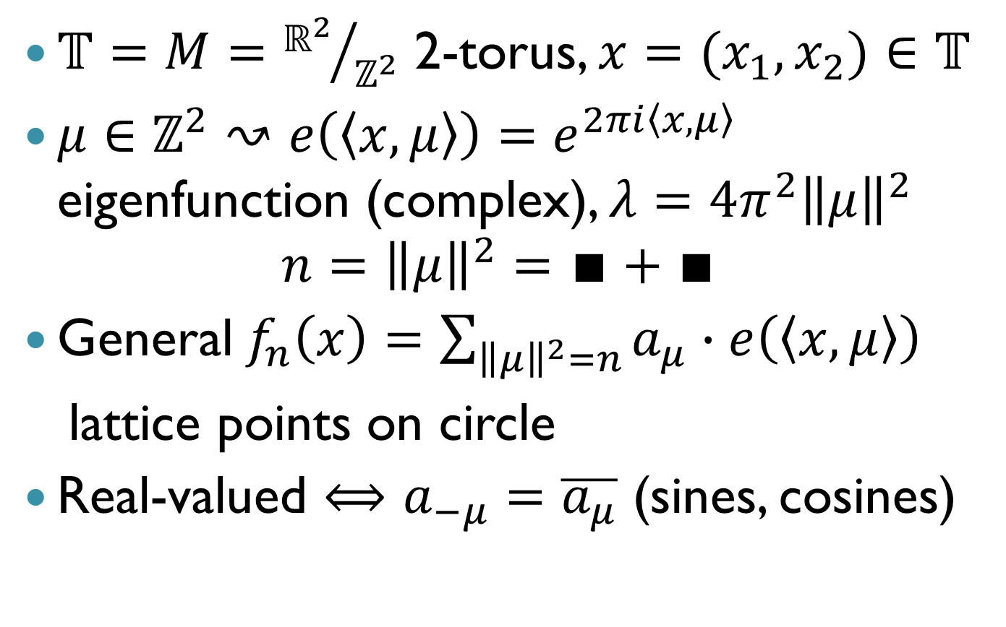
Toral Laplace eigenfunctions
$𝕋=M={ℝ^{2}}/{ℤ^{2}}$ 2-torus, $x=(x_{1},x_{2})∈$ $𝕋$
$μ∈ℤ^{2}↝$ $e\left(\left\langle x,μ\right\rangle \right)=e^{2πi\left\langle x,μ\right\rangle }$ eigenfunction (complex), $λ=4π^{2}{\left\|μ\right\|}^{2}$
$${n=\left\|μ\right\|}^{2}=∎+∎$$
General$f_{n}\left(x\right)=\sum_{{\left\|μ\right\|}^{2}=n}{a_{μ}}∙e\left(\left\langle x,μ\right\rangle \right)$
lattice points on circle
Real-valued $⟺$ $a_{−μ}=\overline{a_{μ}}$ (sines, cosines)

Slide 6
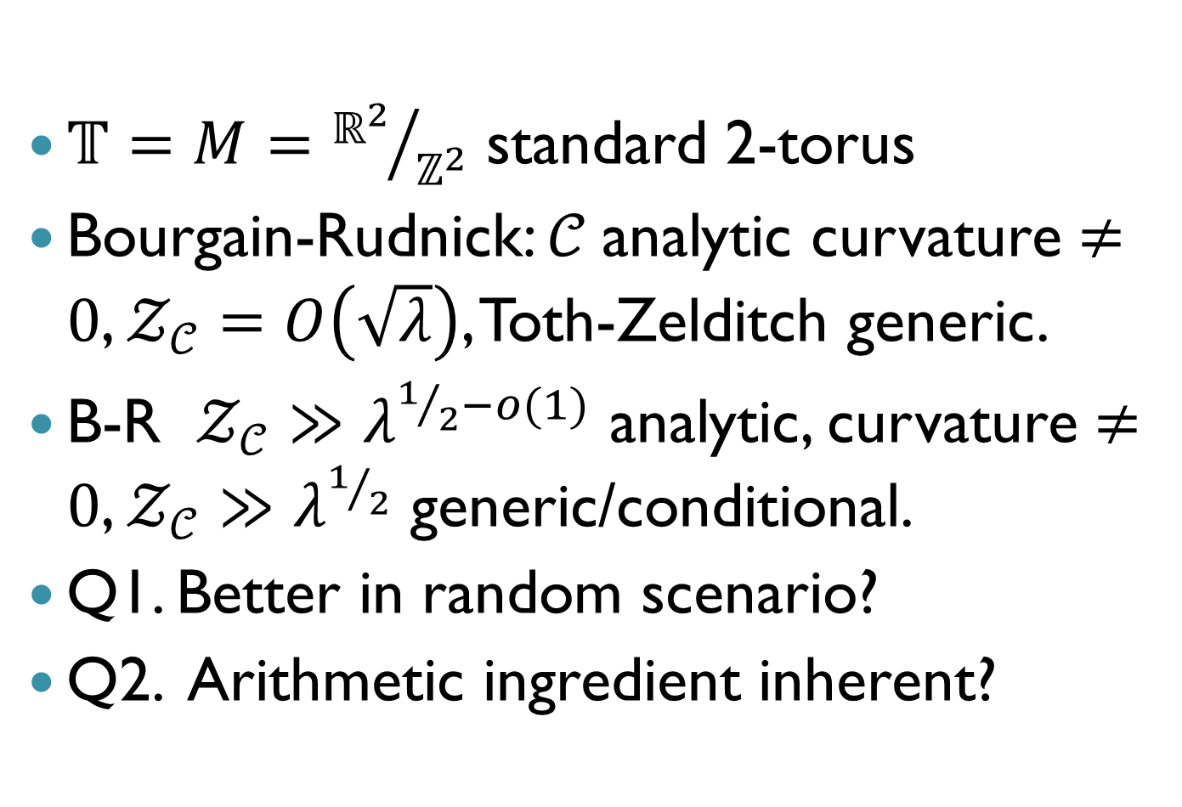
Toral nodal intersections
$𝕋=M={ℝ^{2}}/{ℤ^{2}}$ standard 2-torus
Bourgain-Rudnick: $𝒞$analytic curvature $≠0$, $𝒵_{𝒞}=O\left(\sqrt{λ}\right)$, Toth-Zelditch generic.
B-R $𝒵_{𝒞}≫$ $λ^{1/2−o(1)}$ analytic, curvature $≠0$, $𝒵_{𝒞}≫$ $λ^{1/2}$ generic/conditional.
Q1. Better in random scenario?
Q2. Arithmetic ingredient inherent?

Slide 7
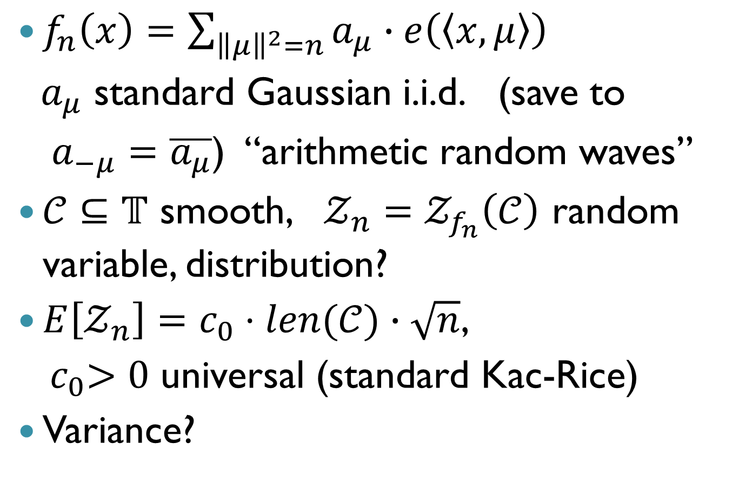
Random eigenfunctions
$f_{n}\left(x\right)=\sum_{{\left\|μ\right\|}^{2}=n}{a_{μ}}∙e\left(\left\langle x,μ\right\rangle \right)$
$a_{μ}$ standard Gaussian i.i.d. (save to
$a_{−μ}=\overline{a_{μ}}$) “arithmetic random waves”
$𝒞⊆𝕋$ smooth, $𝒵_{n}=𝒵_{f_{n}}\left(𝒞\right)$ random variable, distribution?
$E\left[𝒵_{n}\right]=c_{0}⋅len(𝒞)∙\sqrt{n}$,
${ c}_{0}>0$ universal (standard Kac-Rice)
Variance?

Slide 8
2. Variance of nodal intersection number
(joint with Zeev Rudnick)

Slide 9
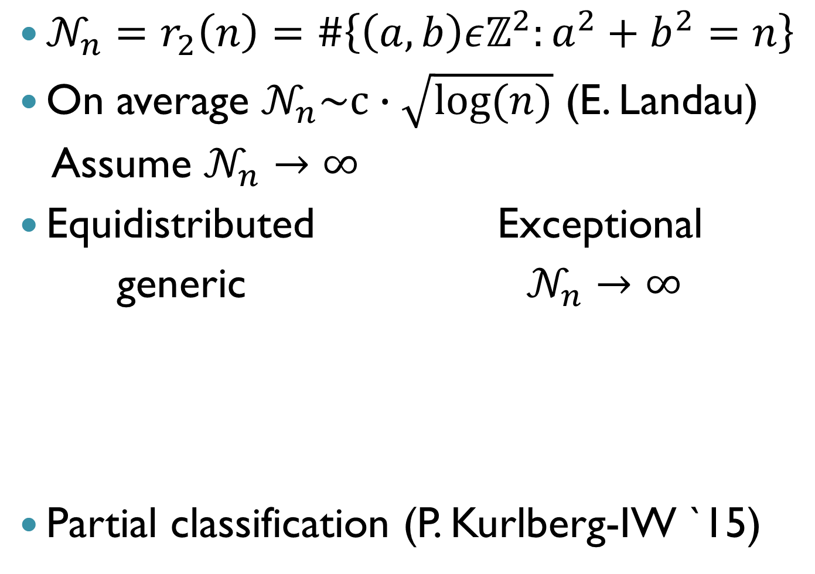
On the 2 squares problem
$𝒩_{n}=r_{2}\left(n\right)=\#\left\{\left(a,b\right)εℤ^{2}:a^{2}+b^{2}=n\right\}$
On average $𝒩_{n}\sim c∙\sqrt{log⁡(n)}$ (E. Landau)
Assume $𝒩_{n}→∞$
Equidistributed Exceptional
generic $𝒩_{n}→∞$
Partial classification (P. Kurlberg-IW `15)

Slide 10
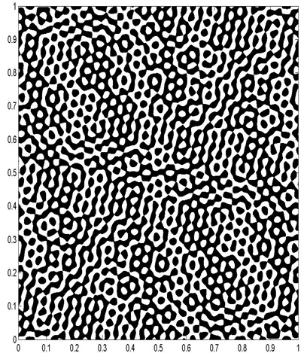
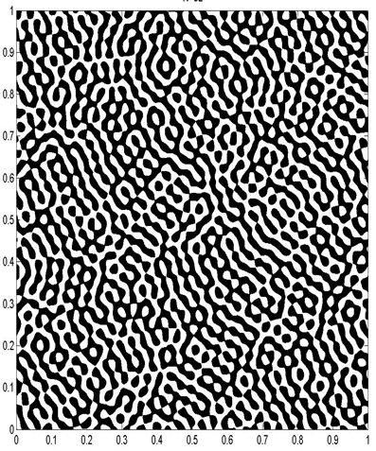
Nodal portraits
ARW n=1105, N=32
RWM, same length

Slide 11
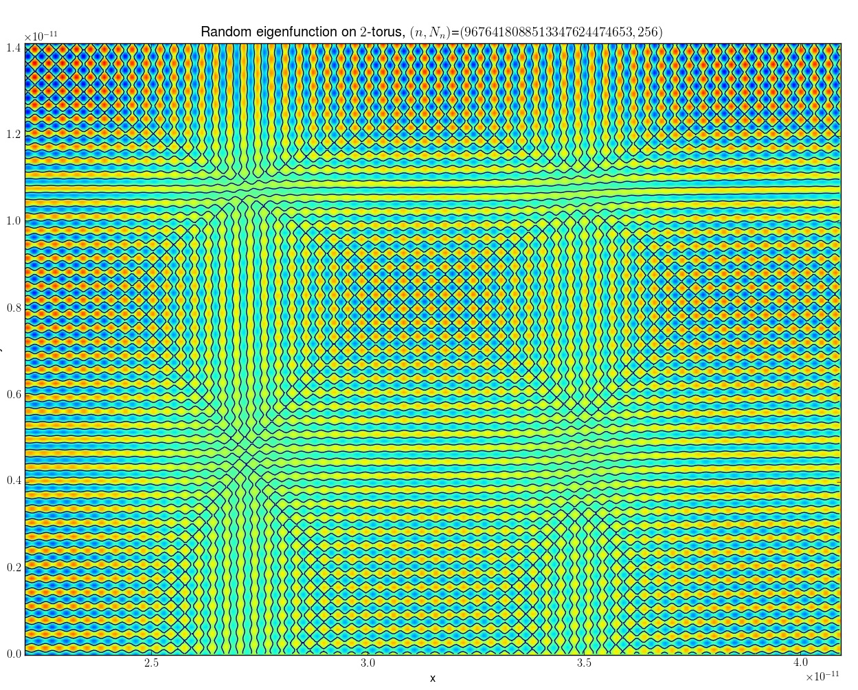
Nodal portrait Cilleruelo (fragment)
Courtesy of Par Kurlberg

Slide 12
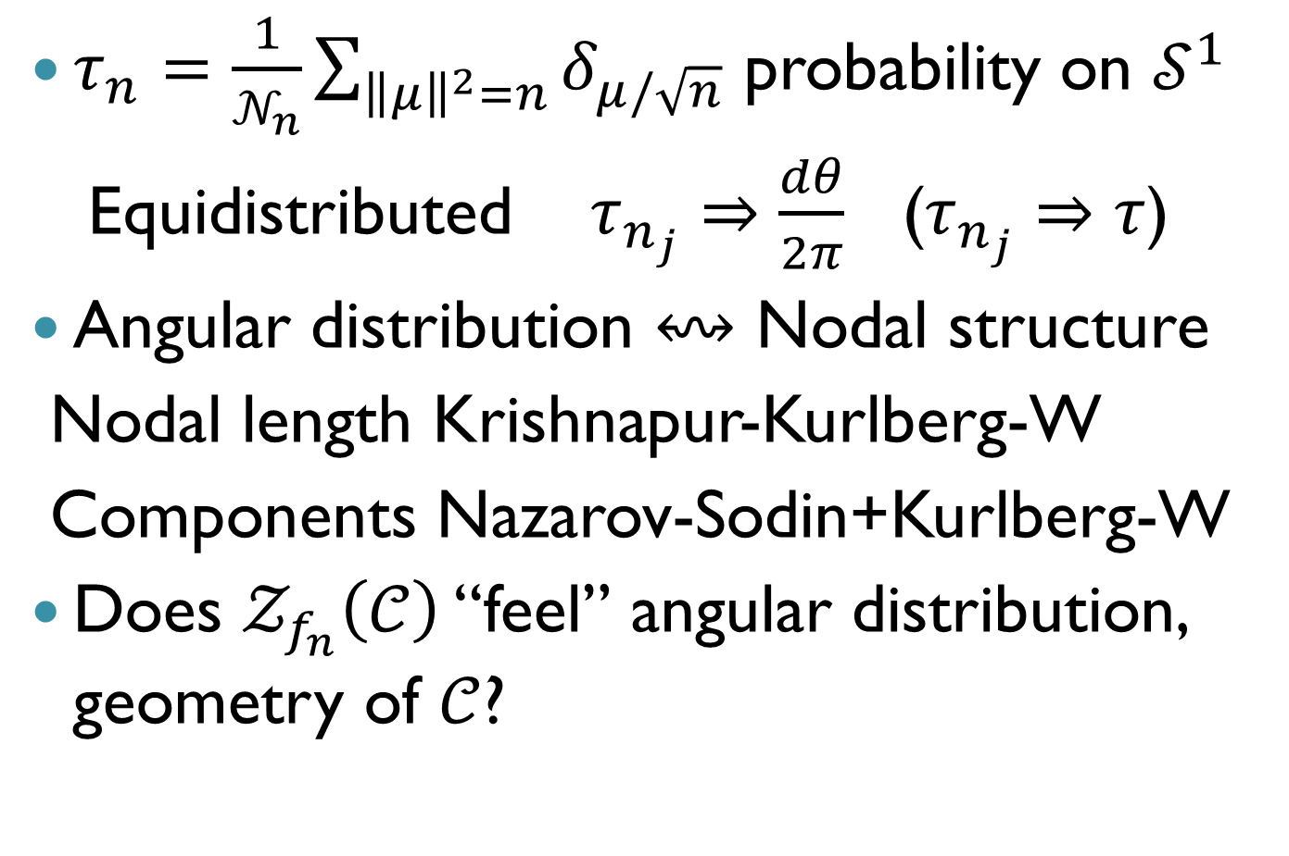
On the 2 squares problem
$τ_{n}=\frac{1}{𝒩_{n}}\sum_{{\left\|μ\right\|}^{2}=n}{δ_{μ/\sqrt{n}}}$ probability on $𝒮^{1}$
Equidistributed $τ_{n_{j}}⇒\frac{dθ}{2π}$ ($τ_{n_{j}}⇒τ$)
Angular distribution $↭$ Nodal structure
Nodal length Krishnapur-Kurlberg-W
Components Nazarov-Sodin+Kurlberg-W
Does $𝒵_{f_{n}}\left(𝒞\right)$ “feel” angular distribution, geometry of $𝒞$?

Slide 13
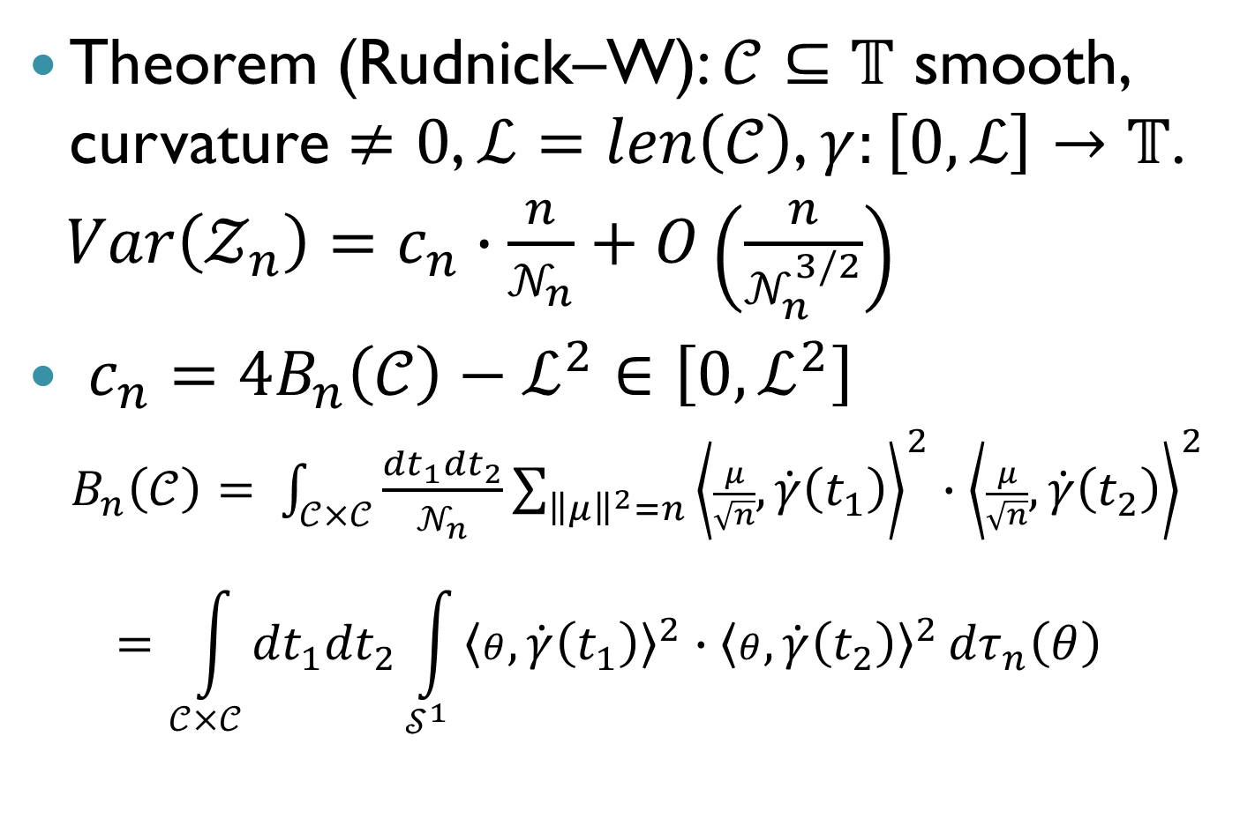
Nodal intersections variance
Theorem (Rudnick–W): $𝒞⊆𝕋$ smooth, curvature $≠0$, $ℒ=len\left(𝒞\right)$, $γ:\left[0,ℒ\right]→$ $𝕋$.
$Var\left(𝒵_{n}\right)=c_{n}∙\frac{n}{𝒩_{n}}+O\left(\frac{n}{𝒩_{n}^{3/2}}\right)$
$c_{n}=4B_{n}\left(𝒞\right)−ℒ^{2}∈\left[0,ℒ^{2}\right]$
$B_{n}\left(𝒞\right)=$ $\int_{𝒞×𝒞}{\frac{{dt}_{1}{dt}_{2}}{𝒩_{n}}}\sum_{{\left\|μ\right\|}^{2}=n}{{\left\langle \frac{μ}{\sqrt{n}},\dot{γ}\left(t_{1}\right)\right\rangle }^{2}∙{\left\langle \frac{μ}{\sqrt{n}},\dot{γ}\left(t_{2}\right)\right\rangle }^{2}}$
$$=\int_{𝒞×𝒞}{{dt}_{1}{dt}_{2}}\int_{𝒮^{1}}{{\left\langle θ,\dot{γ}\left(t_{1}\right)\right\rangle }^{2}∙{\left\langle θ,\dot{γ}\left(t_{2}\right)\right\rangle }^{2}}{dτ}_{n}\left(θ\right)$$

Slide 14
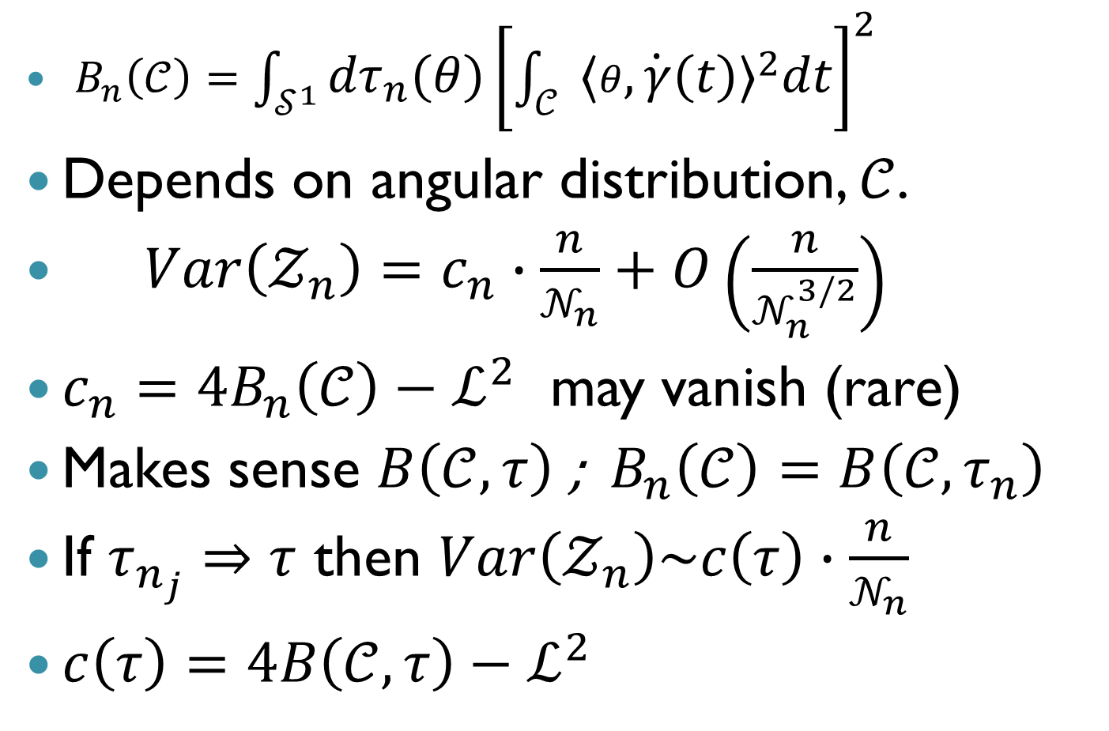
On the limiting constant
$B_{n}\left(𝒞\right)=\int_{𝒮^{1}}{{dτ}_{n}\left(θ\right){\left[\int_{𝒞}{{\left\langle θ,\dot{γ}\left(t\right)\right\rangle }^{2}dt}\right]}^{2}}$
Depends on angular distribution, $𝒞$.
$Var\left(𝒵_{n}\right)=c_{n}∙\frac{n}{𝒩_{n}}+O\left(\frac{n}{𝒩_{n}^{3/2}}\right)$
$c_{n}=4B_{n}\left(𝒞\right)−ℒ^{2}$ may vanish (rare)
Makes sense $B\left(𝒞,τ\right)$ ; $B_{n}\left(𝒞\right)=B\left(𝒞,τ_{n}\right)$
If $τ_{n_{j}}⇒τ$ then $Var\left(𝒵_{n}\right)\sim c\left(τ\right)∙\frac{n}{𝒩_{n}}$
$c\left(τ\right)=4B\left(𝒞,τ\right)−ℒ^{2}$

Slide 15
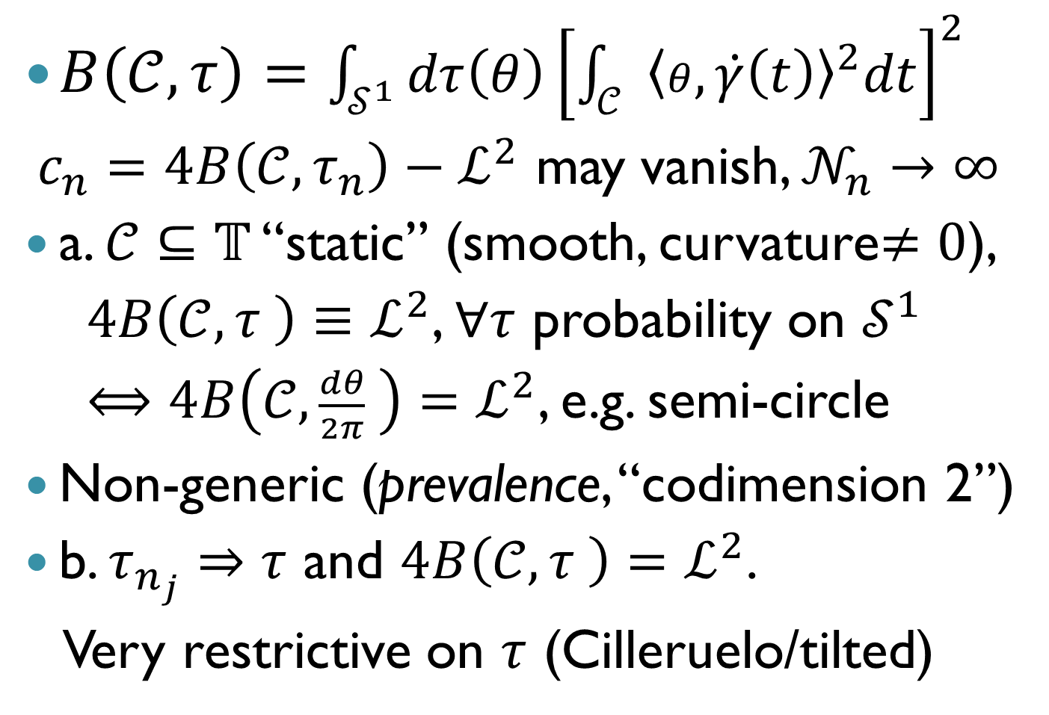
What if it vanishes?
$B\left(𝒞,τ\right)=\int_{𝒮^{1}}{dτ\left(θ\right){\left[\int_{𝒞}{{\left\langle θ,\dot{γ}\left(t\right)\right\rangle }^{2}dt}\right]}^{2}}$
$c_{n}=4B\left(𝒞,τ_{n}\right)−ℒ^{2}$ may vanish, $𝒩_{n}→∞$
a. $𝒞⊆𝕋$ “static” (smooth, curvature$≠0$),
$4B\left(𝒞,τ \right)≡ℒ^{2}$, $∀τ$ probability on $𝒮^{1}$
$⟺4B\left(𝒞,\frac{dθ}{2π} \right)=ℒ^{2}$, e.g. semi-circle
Non-generic (prevalence, “codimension 2”)
b. $τ_{n_{j}}⇒τ$ and $4B\left(𝒞,τ \right)=ℒ^{2}$.
Very restrictive on $τ$ (Cilleruelo/tilted)

Slide 16
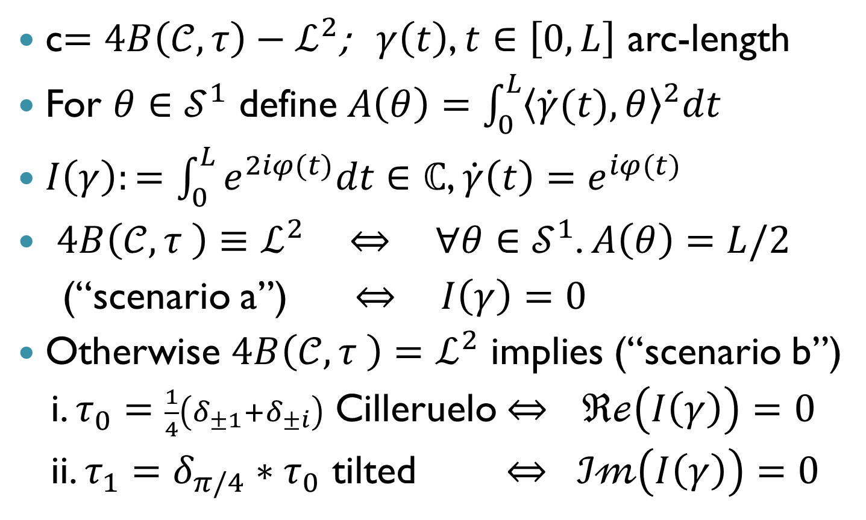
When does the limit constant vanish?
c$=4B\left(𝒞,τ\right)−ℒ^{2}$; $γ\left(t\right)$, $t∈\left[0,L\right]$ arc-length
For $θ∈𝒮^{1}$ define $A\left(θ\right)=\int_{0}^{L}{{\left\langle \dot{γ}(t),θ\right\rangle }^{2}dt}$
$I\left(γ\right):=\int_{0}^{L}{e^{2iφ(t)}dt}∈ℂ$, $\dot{γ}\left(t\right)=e^{iφ(t)}$
$4B\left(𝒞,τ \right)≡ℒ^{2}$ $⇔$ $∀θ{∈𝒮}^{1}$. $A\left(θ\right)=L/2$
(“scenario a”) $⇔$ $I\left(γ\right)=0$
Otherwise $4B\left(𝒞,τ \right)=ℒ^{2}$ implies (“scenario b”)
i. $τ_{0}=\frac{1}{4}\left(δ_{±1}+δ_{±i}\right)$ Cilleruelo $⇔$ $ℜℯ\left(I\left(γ\right)\right)=0$
ii. $τ_{1}={δ_{π/4}∗τ}_{0}$ tilted $⇔ ℐ𝓂\left(I\left(γ\right)\right)=0$

Slide 17
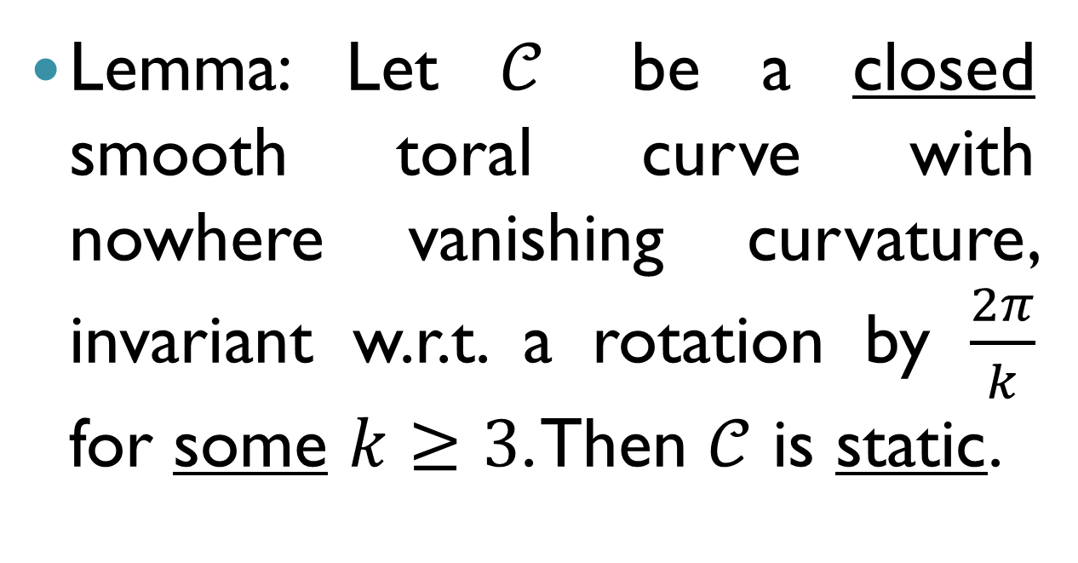
A family of static curves
(construction by Dmitri Panov)
Lemma: Let $𝒞$ be a closed smooth toral curve with nowhere vanishing curvature, invariant w.r.t. a rotation by $\frac{2π}{k}$ for some $k≥3$. Then $𝒞$ is static.

Slide 18
3. Limit distribution of nodal intersections
(joint with Maurizia Rossi)

Slide 19
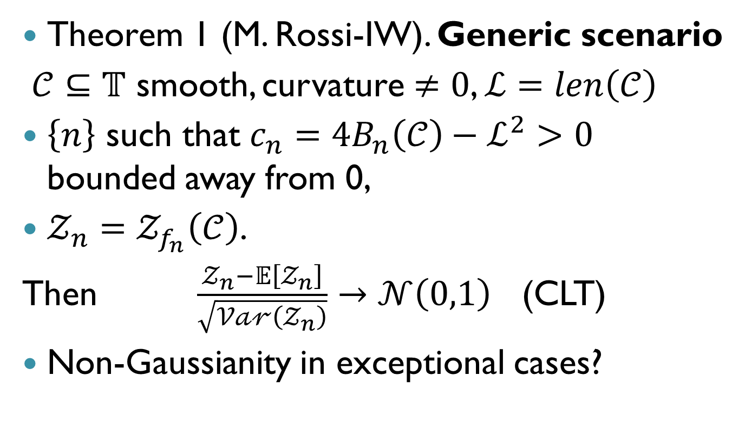
Limit distribution
Theorem 1 (M. Rossi-IW). Generic scenario
$𝒞⊆𝕋$ smooth, curvature $≠0$, $ℒ=len\left(𝒞\right)$
$\left\{n\right\}$ such that $c_{n}=4B_{n}\left(𝒞\right)−ℒ^{2}>0$ bounded away from 0,
$𝒵_{n}=𝒵_{f_{n}}\left(𝒞\right)$.
Then $\frac{𝒵_{n}−𝔼\left[𝒵_{n}\right]}{\sqrt{𝒱𝒶𝓇\left(𝒵_{n}\right)}}→𝒩\left(0,1\right)$ (CLT)
Non-Gaussianity in exceptional cases?

Slide 20
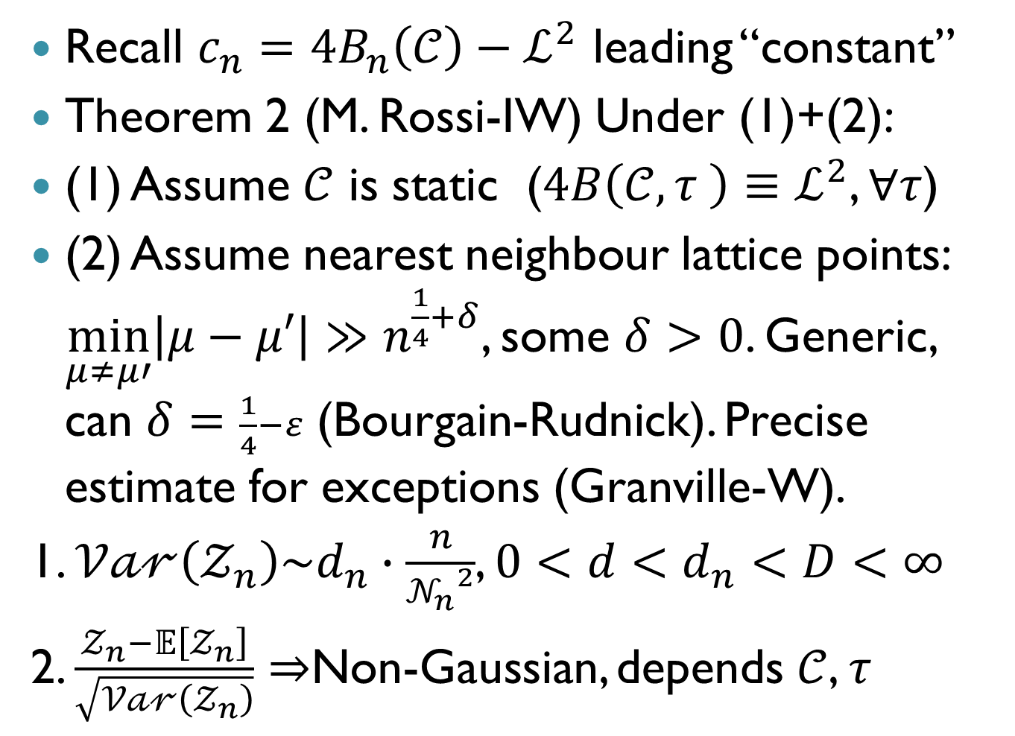
Non-Gaussianity:
Recall $c_{n}=4B_{n}\left(𝒞\right)−ℒ^{2}$ leading “constant”
Theorem 2 (M. Rossi-IW) Under (1)+(2):
(1) Assume $𝒞$ is static ($4B\left(𝒞,τ \right)≡ℒ^{2}$, $∀τ$)
(2) Assume nearest neighbour lattice points: $\min_{μ≠μ′}\left|μ−μ′\right|≫n^{\frac{1}{4}+δ}$, some $δ>0$. Generic, can $δ=\frac{1}{4}−ε$ (Bourgain-Rudnick). Precise estimate for exceptions (Granville-W).
1. $𝒱𝒶𝓇\left(𝒵_{n}\right)\sim d_{n}∙\frac{n}{{𝒩_{n}}^{2}}$, ${0<d<d}_{n}<D<∞$
2. $\frac{𝒵_{n}−𝔼\left[𝒵_{n}\right]}{\sqrt{𝒱𝒶𝓇\left(𝒵_{n}\right)}}⇒$Non-Gaussian, depends $𝒞$, $τ$

Slide 21
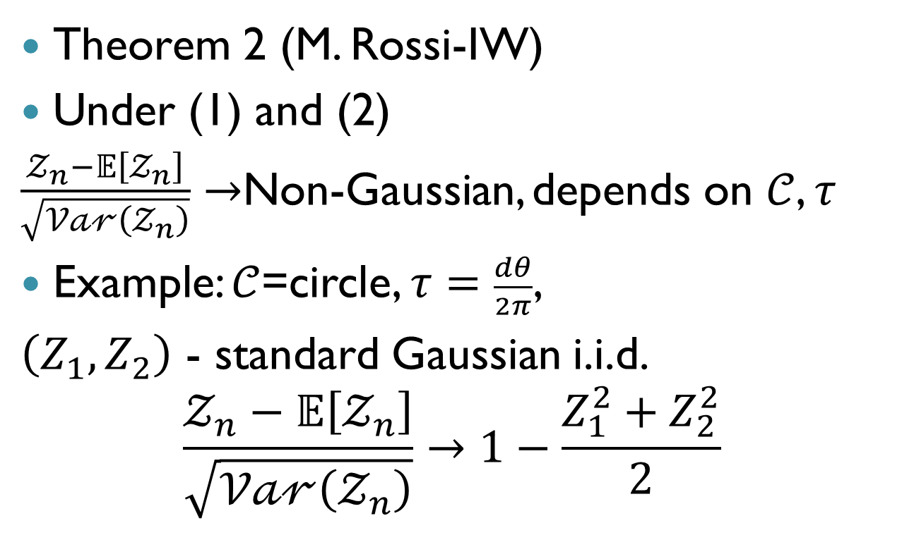
Non-Gaussianity:
Theorem 2 (M. Rossi-IW)
Under (1) and (2)
$\frac{𝒵_{n}−𝔼\left[𝒵_{n}\right]}{\sqrt{𝒱𝒶𝓇\left(𝒵_{n}\right)}}→$Non-Gaussian, depends on $𝒞$, $τ$
Example: $𝒞$=circle, $τ=\frac{dθ}{2π}$,
$\left(Z_{1},Z_{2}\right)$ - standard Gaussian i.i.d.
$$\frac{𝒵_{n}−𝔼\left[𝒵_{n}\right]}{\sqrt{𝒱𝒶𝓇\left(𝒵_{n}\right)}}→1−\frac{Z_{1}^{2}+Z_{2}^{2}}{2}$$

Slide 22
4. Outline of proofs

Slide 23
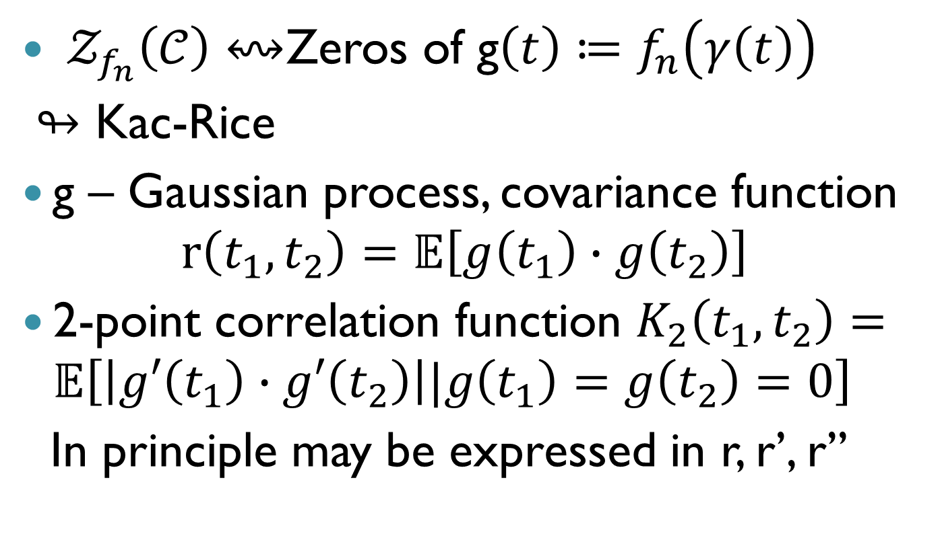
Variance computation: Kac-Rice
$𝒵_{f_{n}}\left(𝒞\right)↭$Zeros of g$\left(t\right)≔f_{n}\left(γ\left(t\right)\right)$
$↬$ Kac-Rice
g – Gaussian process, covariance function
$$r\left(t_{1},t_{2}\right)=𝔼\left[g\left(t_{1}\right)∙g\left(t_{2}\right)\right]$$
2-point correlation function $K_{2}\left(t_{1},t_{2}\right)=𝔼\left[\left|g′\left(t_{1}\right)∙g′\left(t_{2}\right)\right||g\left(t_{1}\right)=g\left(t_{2}\right)=0\right]$
In principle may be expressed in r, r’, r’’

Slide 24
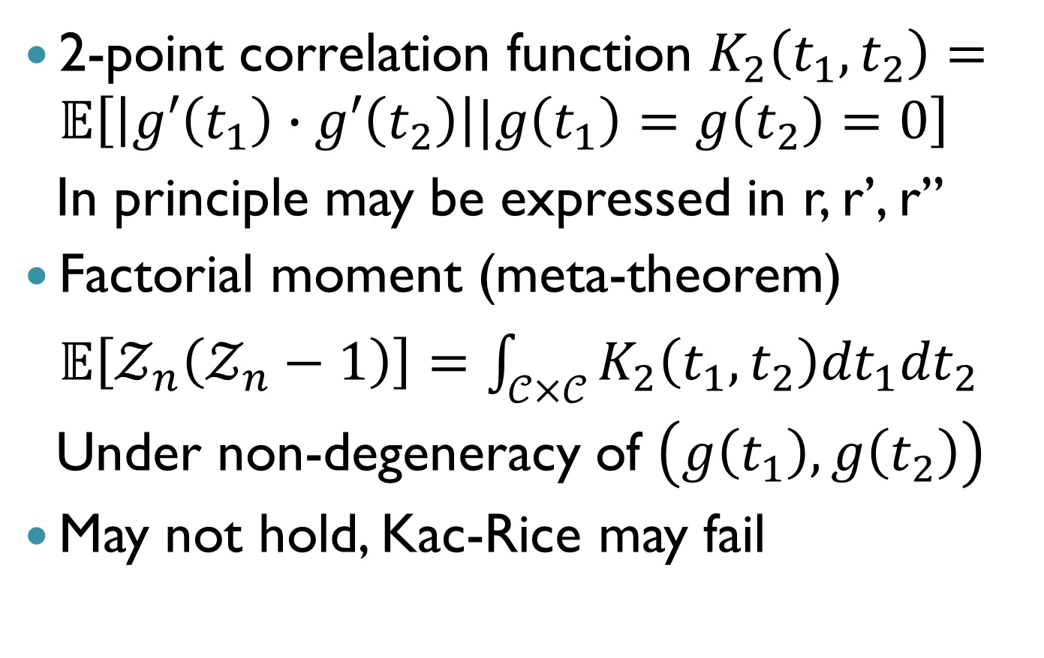
Proof outline: Kac-Rice
2-point correlation function $K_{2}\left(t_{1},t_{2}\right)=𝔼\left[\left|g′\left(t_{1}\right)∙g′\left(t_{2}\right)\right||g\left(t_{1}\right)=g\left(t_{2}\right)=0\right]$
In principle may be expressed in r, r’, r’’
Factorial moment (meta-theorem) $𝔼\left[𝒵_{n}\left(𝒵_{n}−1\right)\right]=\int_{𝒞×𝒞}{K_{2}\left(t_{1},t_{2}\right){dt}_{1}{dt}_{2}}$
Under non-degeneracy of $\left(g\left(t_{1}\right),g\left(t_{2}\right)\right)$
May not hold, Kac-Rice may fail

Slide 25
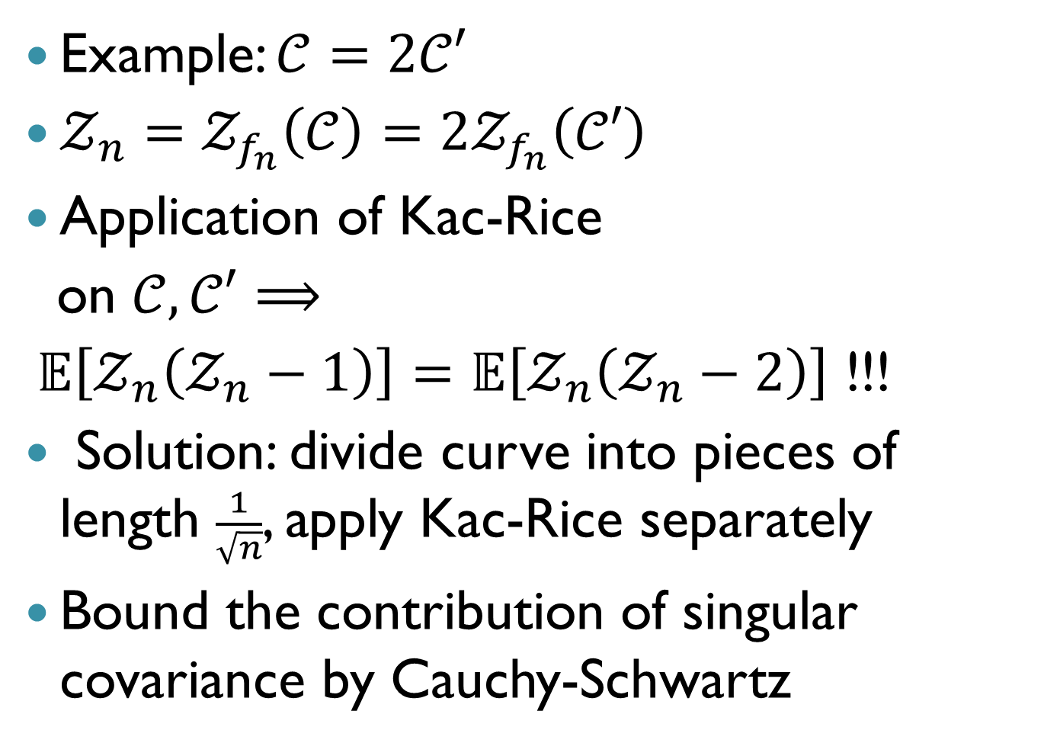

Proof outline (cont.)
Example: $𝒞=2𝒞′$
$𝒵_{n}=𝒵_{f_{n}}\left(𝒞\right)=2𝒵_{f_{n}}\left(𝒞′\right)$
Application of Kac-Rice
on $𝒞,𝒞′$ $⟹$
$𝔼\left[𝒵_{n}\left(𝒵_{n}−1\right)\right]=𝔼\left[𝒵_{n}\left(𝒵_{n}−2\right)\right]$ !!!
Solution: divide curve into pieces of length $\frac{1}{\sqrt{n}}$, apply Kac-Rice separately
Bound the contribution of singular covariance by Cauchy-Schwartz
$$\left(\frac{1}{2},\frac{1}{2}\right)$$

Slide 26
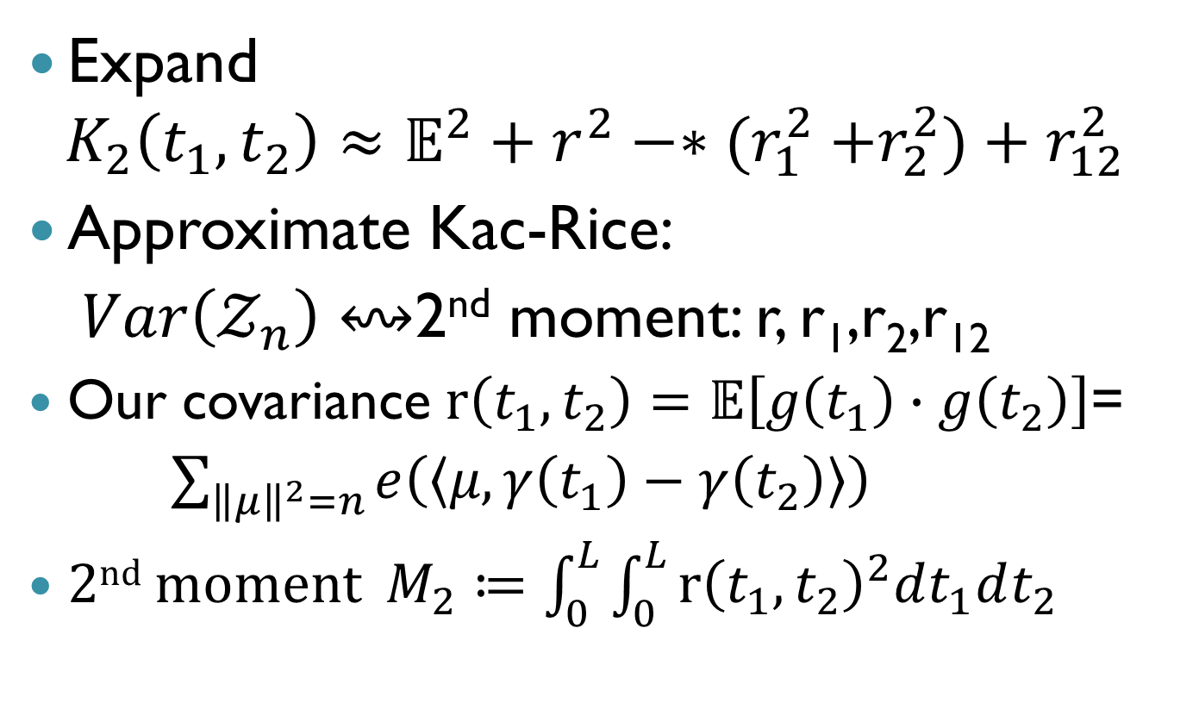
Proof outline (cont.)
Expand
$$K_{2}\left(t_{1},t_{2}\right)≈𝔼^{2}+r^{2}−{∗(r}_{1}^{2}+r_{2}^{2})+r_{12}^{2}$$
Approximate Kac-Rice:
$Var\left(𝒵_{n}\right)↭$2nd moment: r, r₁,r₂,r₁₂
Our covariance $r\left(t_{1},t_{2}\right)=𝔼\left[g\left(t_{1}\right)∙g\left(t_{2}\right)\right]$=
$\sum_{{\left\|μ\right\|}^{2}=n}{e\left(\left\langle μ,γ\left(t_{1}\right)−γ\left(t_{2}\right)\right\rangle \right)}$
2nd moment $M_{2}≔\int_{0}^{L}{\int_{0}^{L}{{r\left(t_{1},t_{2}\right)}^{2}dt_{1}dt_{2}}}$

Slide 27
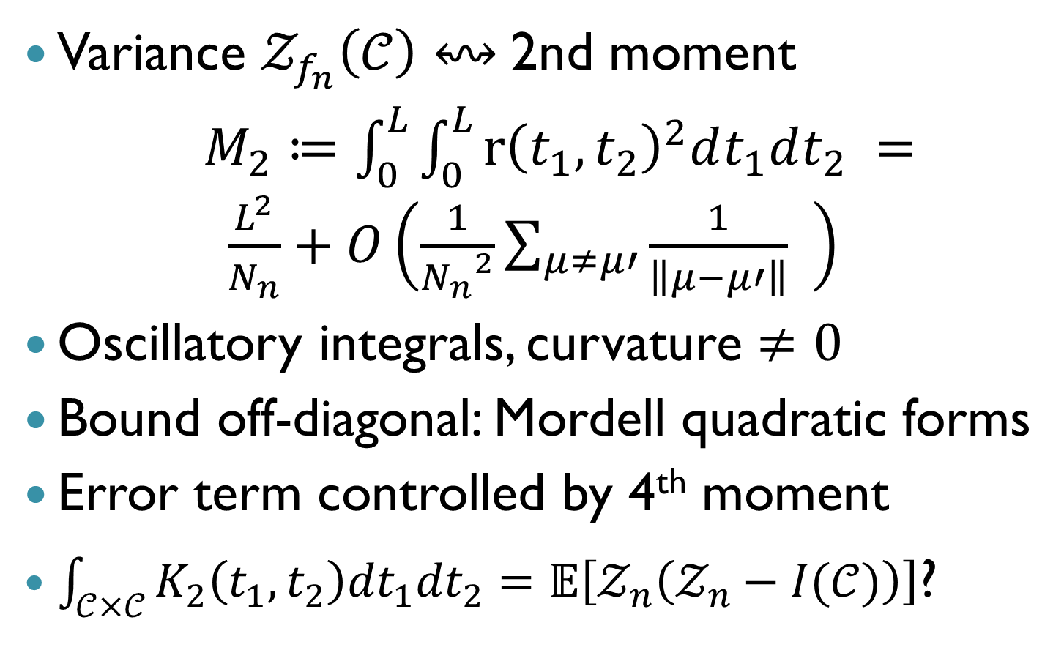
Variance computation: Kac-Rice
Variance $𝒵_{f_{n}}\left(𝒞\right)$ $↭$2nd moment
$M_{2}≔\int_{0}^{L}{\int_{0}^{L}{{r\left(t_{1},t_{2}\right)}^{2}dt_{1}dt_{2}}} = \frac{L^{2}}{N_{n}}+O\left(\frac{1}{{N_{n}}^{2}}\sum_{μ≠μ′}{\frac{1}{\left\|μ−μ′\right\|}} \right)$
Oscillatory integrals, curvature $≠0$
Bound off-diagonal: Mordell quadratic forms
Error term controlled by 4th moment
$\int_{𝒞×𝒞}{K_{2}\left(t_{1},t_{2}\right){dt}_{1}{dt}_{2}}=𝔼\left[𝒵_{n}\left(𝒵_{n}−I(𝒞)\right)\right]$?

Slide 28
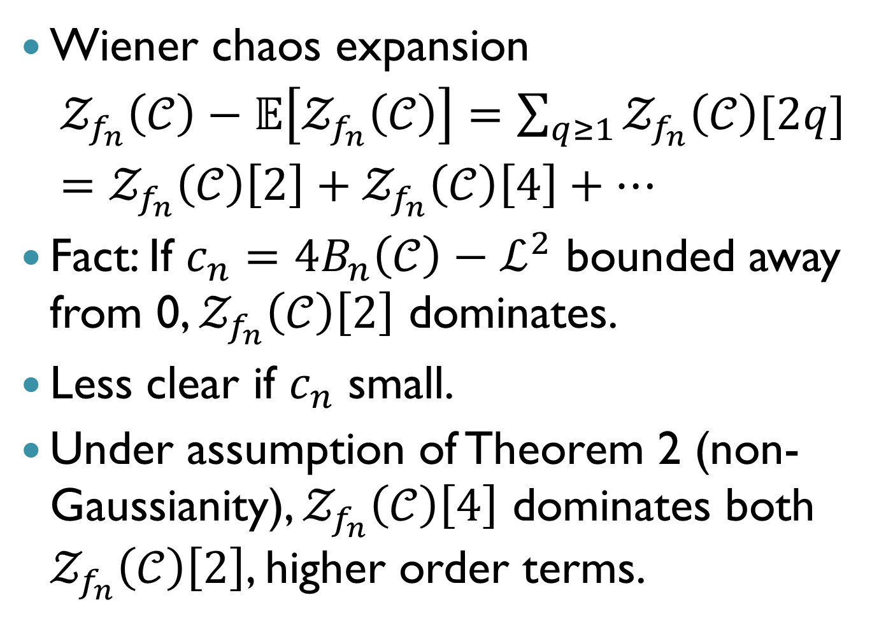
Limit distribution
Wiener chaos expansion
$𝒵_{f_{n}}\left(𝒞\right)−𝔼\left[𝒵_{f_{n}}\left(𝒞\right)\right]=\sum_{q≥1}{𝒵_{f_{n}}\left(𝒞\right)[2q]}$
$=𝒵_{f_{n}}\left(𝒞\right)\left[2\right]+𝒵_{f_{n}}\left(𝒞\right)\left[4\right]+…$
Fact: If $c_{n}=4B_{n}\left(𝒞\right)−ℒ^{2}$ bounded away from 0, $𝒵_{f_{n}}\left(𝒞\right)\left[2\right]$ dominates.
Less clear if $c_{n}$ small.
Under assumption of Theorem 2 (non-Gaussianity), $𝒵_{f_{n}}\left(𝒞\right)\left[4\right]$ dominates both $𝒵_{f_{n}}\left(𝒞\right)\left[2\right]$, higher order terms.

