Slide 1
Decoding trial – by – trial information processing from brain electric activity
Arpan Banerjee
Research Fellow
National Institute of Deafness and Other Communication Disorders
National Institutes of Health, USA

Slide 2
Acknowledgements
Florida Atlantic University
Viktor Jirsa
Scott Kelso
Emmanuelle Tognoli
Armin Fuchs
Ajay Pillai
New York University
Bijan Pesaran
Heather Dean
Swartz foundation
National Institutes of Health
Barry Horwitz
Ajay Pillai
Jessica Gilbert
Jason Smith
Shmuel Appel
Justin Sperling
Johns Hopkins University
Dana Boatman

Slide 3
Goal directed behavior
Sensory processing
Movement planning/
Decision making
Eye-hand
coordination
Notes:
As you see one of the fundamental properties of goal directed behavior is trial- by-trial variability . I will get back to this probably in the last section of this talk. Two aspects are of interest; stage by stage processing, and the time evolution of underlying networks

Slide 4
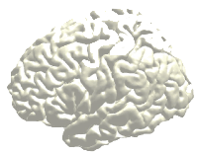
Brain dynamics underlying goal directed behavior
Information processing stages (Donders, 1873; Sternberg, 1969)
Sensory processing
Attention/ memory
retrieval
Decision making
Eye-hand
coordination
Time
Notes:
The neurobiological understanding of goal directed behavior requires an understanding of the how stages of information processing emerge. They psychophysical foundation for studying goal directed behavior were laid out by some pioneering work of Donders some of which is known as mental chronometry.

Slide 5
Methods to study neural basis of goal directed behavior
Brain lesions & cognitive neuropsychology
Electrophysiological recordings in primates (cellular level)
Pharmacological and genetic studies
Transcranial magnetic stimulation
Functional neuroimaging
Hemodynamic-metabolic methods (PET, fMRI)
Electromagnetic methods (EEG, MEG)
Notes:
Neural basis of cognitive behavior can be understood using different approaches. From brain lesions , electrophysiological single unit recordings at cellular level, pharmacologicaL and genetic studies, in particular identifying regulatory networks, direct stimulation of neural areas, inducing lesions temporarily non-invasively and finally through functional neuroimaging of metabolic and electrical activities in the brain.

Slide 6
Generators of neuroelectric signals
Courtesy: NIH MEG Core website

Slide 7
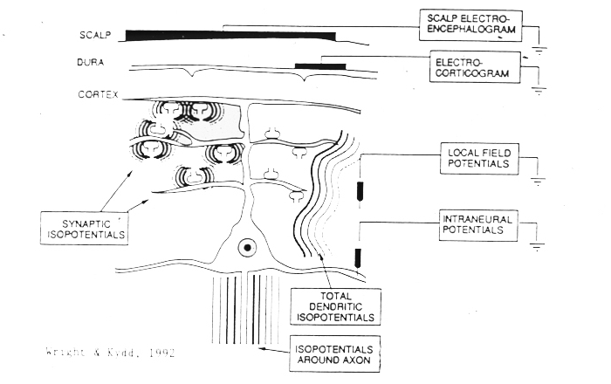
Many physiologic scales
Wright & Kydd (Courtesy Niko Schiff)

Slide 8
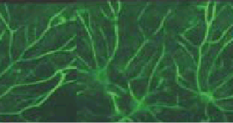
Information processing unit: why I started loving models
Input, intrinsic dynamics and output
Neural tissue
Input
Output
Intrinsic dynamics

Slide 9
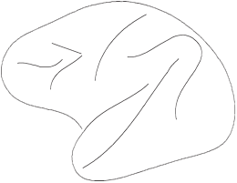
Information processing in the brain
Dorsal (where) pathway
Ventral (what) pathway
All this stuff happens trial by trial ! (Remember batting)
Milner & Goodale
Posner 1975

Slide 10
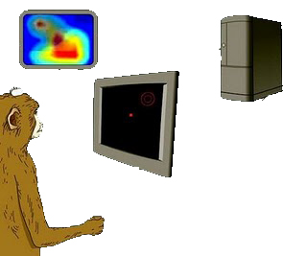
Electrophysiological recordings in primates

Slide 11
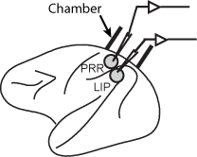
Electrophysiological recordings in primates

Slide 12
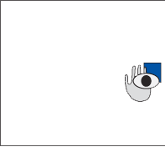
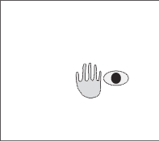
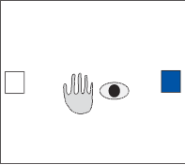
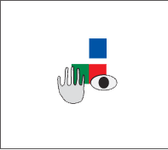
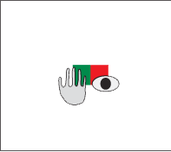
Studying Coordination: Experimental task
Target acquire
Go Cue
Location cue on
SRT: Saccade reaction time
RRT: Reach reaction time
Baseline
SRT
Eye position
RRT
Hand position
Go Cue

Slide 13
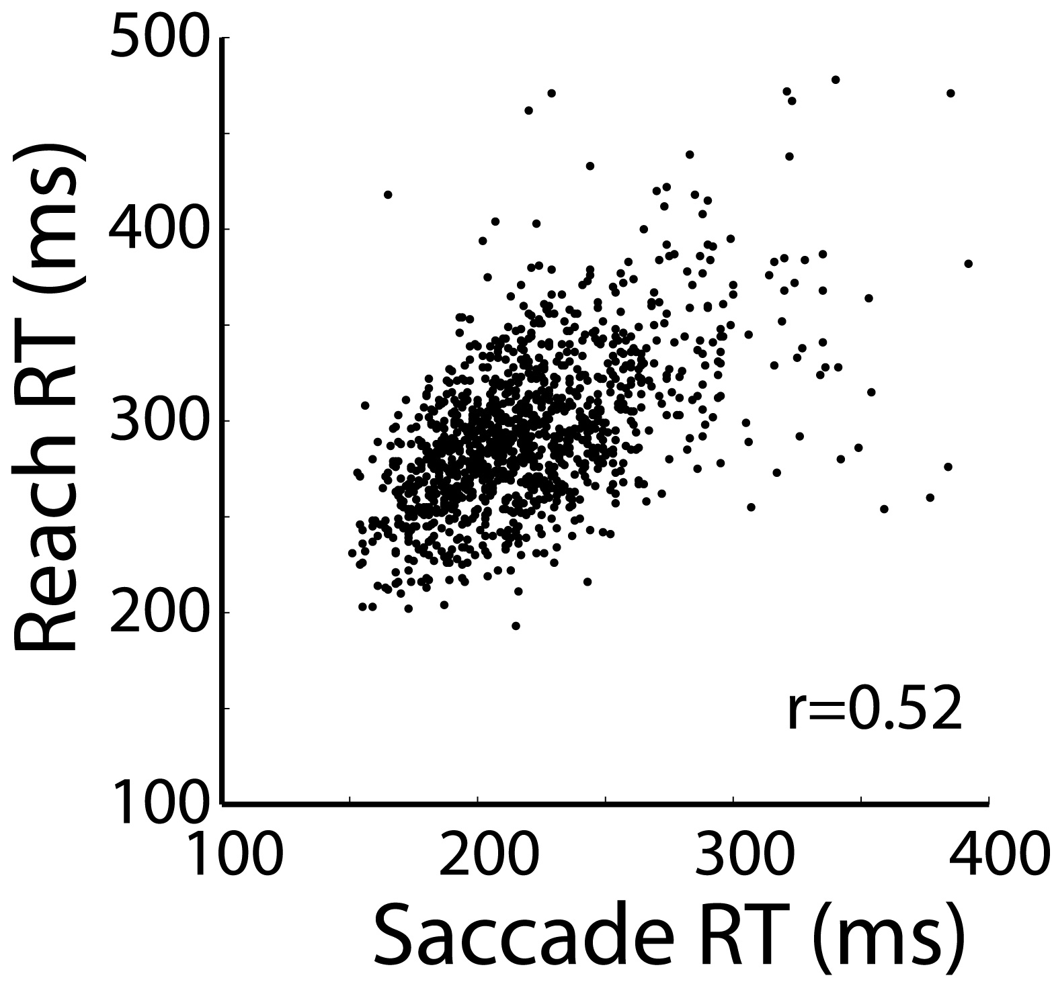
Measuring coordination

Slide 14
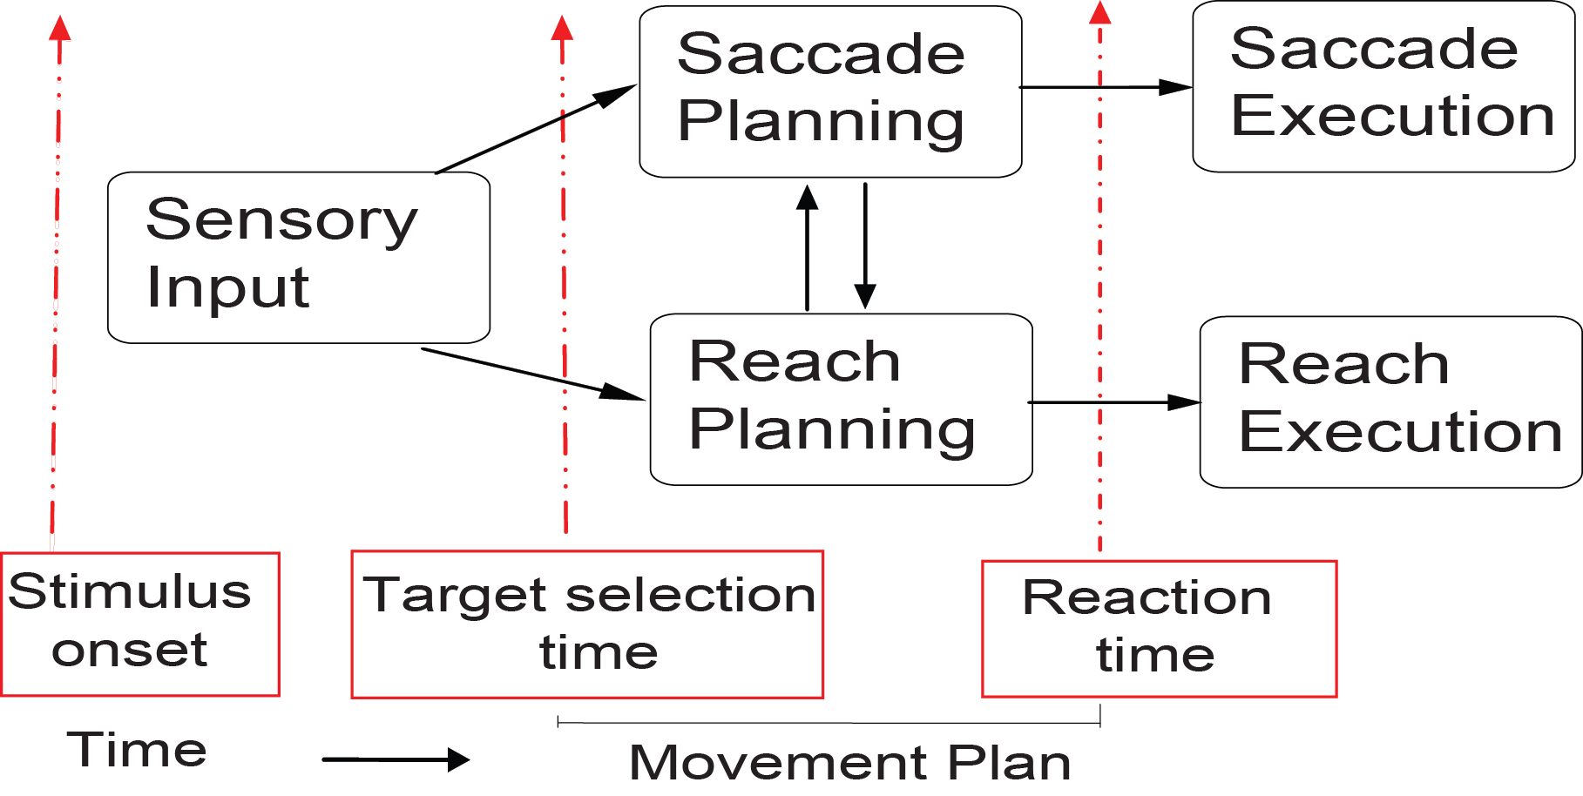
Eye hand coordination: Information processing stages/ events

Slide 15
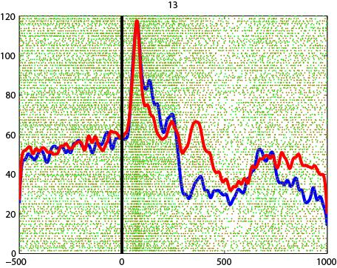
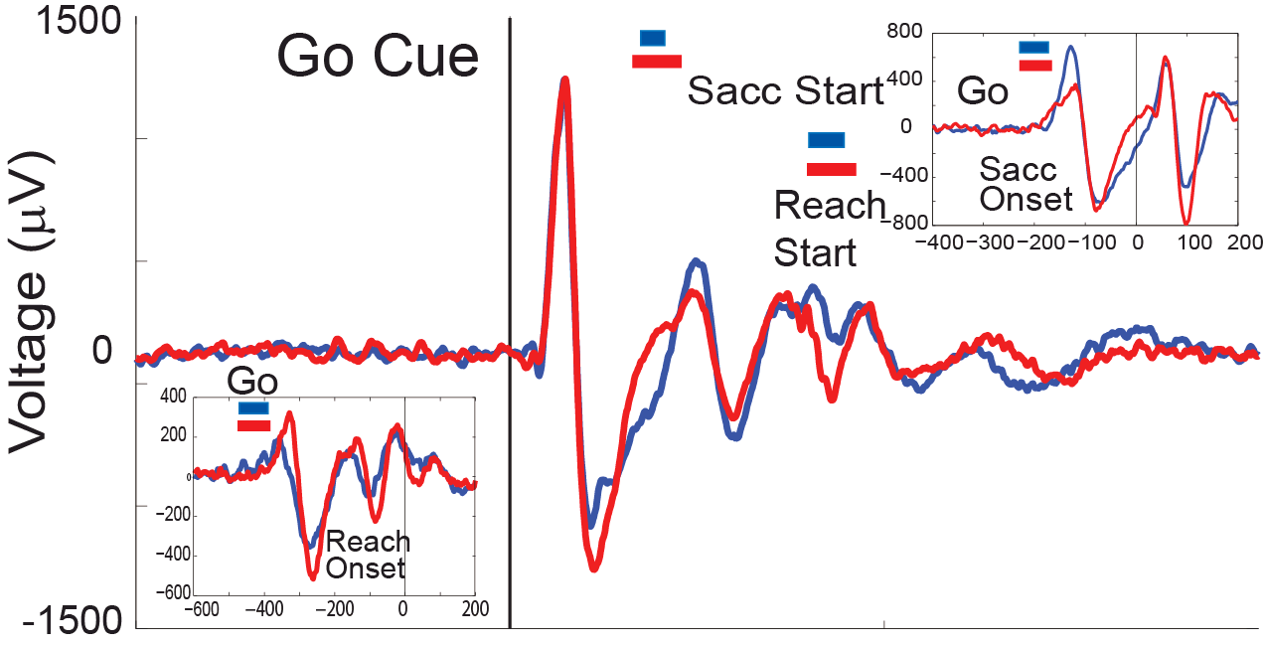
Spike-field responses
Firing rate (Hz)
Some numbers:
For spikes electric potential
is filtered between 1-24 kHz
For fields low pass-filter of
0-1000 Hz is used

Slide 16
Earlier methods of calculating target selection times
Methods used earlier
Spikes:
Surprise Index on the level of single trials. Hanes et. al
1995
msec by msec ANOVA (Spike Activity X Target
location) Monosov et.al. 2008
Fields:
msec by msec ANOVA (LFP Activity X Target
location) Monosov et.al. 2008 , Emeric, Schall 2008
No systematic framework exists to bridge spikes-fields: different statistical properties

Slide 17
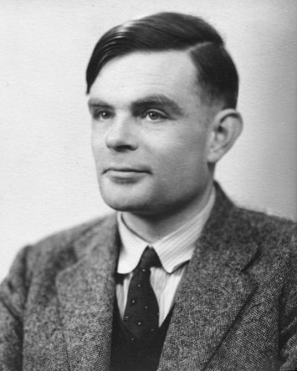
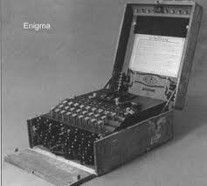
History of decoding
Alan Turing

Slide 18
Single trial decoding: AccLLR
AccLLR: Accumulated log-likelihood ratio
Turing WWII (Classified)
Wald and Wolfowitz, 1948
Banerjee, Dean, Pesaran 2010

Slide 19
Modelling spikes
Input driven spike trains
Input
Notes:
Here is a statistical model of spiking activity. We can model background spiking activity in a neural recording area with an point process. Signal N at time t dependent on its own history up to an order p. gamma’s are constant coefficients which weigh the history and are called GLMcoefficients.
Now a neural input It from an earlier processing stage can affect this recording area at time t which results to a interaction with the tissue in the recording area. This can be now captured by adding introducing a lambda0(t) in this generative model. However in a realistic situation this amplitude and latency of this rate will vary on every trial. For example input coming at different time t-tau with a scaling factor will affect the tissue. This can be modeled by adding a trial by trial scaling factor and latency on the Input as brs and taurs. Hence the entire parameter space can be represented as a,p,b,tau and It needs to be inferred to approximately model the system. I will skip the maths of fitting this model for the purpose of this talk. But please feel free to ask me about this later. Instead I will show you some results of the modeling.

Slide 20
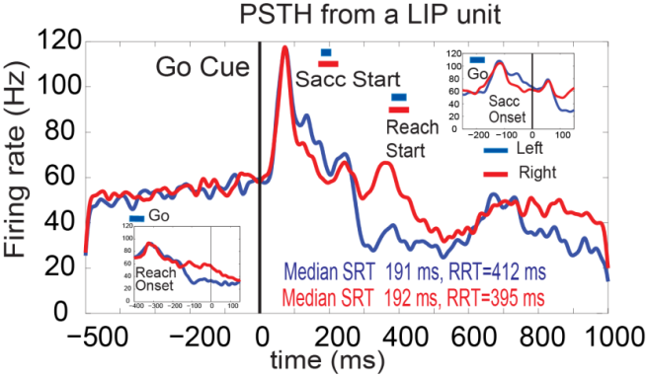
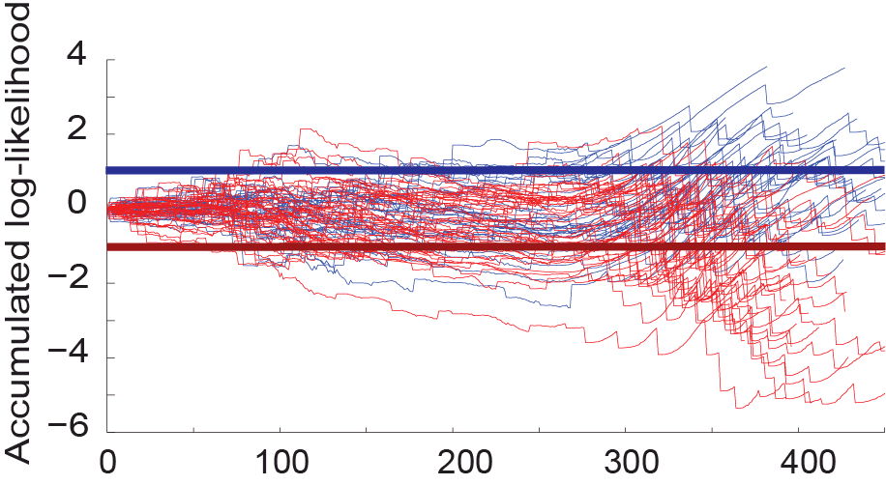
Decoding movement directions (Spikes)
Time from Go Cue (ms)
Banerjee, Dean, Pesaran (In prep)

Slide 21
Modelling LFP
Input driven LFP activity
Input
Notes:
Here is a statistical model of LFP activity. We can model background activity in a neural recording area with an autoregressive process. Signal S at time t dependent on its own history up to an order p plus white noise epsilon. a’s are constant coefficients which weigh the history and are called AR coefficients.
Now a neural input It from an earlier processing stage can affect this recording area at time t which results to a interaction with the tissue in the recording area. This can be now captured by adding a term It in this generative model. However in a realistic situation this amplitude and latency of this input will vary on every trial. For example input coming at different time t-tau with a scaling factor will affect the tissue. This can be modeled by adding a trial by trial scaling factor and latency on the Input as brs and taurs. Hence the entire parameter space can be represented as a,p,b,tau and It needs to be inferred to approximately model the system. In the next step I show you how to infer It and decode the other paramters.

Slide 22
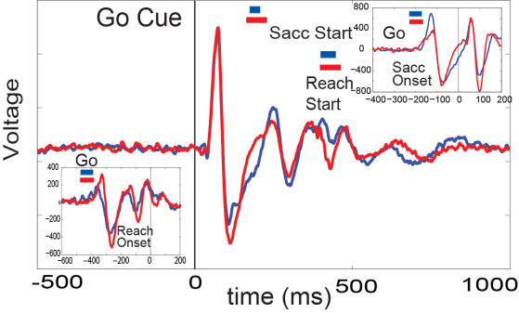
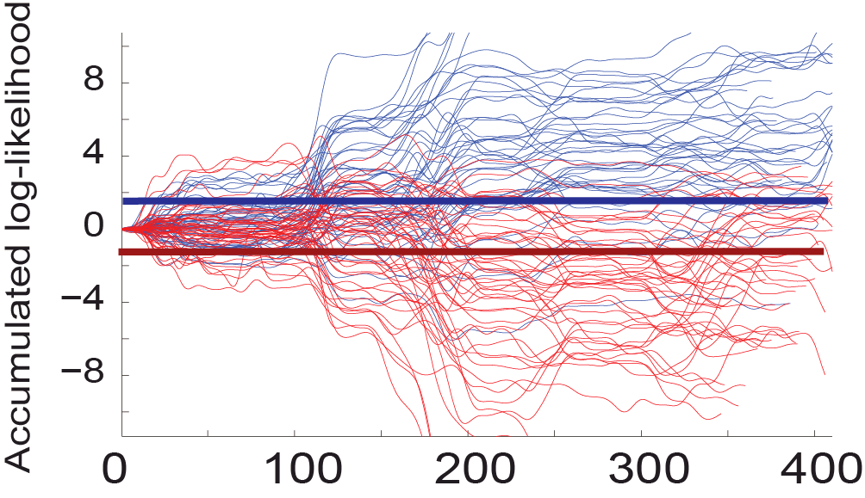
Decoding movement directions (Fields, LFP)
Time from Go Cue (ms)
Banerjee, Dean, Pesaran ( In prep)

Slide 23
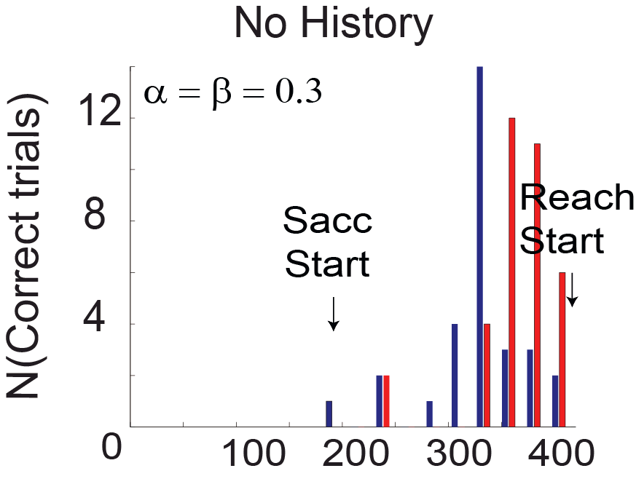
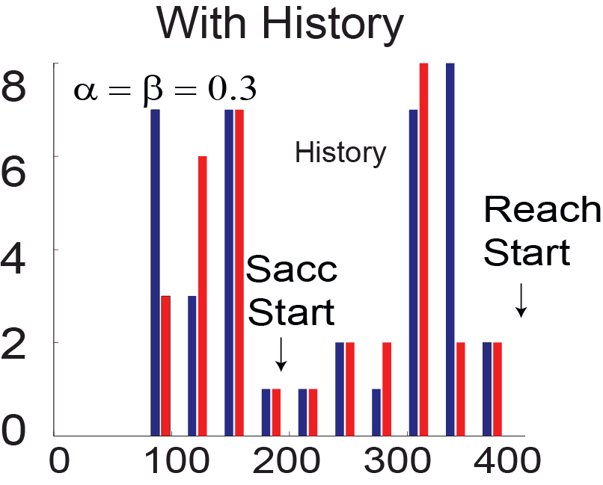
Target selection times (spike trains)
Banerjee, Dean, Pesaran Frontiers in Neuroscience Abs 2010

Slide 24
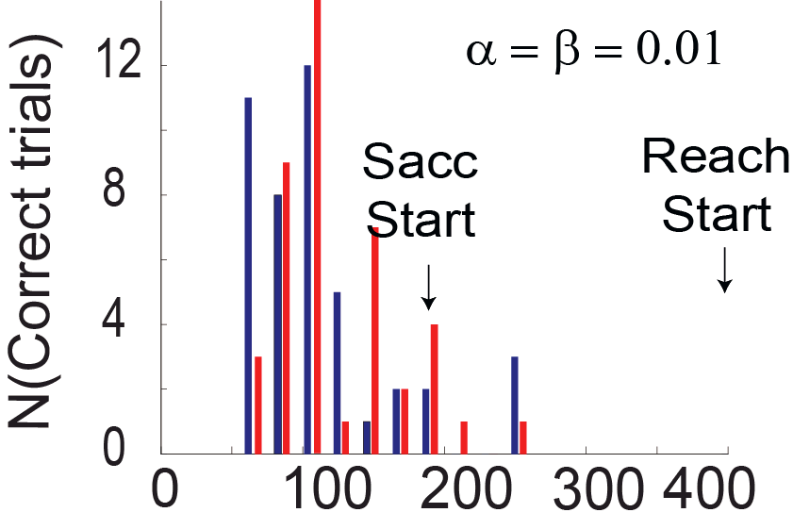
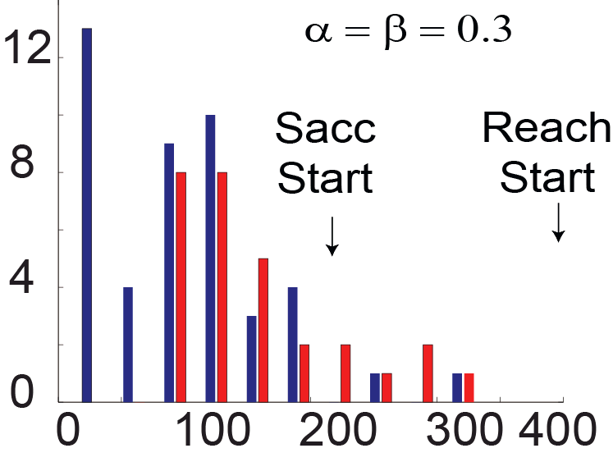
Target selection times from LFP activity
No history
With history

Slide 25
Correlations (spike - behavior, field - behavior, spike - field)

Slide 26
Conclusions
Decoded target selection times trial-by- trial from univariate recordings.

Slide 27
Conclusions
Error rates are lower for fields.
Spike-field-behavior correlations help evaluate the information processing role of a particular brain area.

Slide 28
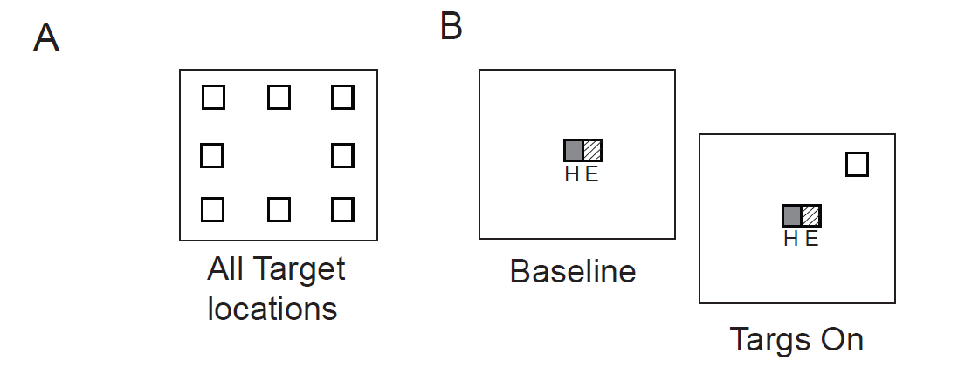
Decoding visual response onsets
Experimental task

Slide 29
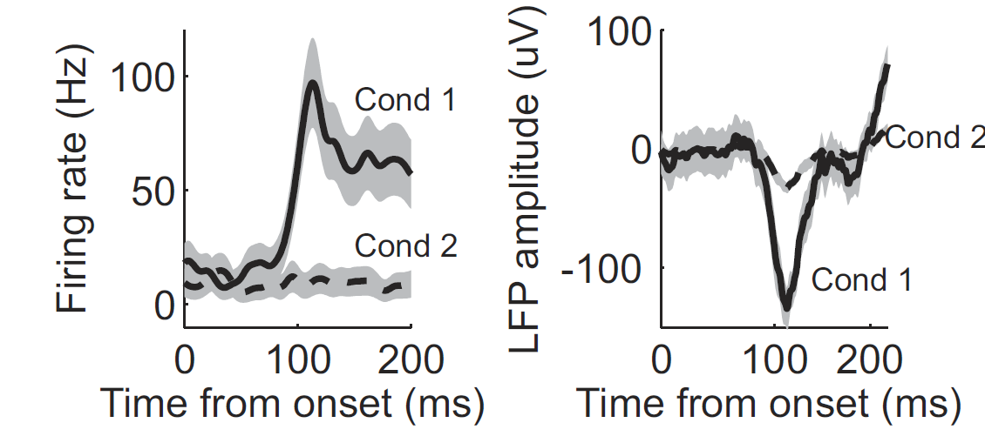
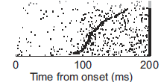
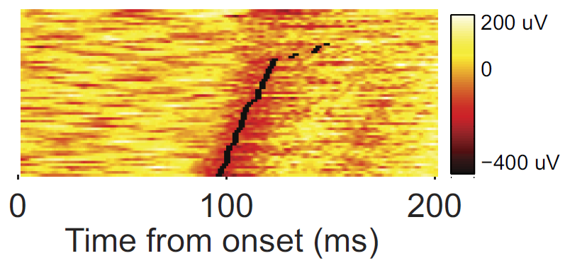
Decoding visual response onset

Slide 30
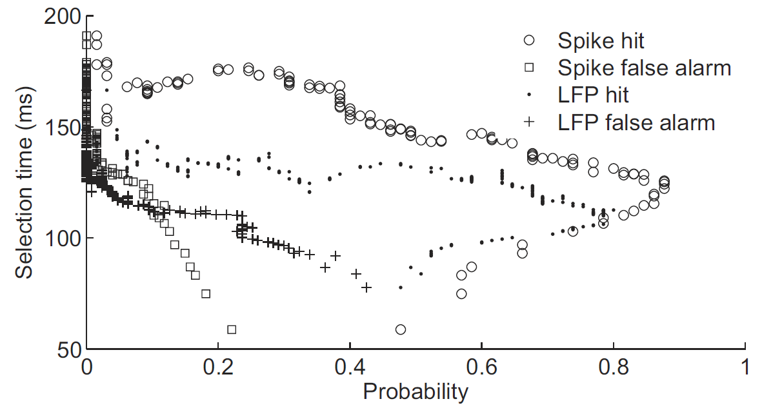
Performance analysis

Slide 31
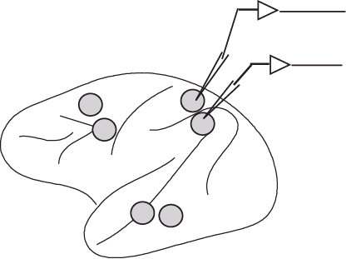
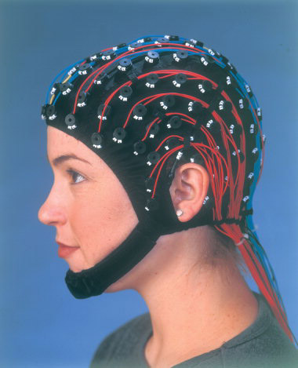
Current work and future directions
Multivariate models to deal with distributed large-scale information processing
Microscopic: Spikes, LFP
Macroscopic: EEG

Slide 32
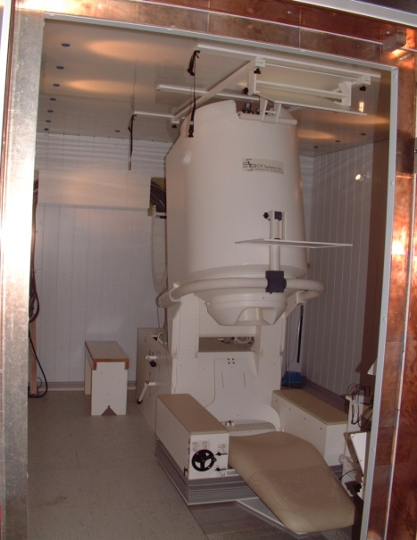
Current work and future directions
Single trial decoding of
EEG/ MEG signals

Slide 33
Thank you

