Slide 1
completely entangled and completely positive
Bangalore
India

Slide 2
Abstract
We will begin with definitions and examples of the notions of partial trace, partial transpose, completely positive maps and completely entangled subspaces. We shall display certain classes of states that can be determined by their partial traces. Entanglement is a powerful resource in Quantum information and communication. Separable states satisfy the Peres test of positivity under partial transpose (PPT) but there is an abundance of non-PPT (NPT) entangled states. Completely entangled subspaces of multipartite quantum systems viz., subspaces of the tensor product of finitely many finite-dimensional Hilbert spaces containing no non-zero product vector, have received attention by many researchers beginning with Bennett et al (1999) via (mutually orthogonal)
Unextendable Product Bases (UPB).

Slide 3
They also note that the projection operator on a completely entangled space so obtained is PPT entangled.
The general case was taken up by Wallach, Parthasarathy, Bhat, Skowronek and a few others over the time. Johnston proved that in the bipartite set-up positive operators with range in a completely entangled space constructed by him is NPT. After giving this development, we will generalise a part of this in the multipartite set-up as done in my joint paper with Arvind and Ritabrata Sengupta : Physical Review A, Dec. , 2014 (ArXiv 1409.5093 [quant-ph]).
Time constraint forces me to omit the following advertised part in Abstract, but you are welcome for discussion:
A quantum channel is a completely positive map that is trace-preserving. We will display various classes of channels that preserve or break entanglement of different states. We will conclude with an idea of the situation for Gaussian channels.
Also I have yet to learn Tex, so this improvised PPT has its own type of errors and omissions to be ignored.

Slide 12
To get a better feel for them we concentrate on the case d=2 for a while.

Slide 13
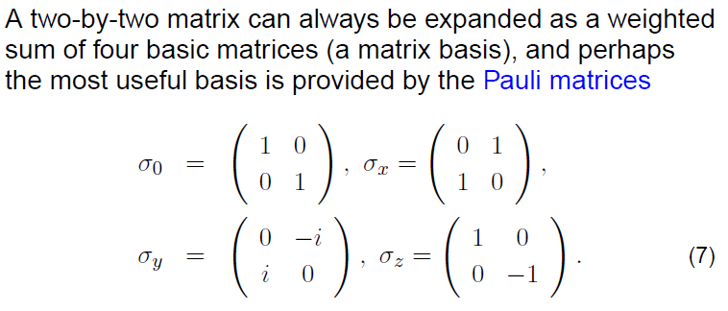

Slide 14
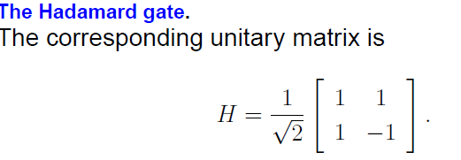
Gates

Slide 15
Quantum bits
a relook on

Slide 16
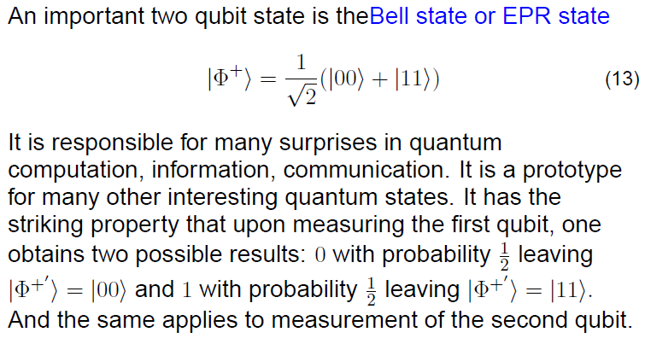
Two qubit maximally entangled states -a relook
Moreover, both the partial traces for the projection
operator X on this vector are readily seen to be (1/2) I.

Slide 17
CNOT GATE

Slide 18
Naïve approaches for partial transpose of a block matrix A (i) Take the block matrix B obtained by taking transposes of respective matrices. (ii) Take the block matrix C obtained by interchanging the matrices in blocks at the jk-th and kj-th positions. What happens? If A is Hermitian then so are B and C. But if A is positive, then B or C need not be so! 1 0 0 1 1 0 0 0 0 0 0 0 0 0 1 0 A= 0 0 0 0 B=C= 0 1 0 0 1 0 0 1 0 0 0 1

Slide 19
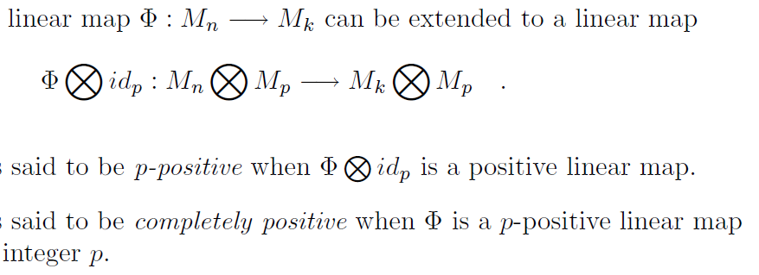
Completely positive maps
Completely positive maps were defined by W.F. Stinespring in
1955. We saw just now that taking transpose is not a completely
positive map. We all know that it is positive, though!

Slide 20
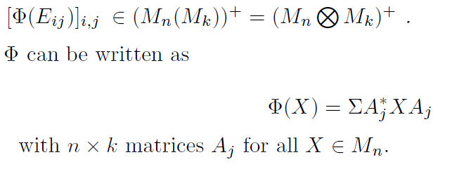
Choi-Jamiolkowsky Check M.D. Choi, Lin. Alg. Appl. 1975 & A. Jamiolkowsky, Rep. Math. Phys. 1972.
An easily checkable equivalent condition for complete positivity is:
This is another equivalent condition.
.

Slide 21
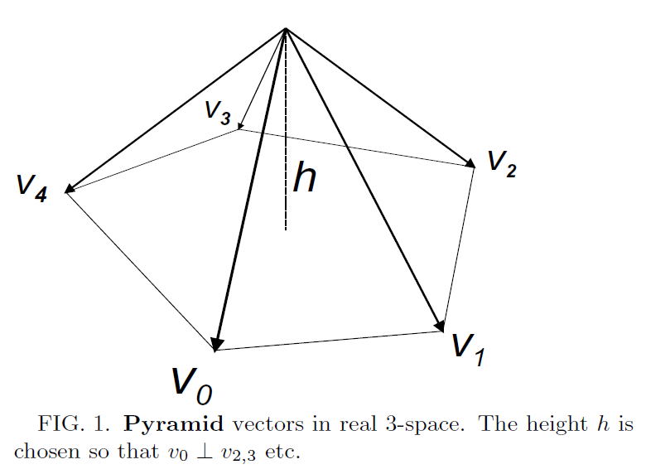
Pyramid for Progress and Quality

Slide 22
Examples of unextendable product bases from Bennett, DiVincenzo, Mor, Shor, Smolin and Terhal,Phys. Rev. Lett. 1999
ded

Slide 23
Examples of UPB (contd.)

Slide 24
Completely entangled spaces in general case
Nolan R. Wallach, AMS Contemp. Math. 305 (2002).
K.R. Parthasarathy, Proc. Indian Acad. Sci. 2004.

Slide 25
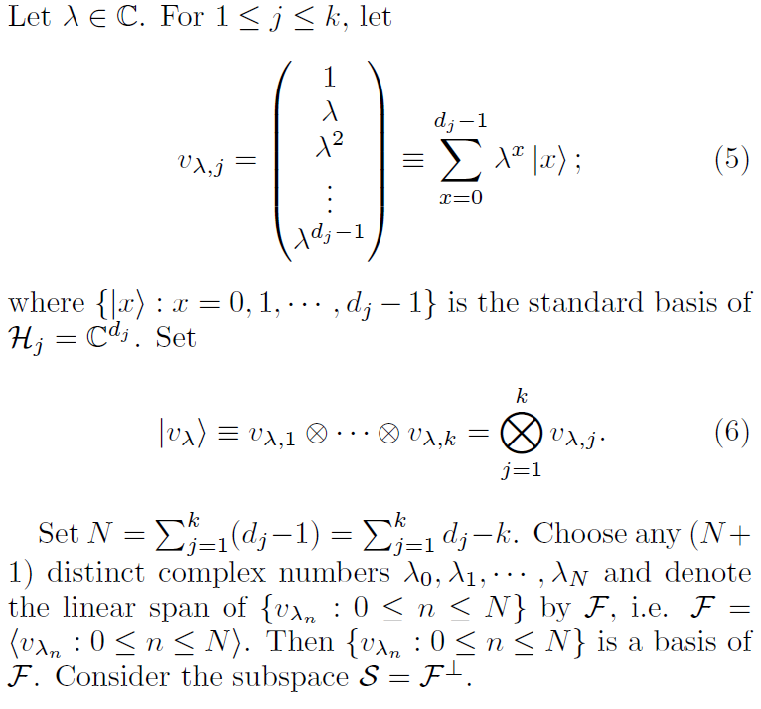

Slide 26
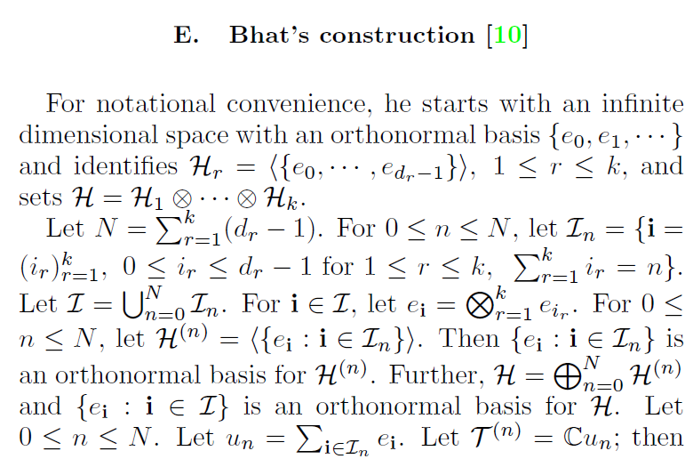

Slide 27
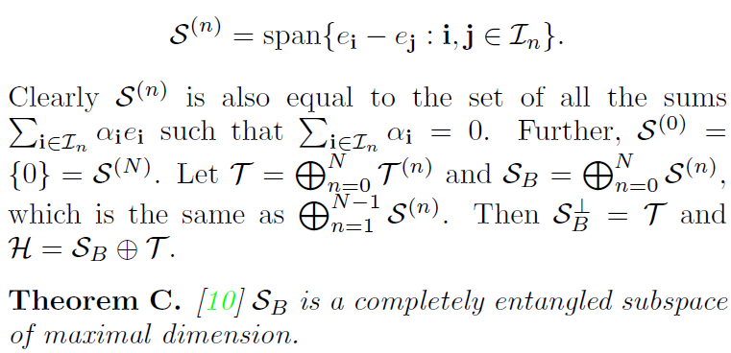

Slide 28
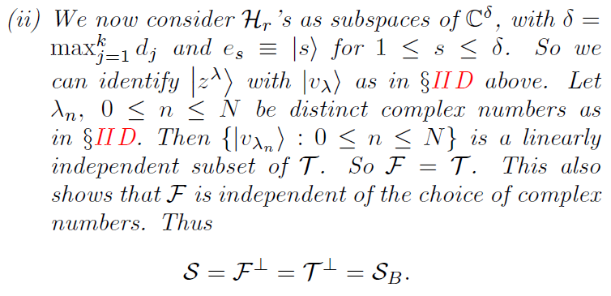
B.V.R. Bhat, Int. J. Quantum Inform. 2006

Slide 29
Jai OTOA 2014 workshop and Jai Hari Bercovici’s Lectures
While attending the lecture, it just occurred to me that we can make the multivariable polynomial in k variables
t-sub- i =product of the monomials t-sub-r raised to i-sub-r correspond to the vector e-sub-i. This enables us to identify script H-sup-(n) with the space of multivariable polynomials in k variables that are homogeneous of degree n with the restriction that the power of t-sub-j cannot exceed (d-sub-j )- 1. Further script H can be identified with such restricted multivariable polynomials of degree up to N. A product vector will then be a product of k polynomials, the j-th one being a polynomial in t-sub-j of degree not more than (d-sub-j )- 1. A vector in the space at n-th level of Bhat’s completely entangled space is such a homogeneous polynomial of degree n vanishing at (1,1,…,1).

Slide 30
Input from Preeti Parashar
The famous quantum marginal problem concerns about compatibility of the reduced density matrices (RDMs), i.e., given a set of RDMs whether there exists a global quantum state having these reductions. This is known as N-representability problem in quantum chemistry and has a cherished literature dating back to Coleman (1976). The latest breakthrough was by Alexander Klyachko (2007)..

Slide 31
There is a simpler problem of the same spirit : to determine a state from its marginals
i.e. if a given density matrix can be determined (uniquely among all possible states) from its RDMs, and if yes, what is the minimum order of the reductions. Surprisingly, almost all pure states can be determined by the RDMs of about half the number of the parties [1]. Indeed except the general GHZ states, viz., |GHZ>=a|00...0>+b|11...1>,
every n-qubit pure state is determined by its (n-1)-party reductions [2,3].

Slide 32
But there are interesting states which require less number of parties (and also less number of marginals), like the W states
which are determined by only bipartite marginals (although it is a genuinely entangled state) [4,5]. This fact about pure states shows that they are totally different from the classical probabilities (indeed there is no analogue for pure states in classical probability theory), which are generically not determined from marginal distributions. 1. Jones and Linden, PRA 71, 012324 (2005)
2. Walck and Lyons, PRL 100, 050501 (2008)
3. Feng, Duan, and Ying, QIC Vol. 9, No. 11&12 (2009) 0997–1012
4. Parashar and Rana, PRA 80, 012319 (2009)
5. Rana and Parashar, PRA 84, 052331 (2011)

Slide 34
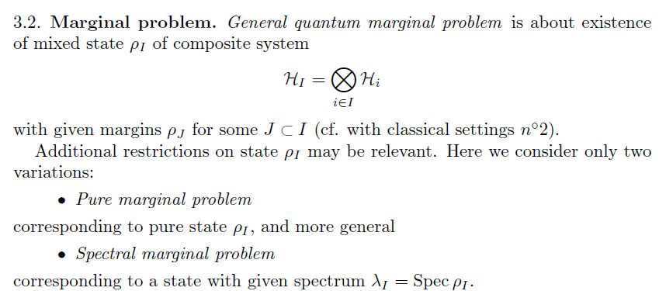
Klyachko’s insight and hard work
He uses and further develops Schubert Calculus and Spectral Theory to
handle this. I simply state a result like a newsreader rather than a
mathematician for a change.

Slide 35
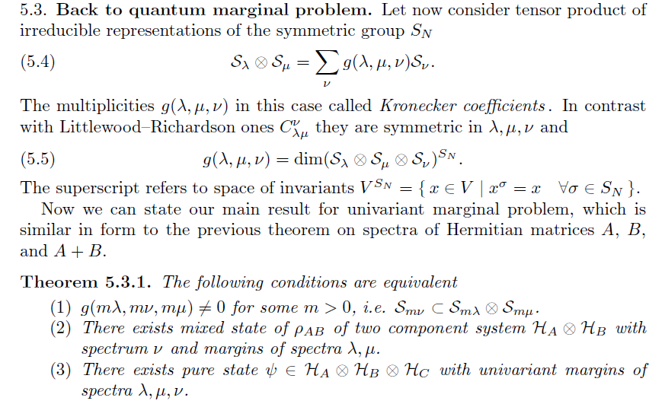
Main result

Slide 36
These four lectures constitute a good companion to Hari Bercovici’s illustrative talks, in the spirit of Quantum Information Theory, particularly the Quantum Marginal Problem. So does an interesting talk by Dan Timotin. I am telling you my future Homework rather than telling you the contents! Same holds for Multipartite Quantum States and their Marginals, Michael Walter’s thesis on Arxiv .

Slide 37
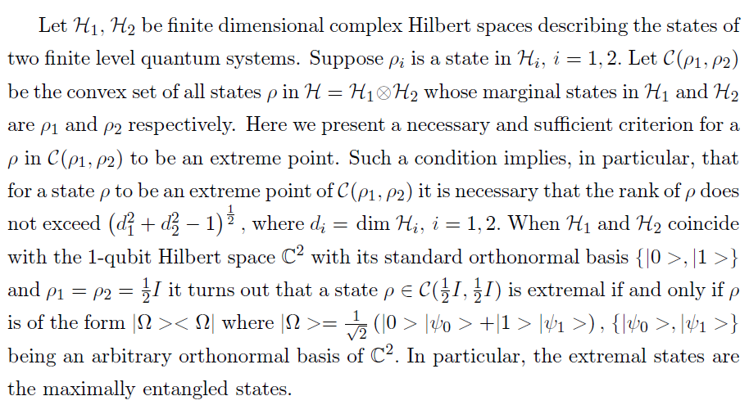
Extremal Quantum States in Coupled System by K.R. Parthasarathy Annales de l'institut Henri Poincaré (B) Prob. et Statistiques 2005

Slide 38
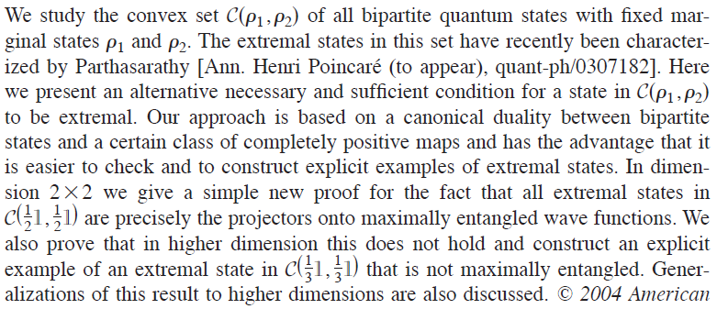
J. Math. Phys. Nov. 2004
E.A. Carlen, J.L. Lebowitz and H. Lieb (J. Math. Phys. 2013 and K.R. Parthasarathy
(his recent papers on ArXiv) have their favourite questions on existence of a
Tripartite density matrix with given consistent bipartite partial traces, BUT

Slide 39
I part with partial traces problems after a few more lines
What is the difference between
A rocket and the moon,
A bat and a ball,
A laptop and its mouse,
a room and a hall?
In their extreme points or faces,
thus roles big or small.

Slide 40
Entanglement properties of positive operators with
Physical Review A , Dec. 2014

Slide 41
Partial transpose at level j, denoted by
, otherwise

Slide 42
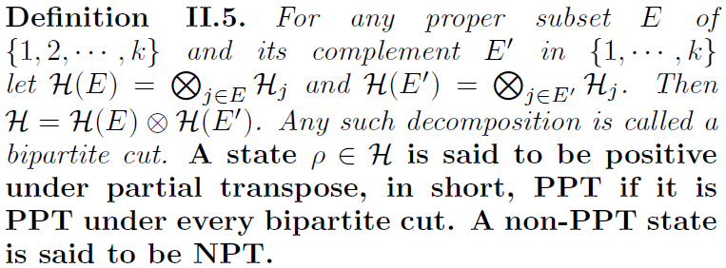

Slide 43
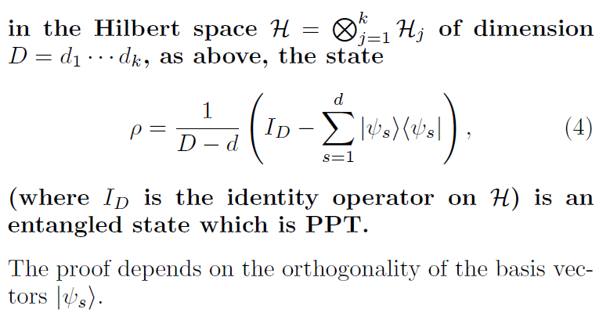
A Key Theorem on PPT Entangled Projection by Bennett et al

Slide 44
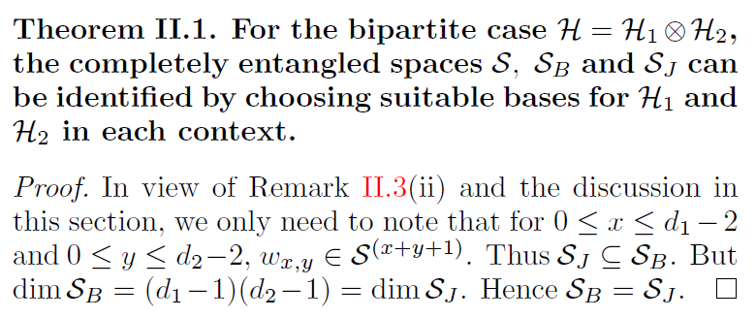
A contrast : Johnston’s construction

Slide 45
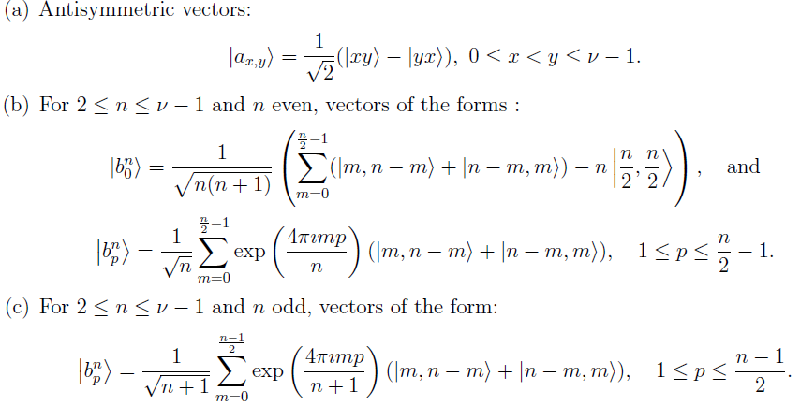
Parthasarathy’s orthonormal basis : Five types of vectors

Slide 46
Basis-continued

Slide 47
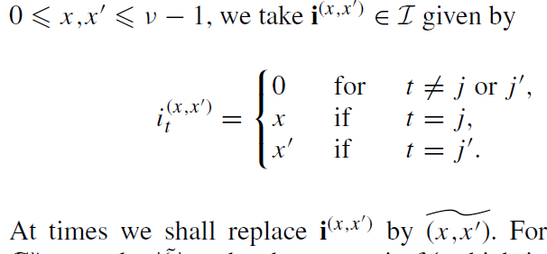
Orthonormal basis for S (general case)

Slide 48
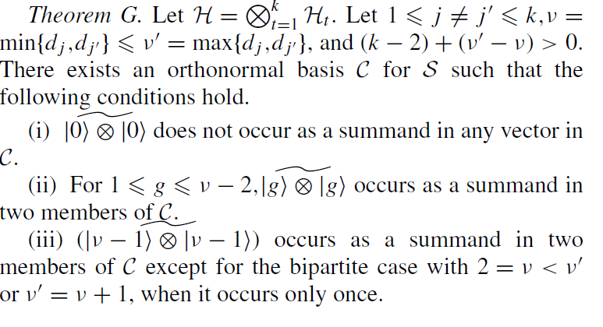

Slide 49
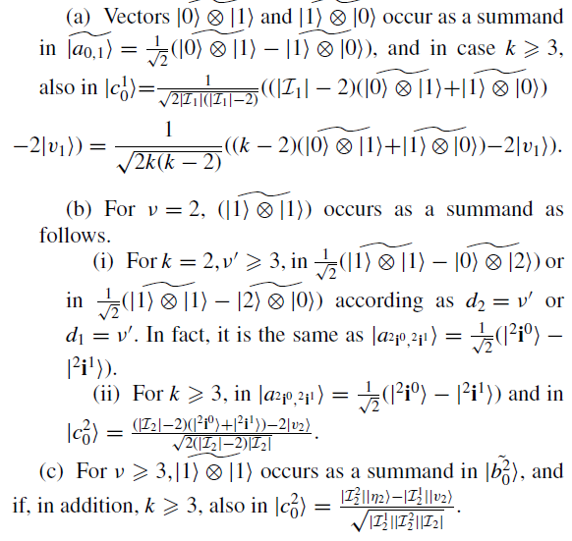
Theorem continued

Slide 50
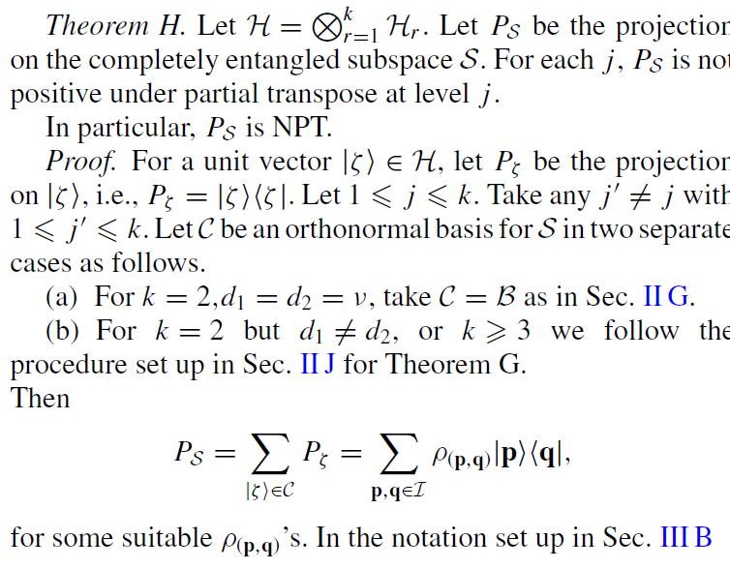
Main Theorem

Slide 51
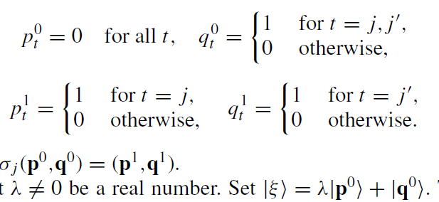
Le

Slide 52
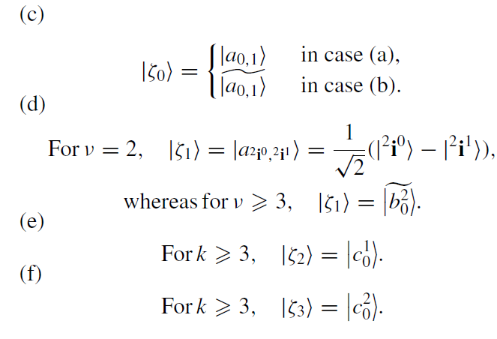
Proof continued

Slide 53
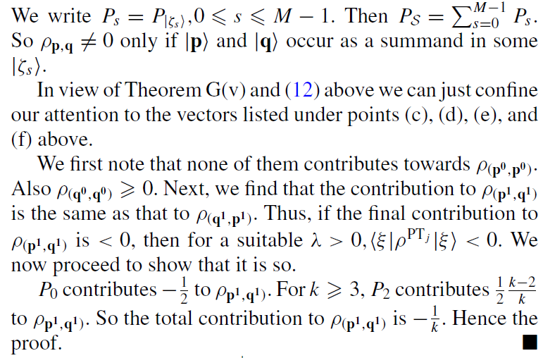
Proof continued

Slide 54
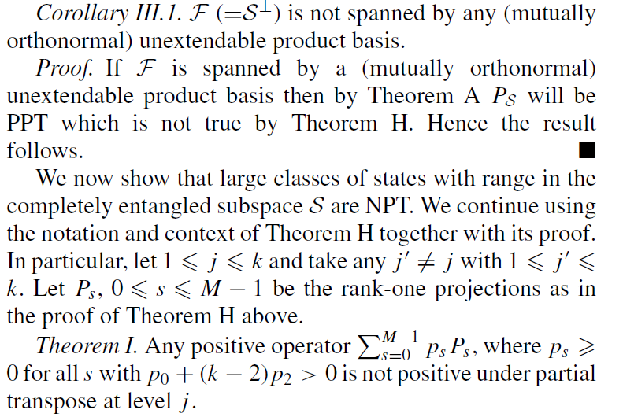
Further use

Slide 55
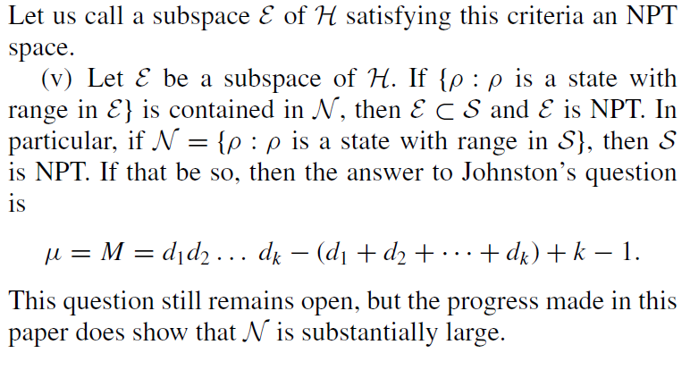
Johnston’s question and our attempt
?
Thank you

